Slide 1
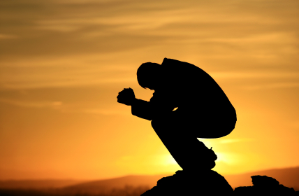
The Uprightness and Perfection of David
1 Kings 9:4
1 Kings 11:4

Slide 2
Terms Defined
UPRIGHT: Honest, Just
PERFECT: To make perfect or more nearly perfect according to a given standard, as by training. The act or process of perfecting.
One who has attained his moral end, the goal for which he was intended – to be obedient in Christ
Matthew 5:48

Slide 3
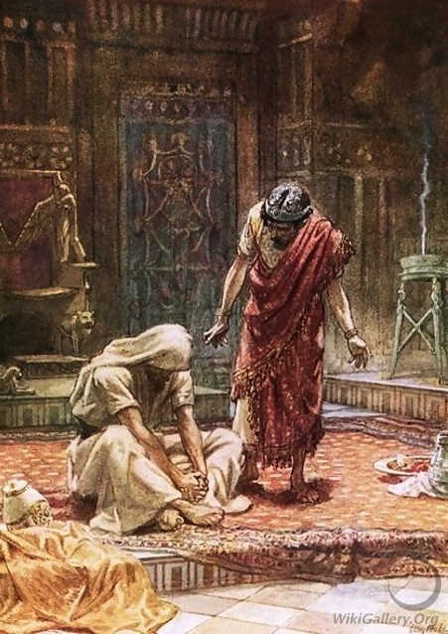
The Sin of David
Bathsheba
2 Samuel 11:2-5
Uriah
2 Samuel 11:14-17
“man after God’s own heart”
Committed adultery
Planned a man’s murder
Later said to be “upright and perfect!

Slide 4
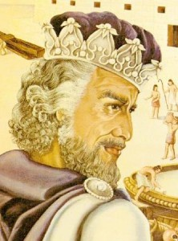
Others Sinned – but most were not Upright and Perfect as David
Solomon
1 Kings 3:3; 1 Chronicles 28:9; 1 Kings 11:4,6
Abijam
1 Kings 15:3
Asa
1 Kings 15:11-14
Amaziah
2 Kings 14:3

Slide 5
Others Sinned – but most were not Upright and Perfect as David
Ahaz
2 Kings 16:2
Hezekiah
2 Kings 18:3
Josiah
2 Chronicles 34:2-3

Slide 6
Why Was David the Model?
His heart was set on serving the Lord
Nathan sent to point out David’s error
2 Samuel 11:27-12:7
David recognized his sin and repented
2 Samuel 12:13
He still had to pay the consequences
2 Samuel 12:14-23
Did not blame God – He worshiped God!

Slide 7
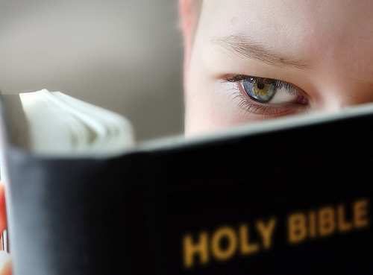
The “Perfect” Heart
Heart set on serving God in every manner of one’s life!
Hezekiah
2 Kings 20:3
The People
1 Chronicles 29:9
David
1 Kings 14:8; 1 Kings 15:5; Psalms 101:2

Slide 8
The Uprightness and Perfection of David
Are we walking uprightly with a “perfect” heart?
Philippians 3:15
2 Corinthians 7:10
Be determined to be steadfast in the Lord!
1 Corinthians 15:58

