Slide 1
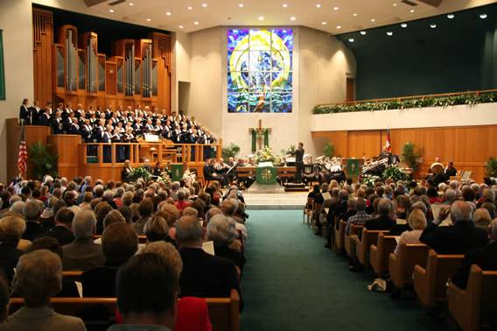
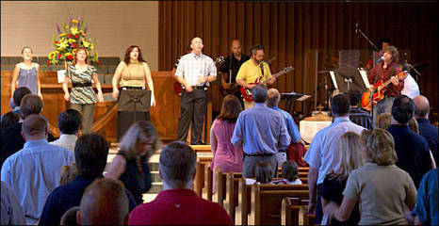
Unacceptable Worship to God
Exodus 20:1-6
Richie Thetford www.thetfordcountry.com

Slide 2
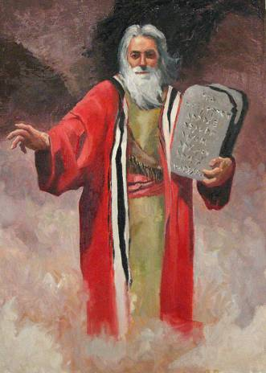
One Can Worship the Wrong God
This happened in the Old Testament times
“Now when the people saw that Moses delayed coming down from the mountain, the people gathered together to Aaron, and said to him,“ Come, make us gods that shall go before us; for as for this Moses, the man who brought us up out of the land of Egypt, we do not know what has become of him.”
Exodus 32:1
Richie Thetford www.thetfordcountry.com

Slide 3
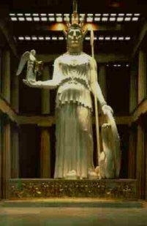
One Can Worship the Wrong God
This happened in early New Testament times
“….Professing to be wise, they became fools, and changed the glory of the incorruptible God into an image made like corruptible man — and birds and four-footed animals and creeping things.” Romans 1:20-23
Richie Thetford www.thetfordcountry.com

Slide 4
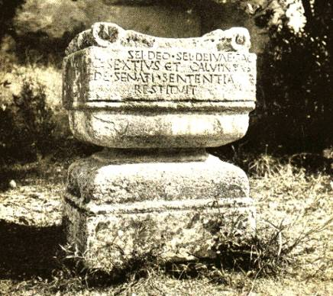
One Can Worship the Wrong God
At Athens, they were worshiping many gods, to include an “unknown god”
The above altar is located on Palatine Hill, Rome, where once stood the palaces of the Caesars. It dates from about 100 B.C. and has the inscription, ´To the unknown God.´
Richie Thetford www.thetfordcountry.com

Slide 5
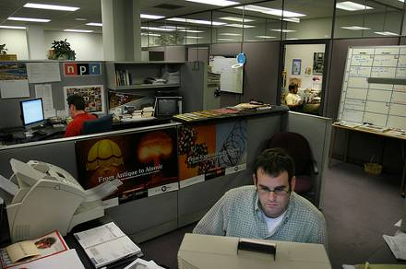
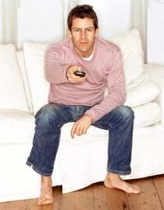
One Can Worship the Wrong God
Today, man continues to worship the wrong God of their life
Television
Jobs or Hobbies
“But seek first the kingdom of God and His righteousness, and all these things shall be added to you.” (Matthew 6:33)
Richie Thetford www.thetfordcountry.com

Slide 6
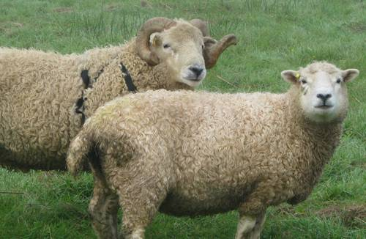
Right God with Wrong Authority
Malachi 1:6-8 Leviticus 22:19-25
Offering that which had no “market value” in sacrifice to Jehovah!
2 Corinthians 5:21
Richie Thetford www.thetfordcountry.com

Slide 7
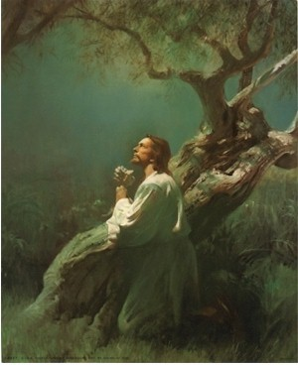
Right God with Wrong Authority
Today we are to “Worship in spirit and in truth”
John 4:23-24;
1 Peter 2:5
We must act by Christ’s authority
Colossians 3:17
Matthew 15:8-9
2 John 9-11
Matthew 17:5 Acts 3:22-23
Richie Thetford www.thetfordcountry.com

Slide 8
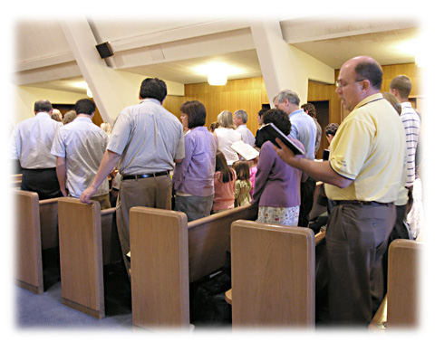
The Lord’s Day Worship
Our Lord’s Day worship consists of:
Lord’s Supper
Acts 20:7
Singing
Ephesians 5:19
Giving
1 Corinthians 16:1-2
Praying
2 Thessalonians 5:17
Teaching
2 Timothy 4:2
Richie Thetford www.thetfordcountry.com

Slide 9
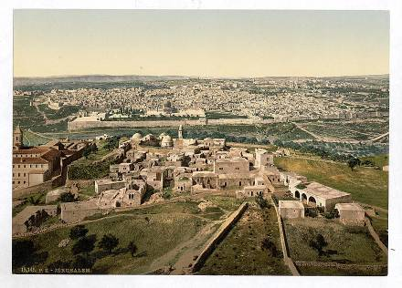
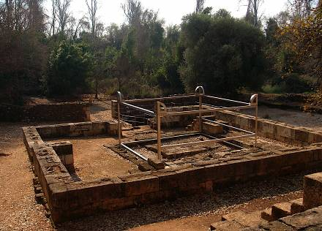
Worship the Right God in the Wrong Place
Jerusalem was the right place for the Jews
Jeroboam set up alters at Bethel and Dan
1 Kings 12:27-29 John 4:19-20
Richie Thetford www.thetfordcountry.com

Slide 10
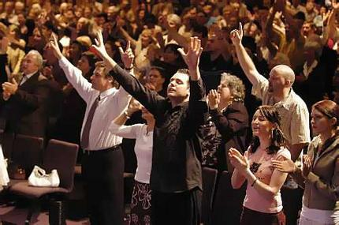
Worship the Right God in the Wrong Place
Men and women today attempt to worship God in the “wrong places”
Meaning “wrong relationship”
Matthew 15:13
Matthew 15:8-9
1 Peter 3:12
John 10:16
Richie Thetford www.thetfordcountry.com

Slide 11
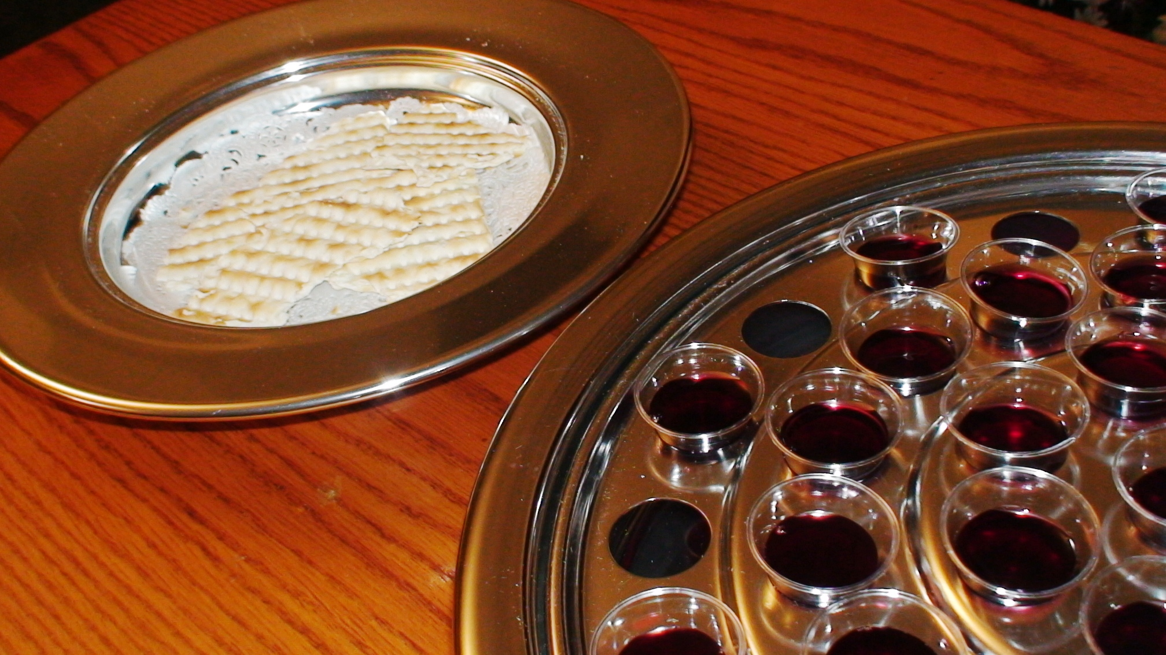
Worship the Right God, by the Right Authority, in the Right Place, and Still NOT Worship God Acceptably!
How is this possible?
By NOT discerning the Lord’s body and blood in communion
1 Corinthians 11:28-29
Richie Thetford www.thetfordcountry.com

Slide 12
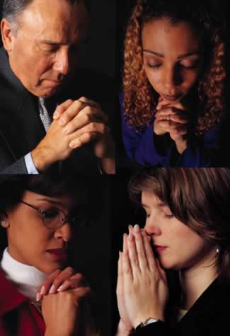
Worship the Right God, by the Right Authority, in the Right Place, and Still NOT Worship God Acceptably!
How is this possible?
By NOT meaning and understanding what one sings and prays
1 Corinthians 14:15
Richie Thetford www.thetfordcountry.com

Slide 13
Worship the Right God, by the Right Authority, in the Right Place, and Still NOT Worship God Acceptably!
How is this possible?
By NOT giving cheerfully and bountifully as one has been prospered
2 Corinthians 9:7
Richie Thetford www.thetfordcountry.com

Slide 14
Worship the Right God, by the Right Authority, in the Right Place, and Still NOT Worship God Acceptably!
How is this possible?
By failing to be a proper listener intending to do the will of Christ
James 1:22-25
James 2:14-26
Richie Thetford www.thetfordcountry.com

Slide 15
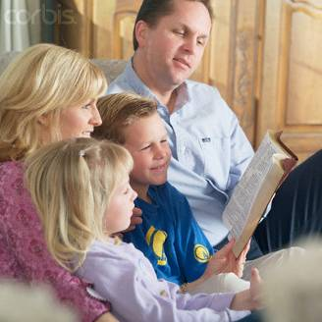
CONCLUSION
Are you a true worshiper of God?
John 4:24
It’s easy to follow the crowd and our own personal feelings
What will our final sentence be?
Our worship to God will determine the answer
Richie Thetford www.thetfordcountry.com

