Slide 1
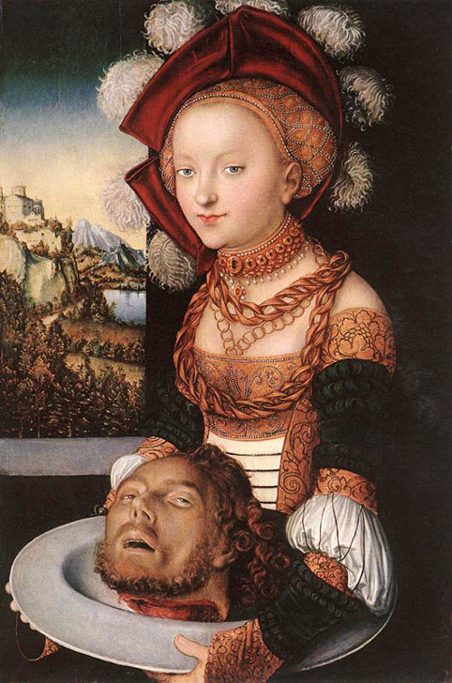
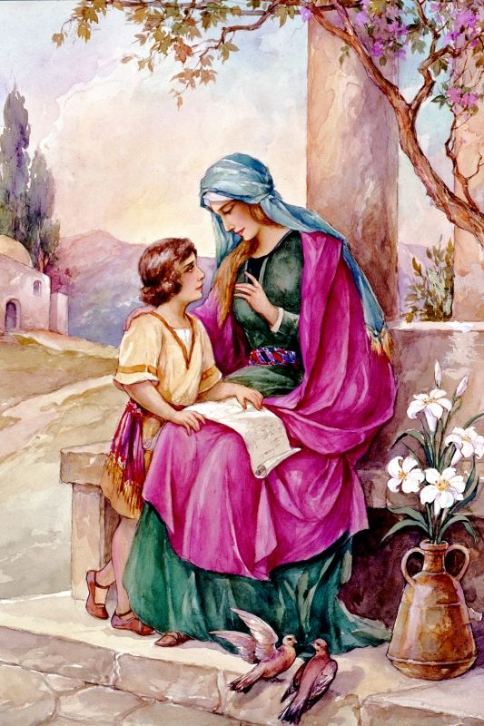
Two Mothers,
Two Influences
Herodias
and
Eunice

Slide 2
Wicked Herodias
Daughter – Salome
  Mark 6:17-28
Marital fidelity not important (17-18)
Evil conspiracies (19, 21)
Pervert wholesome attraction (22)
Immodesty acceptable (24-28)
Manipulation is acceptable (24-28)

Slide 3
Godly Eunice
Son – Timothy
Younger women need older women
  2 Timothy 1:5
Children are a heritage from the Lord
  Psalms 127:3
  Proverbs 22:6
Bad circumstances can be overcome
  Acts 16:1,3

Slide 4
Godly Eunice
Son – Timothy
Scriptures are important
  2 Timothy 3:14-16
  1 Timothy 4:6
Godly children bring delight to the soul
  Acts 16:1-2
  Proverbs 29:17

Slide 5
Godly Mothers Are Special
Never leaves her first love
  Help meet for her husband
  Submits to her husband
  Stands with her husband
  Husband trusts in her
Cherishes all there is to being a mom
  Trains her children in the laws of God
  Wants her children to love God first
  Her children honor her

Slide 6
Conclusion
Godly mothers are a great example for her children and husband
  Proverbs 31:28-29
What makes a mother so special?
She is the one who exemplifies the qualities that pleases
our heavenly Father!

