Slide 1
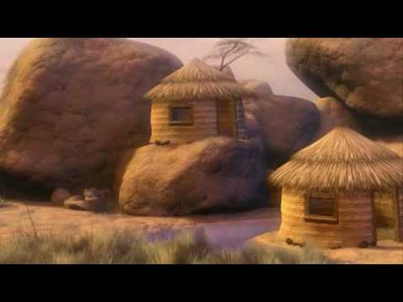
Two Builders
Matthew 7:24-29
Richie Thetford www.thetfordcountry.com

Slide 2
Everyone Is A Builder
The wise man and foolish man
Terrain of Palestine
We are all going to build on a foundation
2 Timothy 2:19
1 Timothy 6:19
Richie Thetford www.thetfordcountry.com

Slide 3
The Wise Builder
Founded upon a rock
Must follow directions
Must “hear” and be a “doer”
Hear:
Romans 10:17; 2 Timothy 2:15
Do:
Matthew 7:21; Genesis 4:4; 2 Kings 22:2; 2 Timothy 4:7
Richie Thetford www.thetfordcountry.com

Slide 4
Build On A Rock
Old Testament – Deity
Deuteronomy 32:4
Isaiah 28:16
New Testament – Christ
Matthew 16:13-18
2 Timothy 2:19
Ephesians 2:20
Richie Thetford www.thetfordcountry.com

Slide 5
The Foolish Builder
Heard the truth but didn’t put it into practice
Luke 8:12
1 Corinthians 15:2
James 1:22
Looks for an easy way out
Amos 6:1
Richie Thetford www.thetfordcountry.com

Slide 6
Two Builders
We are all going to build on a foundation
Matthew 7:24-29
FIRM or Weak?
Richie Thetford www.thetfordcountry.com

