Slide 1

“True” Disciples of Christ
Mark 8:34-38
Richie Thetford www.thetfordcountry.com

Slide 2

Deny Yourself
Submit to the guidance of Jesus
in mind, body, and soul
  1 Corinthians 6:19-20
ASK:
“What would Jesus do?”
Richie Thetford www.thetfordcountry.com

Slide 3


Take Up Your Cross
Living as Jesus taught
  Romans 6:6-8
  Galatians 2:20
Give up the old way of life
  2 Corinthians 5:17
  Colossians 3:5-17
  1 Peter 2:9
  Titus 2:14
Richie Thetford www.thetfordcountry.com

Slide 4

Follow Me
Head in the Lord’s direction
  Jeremiah 10:23
  John 14:6
  John 15:5
We can do so successfully
  Must be a “full-time” Christian
Richie Thetford www.thetfordcountry.com

Slide 5
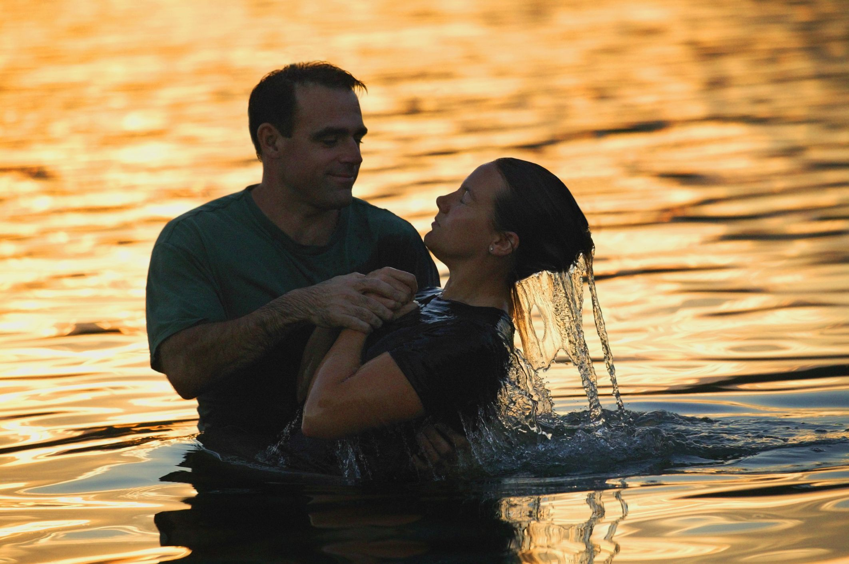
Baptism:
A resurrection to a new life!
Romans 6:3-8
Richie Thetford www.thetfordcountry.com

