Slide 1
Troubled Hearts
John 14:1-6
Richie Thetford www.thetfordcountry.com

Slide 2
He Will Never Leave Us
Troublesome times will come
Philippians 4
Psalms 55:22
Times of adversity are not always harmful
Richie Thetford www.thetfordcountry.com

Slide 3
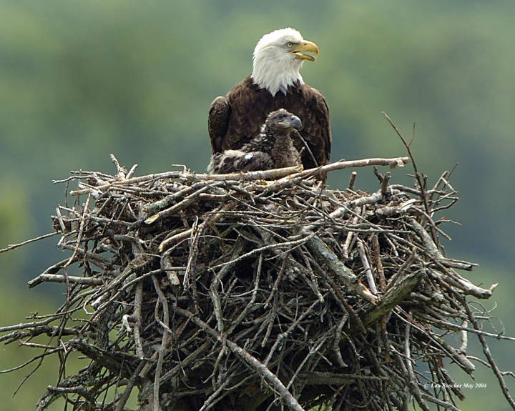
Lessons Learned From Eagles
God does not cause troubled times
Isaiah 40:27-31
1 Peter 1:7
James 1:2-4
God provides a way of escape
1 Corinthians 10:13
Richie Thetford www.thetfordcountry.com

Slide 4
Place Our Trust in God
Believe in Jesus ….. Trust in God
John 14:1
God will supply our needs
Philippians 4:19
Richie Thetford www.thetfordcountry.com

Slide 5
Never Lose Hope
Jesus provides us great hope!
John 14:2-3
We have a “life after life”
1 Corinthians 15:50-58
Biblical hope is a confident expectation!
Richie Thetford www.thetfordcountry.com

Slide 6
Conclusion
Sometimes we must be shaped by the encouragement of God
Troubled Heart promises can be ours!
John 14:6
Make Jesus your way, your truth, and your life!
Richie Thetford www.thetfordcountry.com

