Slide 1
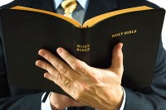
Timothy
Richie Thetford www.thetfordcountry.com

Slide 2

Timothy
Apostle Paul spoke highly of him
  Philippians 2:19-24
Well spoken as a follower of Christ
  Acts 16:1
Trained early in life
  2 Timothy 1:5
  2 Timothy 3:14-15
Richie Thetford www.thetfordcountry.com

Slide 3
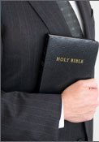
Timothy
“His Personality”
Paul asked that no one despise him
  1 Corinthians 16:10-11
  1 Timothy 1:2
  1 Timothy 4:12
  2 Timothy 1:7
A “true son in the faith”
Richie Thetford www.thetfordcountry.com

Slide 4

Timothy
“His Assignments”
Commanded to teach
  1 Timothy 4:11-16; 1:3-5; 4:6
Reminded the rich – riches would pass
  1 Timothy 6:17
Guard things committed to him
  1 Timothy 6:20-21
Richie Thetford www.thetfordcountry.com

Slide 5
Timothy
Willing, eager, faithful student
Listened to authority and did what was pleasing to God
Sincere and obedient
He Served God!
We must serve God
with all our heart, mind, and soul
Richie Thetford www.thetfordcountry.com

