Slide 1
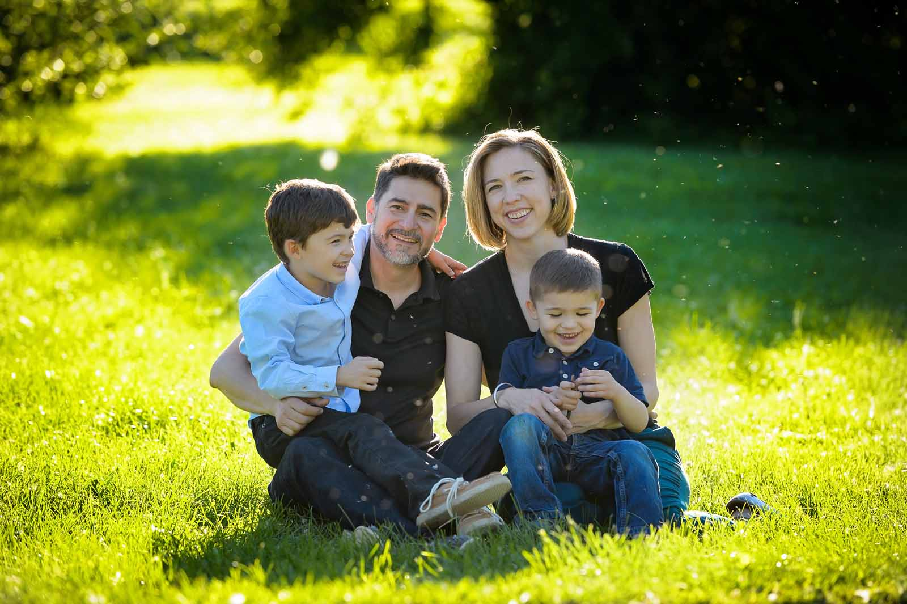
Things Our Children Must Know
Proverbs 22:6
Ephesians 6:4
Richie Thetford www.thetfordcountry.com

Slide 2

Things Our Children Must Know
They are a special creation of God
  Genesis 1:26-27
  Psalms 139:14
They are unconditionally loved
  Titus 2:3-4
  John 15:13
  1 John 3:16-18
Richie Thetford www.thetfordcountry.com

Slide 3
Things Our Children Must Know
The truly important things in life cannot be bought
  Job 1:21
  Luke 12:15-21
Choices have consequences
  Numbers 32:23
  Ecclesiastes 11:9-10
  Deuteronomy 6:24-25
Richie Thetford www.thetfordcountry.com

Slide 4
Things Our Children Must Know
There is right and wrong
  Matthew 7:13-14
  Ephesians 6:1-3
  1 Peter 3:17
Courage is a must
  1 Corinthians 15:33
  1 Timothy 4:12
Richie Thetford www.thetfordcountry.com

Slide 5
Things Our Children Must Know
Human life is sacred
  Genesis 1:26-27; 9:5-6
  Matthew 7:12
Hard work is worth it
  Ecclesiastes 9:10
  Colossians 3:22-24
Richie Thetford www.thetfordcountry.com

Slide 6
Things Our Children Must Know
Marriage is for life
  Genesis 2:24
  Matthew 19:4-6
  Romans 7:12
  Hebrews 13:4
Richie Thetford www.thetfordcountry.com

Slide 7
Things Our Children Must Know
God is their center in EVERYTHING. God takes priority
  Exodus 20:3
  1 Chronicles 28:9
  Proverbs 1:7
  Ecclesiastes 12:13-14
Teach, Heed, and Do
Richie Thetford www.thetfordcountry.com

