Slide 1
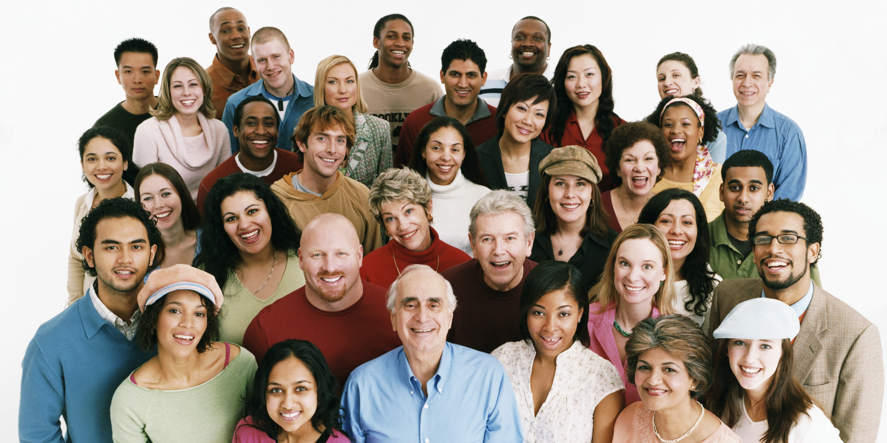
Things Happy People Do
Richie Thetford www.thetfordcountry.com

Slide 2

Things Happy People Do
Express gratitude
  1 Timothy 6:7-8
  Hebrews 13:5
Cultivate optimism
  2 Corinthians 4:7-10
Avoid social comparison
  2 Corinthians 10:12
Richie Thetford www.thetfordcountry.com

Slide 3

Things Happy People Do
Things Happy People Do
Practice acts of kindness
  Galatians 5:22-23
  Ephesians 4:32
Nurture social relationships
  Philippians 2:19-20
  Philippians 4:10
Develop strategies for coping
Richie Thetford www.thetfordcountry.com

Slide 4
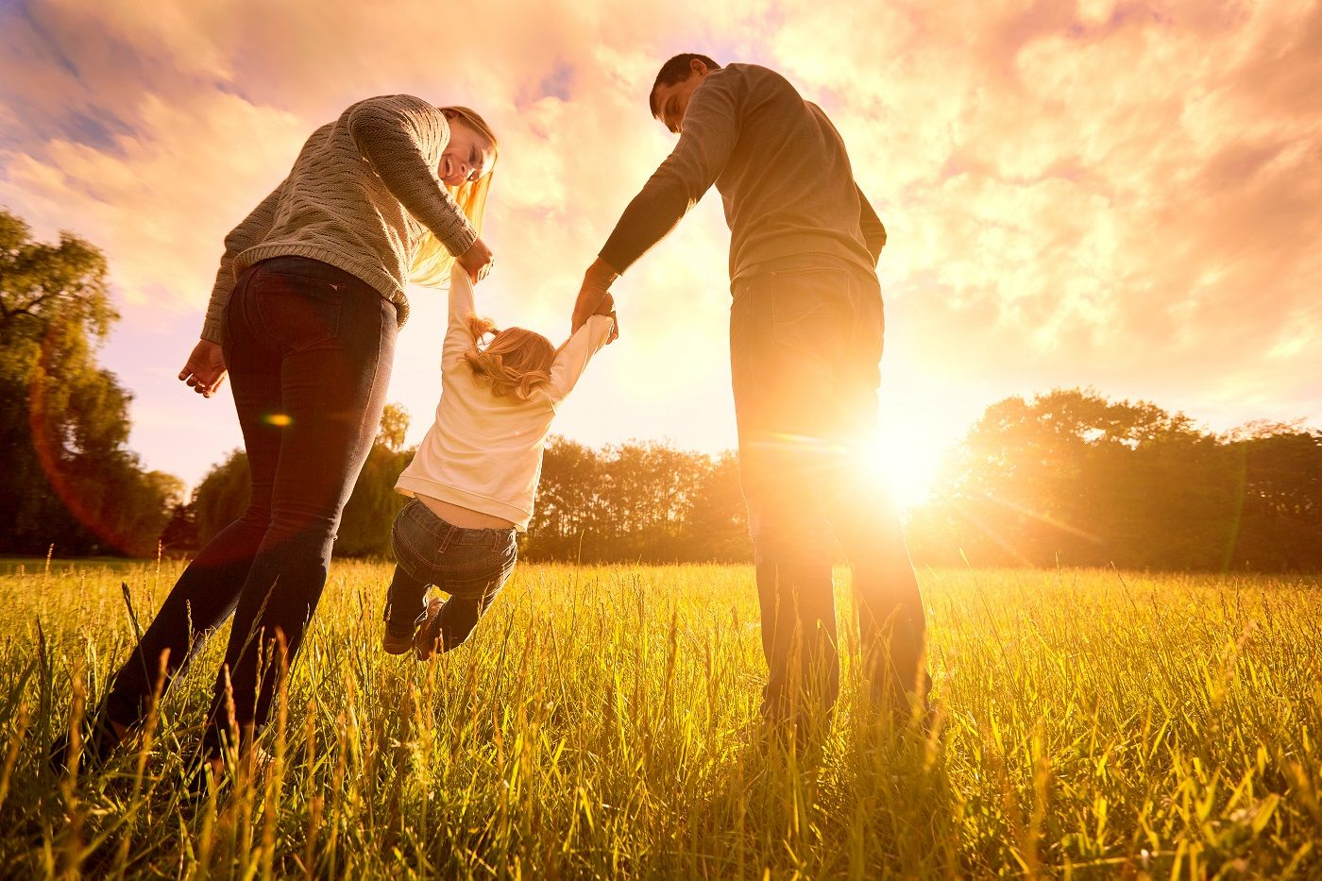
Things Happy People Do
Learn to forgive
  Matthew 6:14-15
Increase flow experiences
  Matthew 6:24
Savor life’s joys
  Romans 12:15
Richie Thetford www.thetfordcountry.com

Slide 5
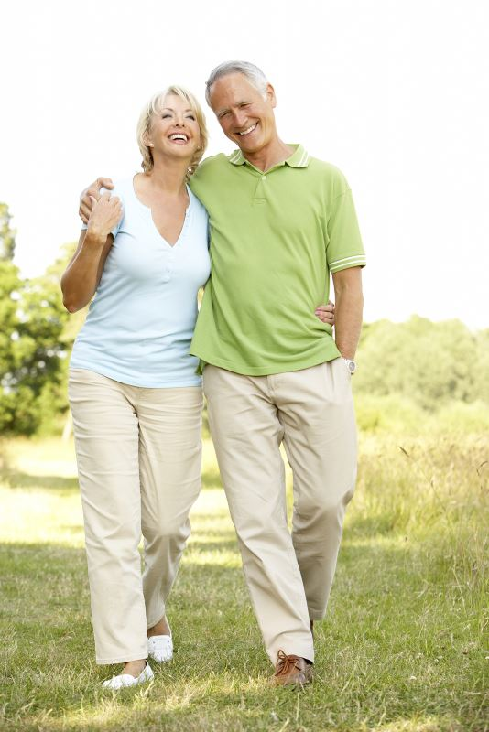
Things Happy People Do
Commit to our goals
  Philippians 3:13-14
Practice spirituality
  Romans 12:1-2; 1 Peter 5:5
Take care of our body
  1 Corinthians 6:12-20; 1 Timothy 4:6
Richie Thetford www.thetfordcountry.com

Slide 6

The happiest of all people are those who live for God in all things and are loving, caring, and forgiving of others
Things Happy People Do
Richie Thetford www.thetfordcountry.com

