Slide 1
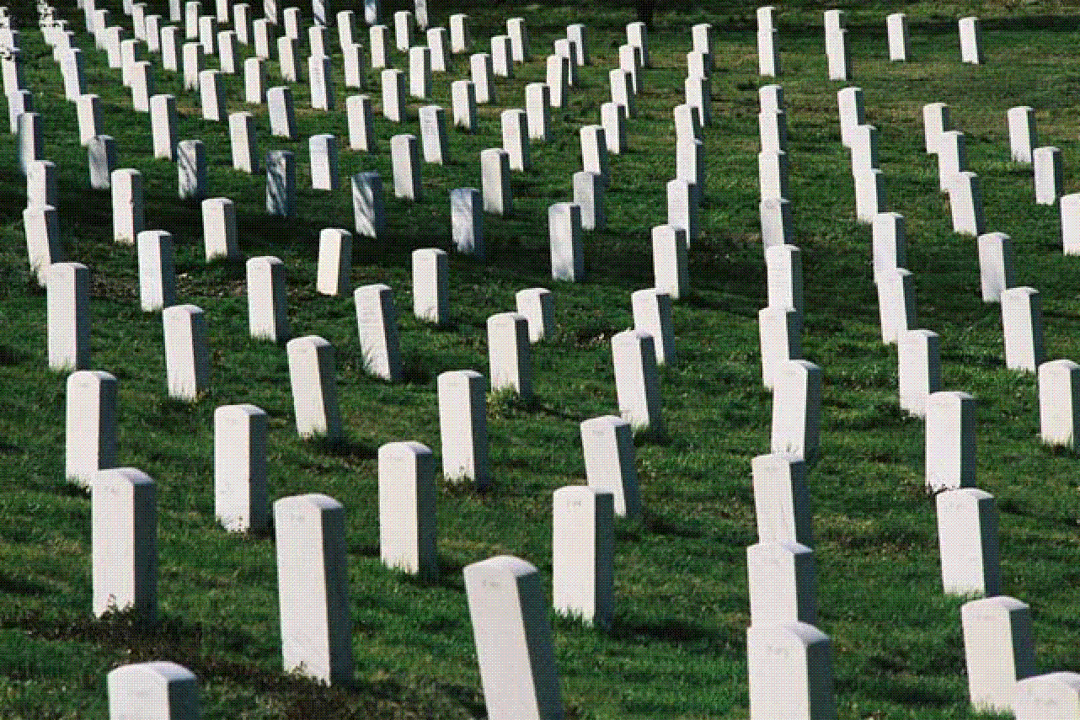
There's A Great Day Coming!
“Truly, these times of ignorance God overlooked, but now commands all men everywhere to repent, because He has appointed a day on which He will judge the world in
righteousness by the Man whom He has ordained. He has
given assurance of this to all by raising Him from the dead.”
Acts 17:30-31
Richie Thetford www.thetfordcountry.com

Slide 2
John 6:40 And this is the will of Him who sent Me, that everyone who sees the Son and believes in Him may have everlasting life; and I will raise him up at the last day.
John 6:44 No one can come to Me unless the Father who sent Me draws him; and I will raise him up at the last day.
John 6:54 Whoever eats My flesh and drinks My blood has eternal life, and I will raise him up at the last day.
There's A Great Day Coming!
Richie Thetford www.thetfordcountry.com

Slide 3
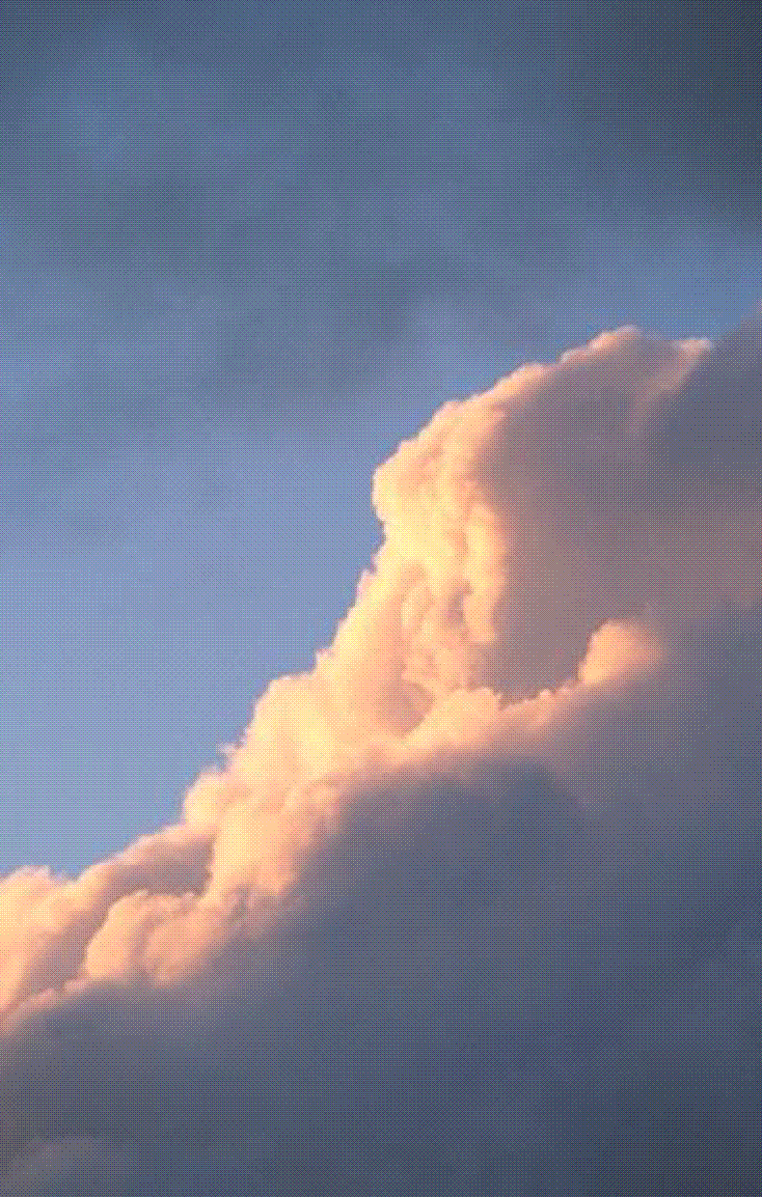
The Greatest Demonstration Ever Known
Lord will come with the trumpet of God
  1 Corinthians 15:52
  1 Thessalonians 4:16
Will come back with His mighty angels
  Matthew 25:31
  2 Thessalonians 1:7-9
Everything on earth will be destroyed
  2 Peter 3:10
Everyone will know it!
There's A Great Day Coming!
Richie Thetford www.thetfordcountry.com

Slide 4
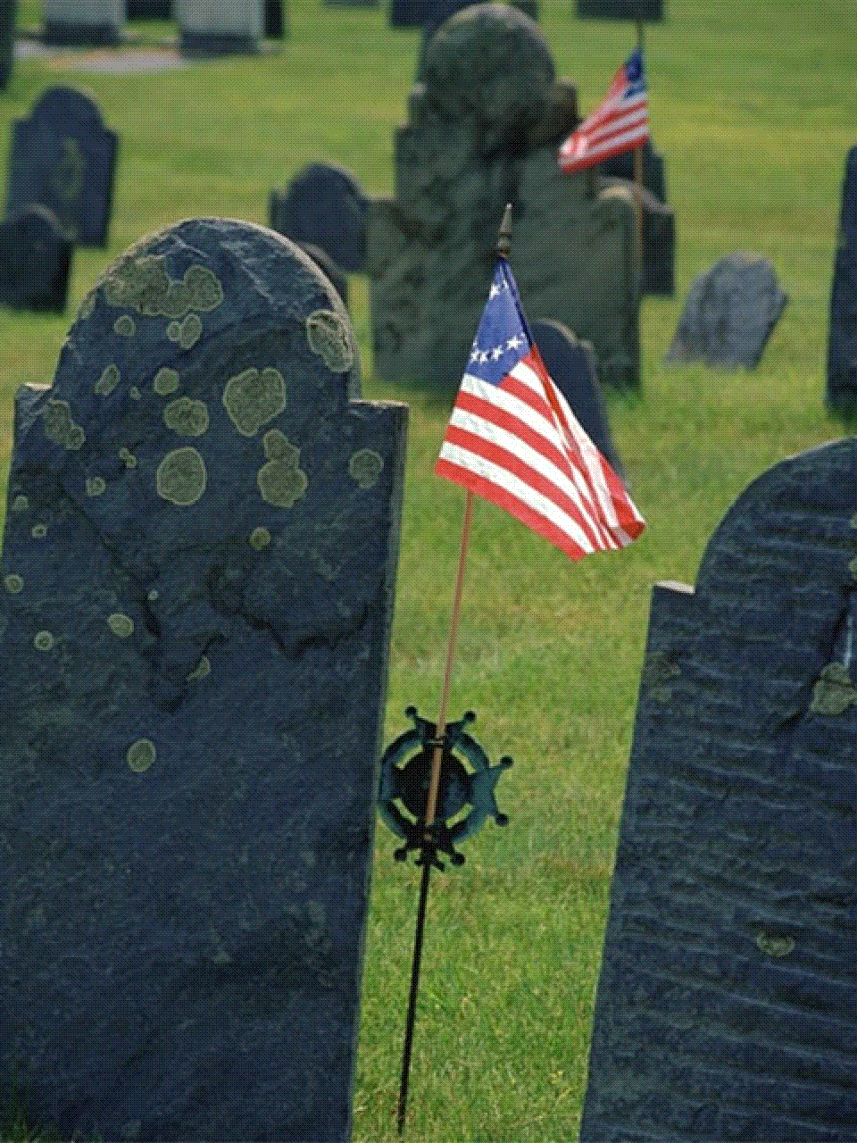
The Greatest Resurrection Will Occur
All the bodies will be raised
  John 5:28-29
Only one resurrection
  Acts 24:15
When Jesus returns
  1 Corinthians 15:52
  1 Thessalonians 4:15
We’re in the last age
  Hebrews 9:26-28
The great day will be the last day!
There's A Great Day Coming!
Richie Thetford www.thetfordcountry.com

Slide 5
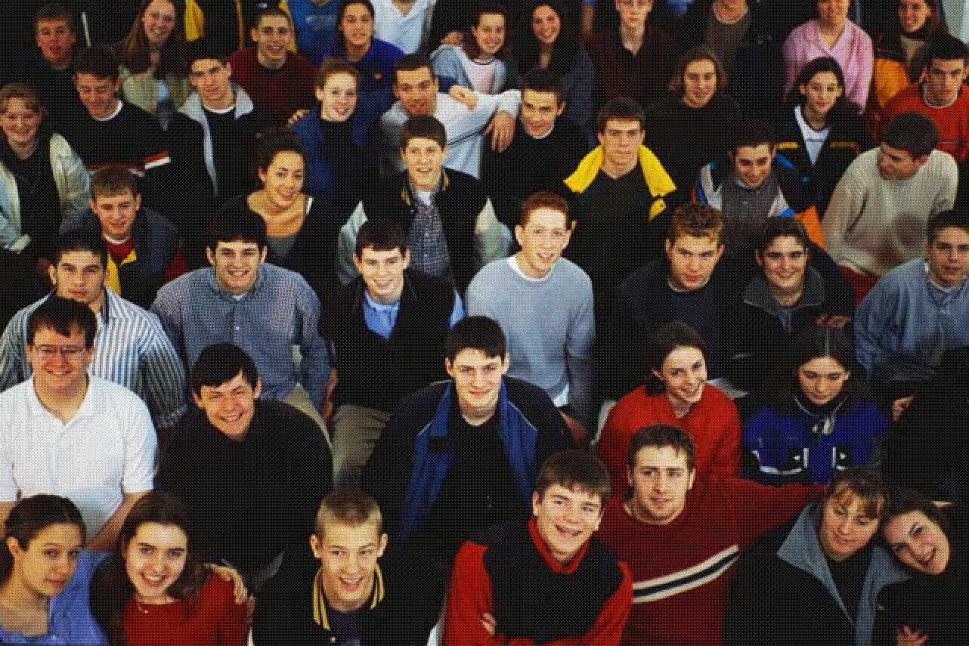
The Greatest Crowd Will Assemble
All men of all nations will be assembled
  Matthew 25:31-33
  2 Corinthians 5:10
  Romans 14:11-12
God will judge all according to works
  1 Peter 1:17
  Proverbs 1:7
There will be NO mistaken identity on that day!
There's A Great Day Coming!
Each one will receive justice on that day!
Richie Thetford www.thetfordcountry.com

Slide 6
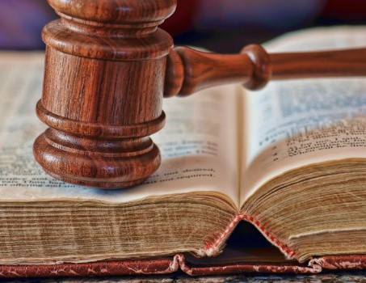
The Greatest Judge Will Preside
Jesus will judge all
  Acts 10:42
  John 12:48
Will occur at His second coming
  2 Timothy 4:1
There's A Great Day Coming!
Jesus will judge every man righteously!
Richie Thetford www.thetfordcountry.com

Slide 7

The Greatest Books Will Be Opened
All will be revealed concerning
each of us
  Revelation 20:11-12
His Words will NOT pass away
  Matthew 24:35
There's A Great Day Coming!
Have you obeyed its holy precepts?
John 6:29; Luke 13:3; Romans 10:9-10;
Acts 22:16; Hebrews 10:24-25
Richie Thetford www.thetfordcountry.com

Slide 8
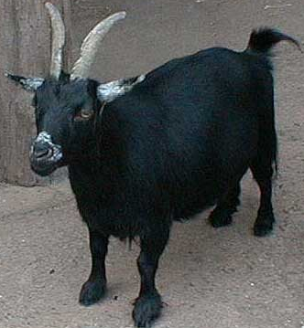
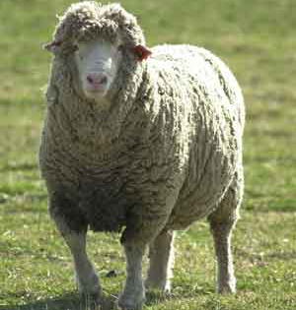
The Greatest Separation Will Occur
GOATS
SHEEP
There's A Great Day Coming!
Matthew 25:31-46
Richie Thetford www.thetfordcountry.com

Slide 9
The Greatest Verdict Will Be Handed Down
GOATS
SHEEP
There's A Great Day Coming!
Condemnation
Eternal Life
Matthew 25:41
Matthew 7:23
Mark 9:47-48
Matthew 25:21
Matthew 25:34
Richie Thetford www.thetfordcountry.com

Slide 10
Are You Ready For That Day?
There's A Great Day Coming!
For He says: “In an acceptable
time I have heard you, And in the day of salvation I have helped you." Behold, now is the accepted time; behold, now is the day of salvation.”
2 Corinthians 6:2
Richie Thetford www.thetfordcountry.com

