Slide 1

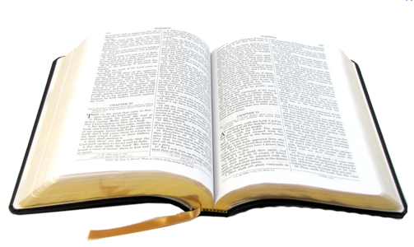
dd
Richie Thetford www.thetfordcountry.com

Slide 2

The Race Course
Must keep to the course
Must enter the race
  Matthew 7:13-14
Richie Thetford www.thetfordcountry.com

Slide 3

Preparing to Run
Prepare by practicing
For the Christian:
  Galatians 5:7
  Philippians 3:13
  Hebrews 12:1
Richie Thetford www.thetfordcountry.com

Slide 4
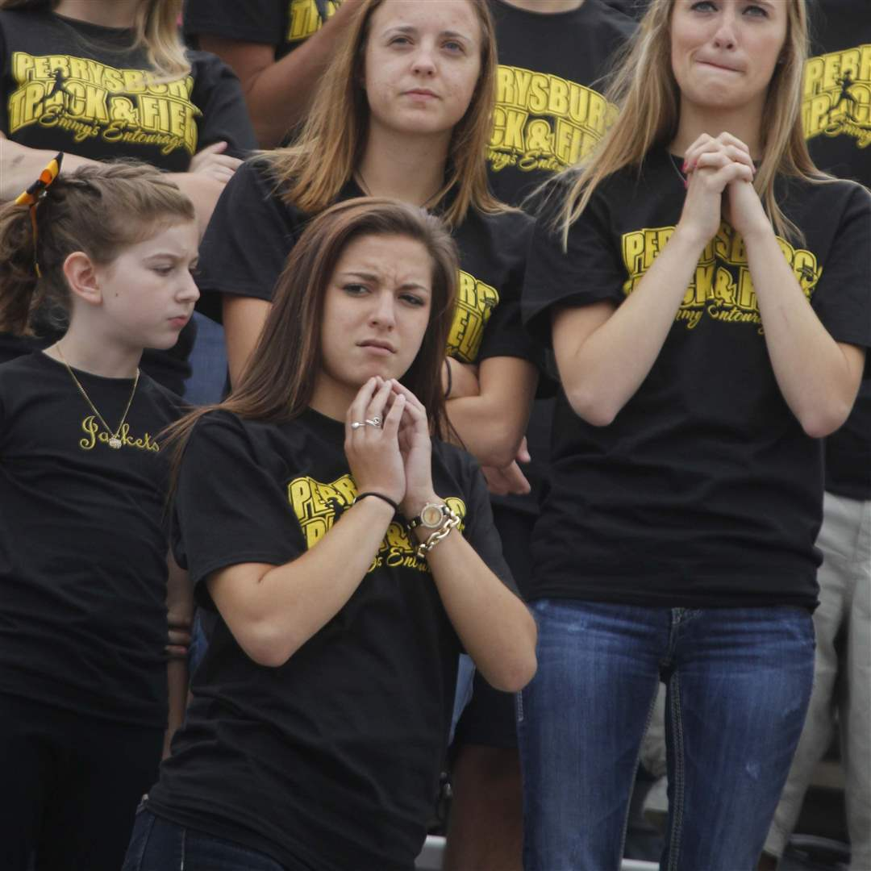
The Witnesses
Many spectators
For the Christian:
  1 Corinthians 4:9
  Luke 15:10
Be inspired to try harder!
Richie Thetford www.thetfordcountry.com

Slide 5
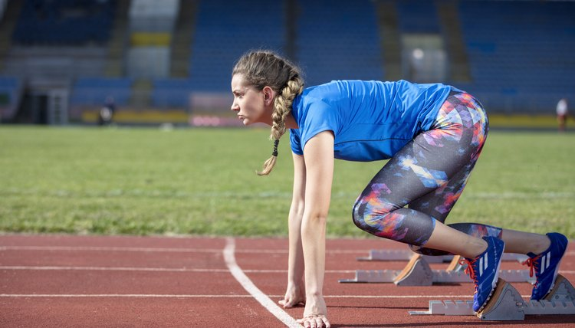
Rules Governing the Race
Must obey the rules
For the Christian:
  2 Timothy 2:5
  Romans 10:3
  Titus 1:16
Richie Thetford www.thetfordcountry.com

Slide 6
Rules Governing the Race
Christians must observe:
  Patience
    Hebrews 12:1
  Self-control
    1 Corinthians 9:25
  Zealous
    Philippians 3:14
  Jesus for guidance
    Hebrews 12:2
Richie Thetford www.thetfordcountry.com

Slide 7

The Judge
The winner receives
the reward
The Lord is our judge
  John 5:22, 27
  2 Timothy 4:7-8
  Revelation 20:11-12
Richie Thetford www.thetfordcountry.com

Slide 8
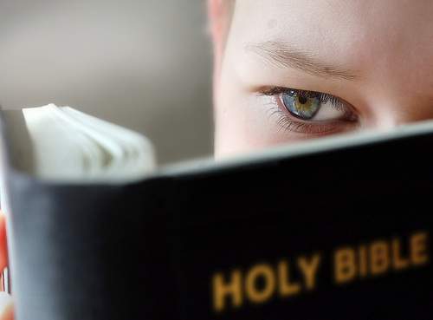
Where the Races Differ
In the reward
  1 Timothy 4:8
  James 1:12
  1 Peter 5:4
The number of victors
  1 Corinthians 9:24
The consequences
  Matthew 7:26-27
Results to those who fail
  Matthew 10:32
  Hebrews 10:38
  2 Peter 2:20-21
Richie Thetford www.thetfordcountry.com

Slide 9
We Must ALL Run the Race of Life
dd
Matthew 7:21
Richie Thetford www.thetfordcountry.com

