Slide 1

“…that He might preserve us alive”
Richie Thetford www.thetfordcountry.com

Slide 2
“…that He might preserve us alive”
Deuteronomy 6:20-25
“And the LORD commanded us
to observe all these statutes,
to fear the LORD our God,
for our good always, that He might preserve us alive, as it is this day.”
Richie Thetford www.thetfordcountry.com

Slide 3
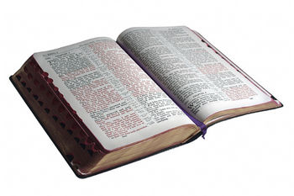
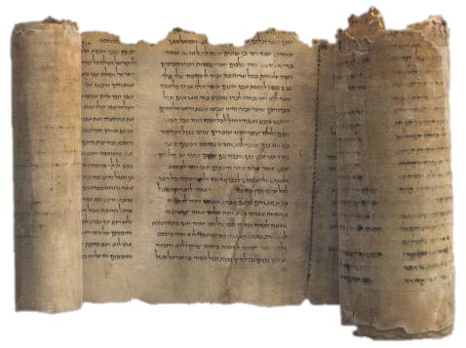
Commanded Us to Do
All These Statutes
Was well understood by Israel
that this was required of them
  Old Testament
    Exodus 19:1-8; 24:3
    Psalms 119
Richie Thetford www.thetfordcountry.com

Slide 4
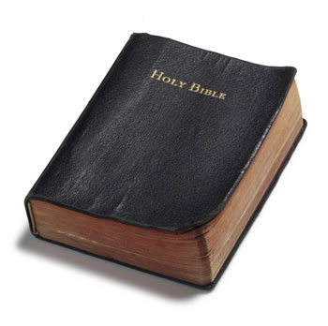
Commanded Us to Do
All These Statutes
We must understand the statutes
required of us today
  New Testament
    Matthew 7:24; 28:20;
    1 Corinthians 14:37
Richie Thetford www.thetfordcountry.com

Slide 5
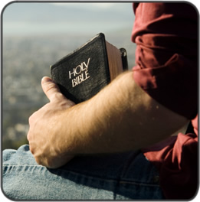
Commanded Us to Do
All These Statutes
God has never given a law that
cannot be followed
  Romans 10:5
  Ezekiel 20:11-13
  1 John 5:2-3
Richie Thetford www.thetfordcountry.com

Slide 6
To Fear the Lord Our God
FEAR:
“Respect, Awe, Reverence”
Richie Thetford www.thetfordcountry.com

Slide 7
Psalm 34:9 Oh, fear the LORD, you His saints! There is no want to those who fear Him.
Psalm 86:11 Teach me Your way, O LORD; I will walk in Your truth; Unite my heart to fear Your name.
Psalm 96:4 For the LORD is great and greatly to be praised; He is to be feared above all gods.
Psalm 112:1 Praise the LORD! Blessed is the man who fears the LORD, Who delights greatly in His commandments.
Richie Thetford www.thetfordcountry.com

Slide 8
Matthew 10:28 And do not fear those who kill the body but cannot kill the soul. But rather fear Him who is able to destroy both soul and body in hell.
Acts 10:2 a devout man and one who feared God with all his household, who gave alms generously to the people, and prayed to God always.
Acts 10:34-35 Then Peter opened his mouth and said: “In truth I perceive that God shows no partiality. But in every nation whoever fears Him and works righteousness is accepted by Him.”
Richie Thetford www.thetfordcountry.com

Slide 9

To Fear the Lord Our God
FEAR:
“Respect, Awe, Reverence”
God is to be revered as the God
of heaven and earth
  Don’t lower God from
  His exalted position
Richie Thetford www.thetfordcountry.com

Slide 10

For Our Good Always
None of the statutes of God in any
dispensation are harmful in any way!
  Proverbs 9:10-12; Romans 6:16-23
God shows us the way to be pure,
moral, upright, fair and kind
Richie Thetford www.thetfordcountry.com

Slide 11

That He Might
Preserve Us Alive
Referred to the physical in the Old Testament
  Deuteronomy 4:1-4
Spiritual life culminating in eternal
life in the New Testament
  John 10:10; 2 Peter 1:11;
  Galatians 6:8
Richie Thetford www.thetfordcountry.com

Slide 12
CONCLUSION
Obey His statutes
Fear Him
“The fear of the LORD is the beginning of knowledge, But fools despise wisdom and instruction.”
Proverbs 1:7
Richie Thetford www.thetfordcountry.com

