Slide 1

Colossians 3:12-17
Colossians 3:12-17
Richie Thetford www.thetfordcountry.com

Slide 2

A Time to Reflect
Richie Thetford www.thetfordcountry.com

Slide 3

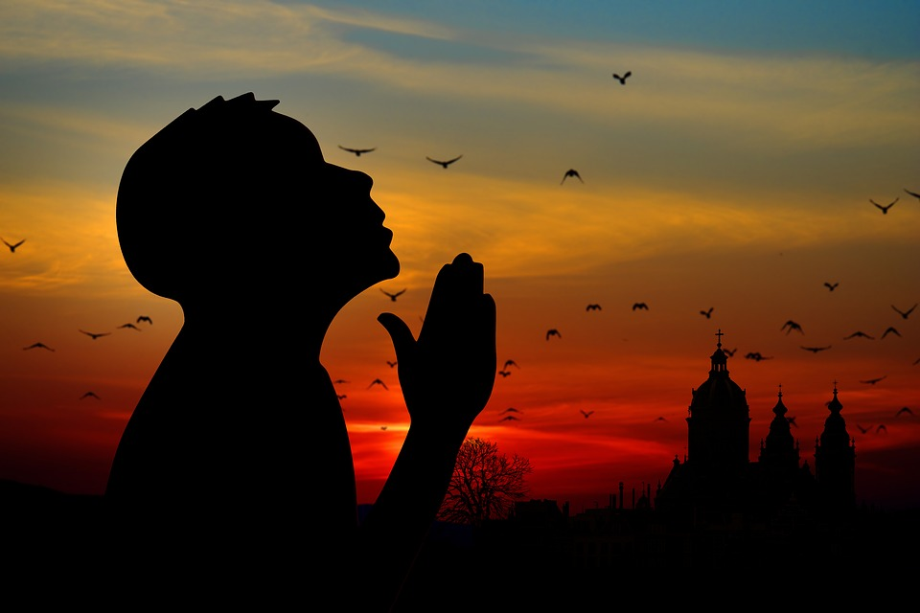

Why Give Thanks?
Romans 1:21
Psalms 92:1
1 Chronicles 29:16
Psalms 50:14
1 Timothy 1:12
Luke 17:12-18
Richie Thetford www.thetfordcountry.com

Slide 4


What Should We Give Thanks For?
2 Corinthians 9:15
2 Thessalonians 1:3
1 Corinthians 15:56-58
1 Thessalonians 5:18
Psalms 26:7
Philippians 4:6
Richie Thetford www.thetfordcountry.com

Slide 5
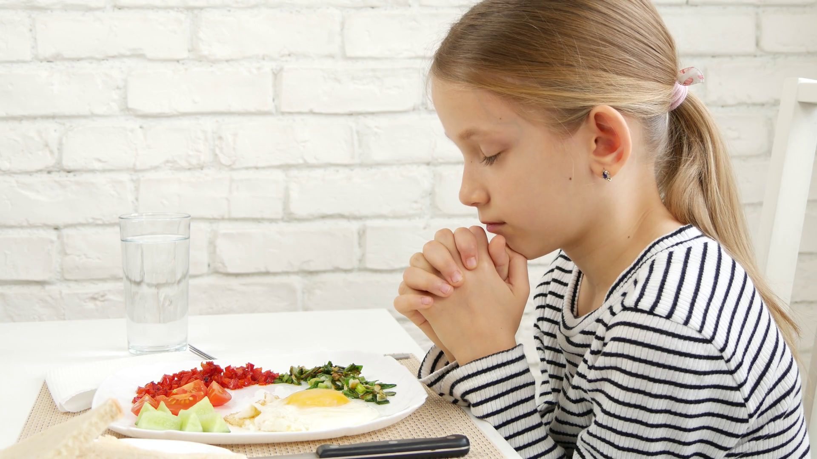
When Should We Give Thanks?
Ephesians 5:20
Richie Thetford www.thetfordcountry.com

Slide 6
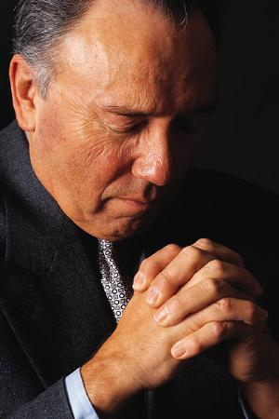

Who Should Give Thanks?
1 Timothy 2:1-2
1 Timothy 4:1-4
Richie Thetford www.thetfordcountry.com

Slide 7
THANKSGIVING
An honor and blessing for Christians
Richie Thetford www.thetfordcountry.com

