Slide 1
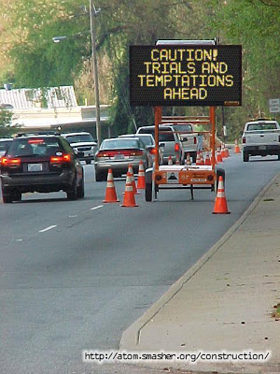
Temptations and Trials
James 1:12
Richie Thetford www.thetfordcountry.com

Slide 2
What Is “Temptation?”
An enticement to sin
Genesis 3:1-6
2 Peter 2:18-19
1 John 2:16
The Devil is the source of temptation
Matthew 4:1-11
1 Thessalonians 3:5
1 Corinthians 10:13
Richie Thetford www.thetfordcountry.com

Slide 3
What Are “Trials?”
A difficulty or hardship that tests us
Genesis 22:1-2 Now it came to pass after these things that God tested Abraham, and said to him, "Abraham!" And he said, "Here I am.“ Then He said, "Take now your son, your only son Isaac, whom you love, and go to the land of Moriah, and offer him there as a burnt offering on one of the mountains of which I shall tell you."
Richie Thetford www.thetfordcountry.com

Slide 4
What Are “Trials?”
A difficulty or hardship that tests us
2 Corinthians 12:7 And lest I should be exalted above measure by the abundance of the revelations, a thorn in the flesh was given to me, a messenger of Satan to buffet me, lest I be exalted above measure.
Richie Thetford www.thetfordcountry.com

Slide 5
What Are “Trials?”
A difficulty or hardship that tests us
Revelation 2:10 Do not fear any of those things which you are about to suffer. Indeed, the devil is about to throw some of you into prison, that you may be tested, and you will have tribulation ten days. Be faithful until death, and I will give you the crown of life.
Richie Thetford www.thetfordcountry.com

Slide 6
What Are “Trials?”
A difficulty or hardship that tests us
Exodus 16:4 Then the LORD said to Moses, "Behold, I will rain bread from heaven for you. And the people shall go out and gather a certain quota every day, that I may test them, whether they will walk in My law or not.
Richie Thetford www.thetfordcountry.com

Slide 7
What Are “Trials?”
A difficulty or hardship that tests us
Judges 2:20-23 Then the anger of the LORD was hot against Israel; and He said, "Because this nation has transgressed My covenant which I commanded their fathers, and has not heeded My voice, I also will no longer drive out before them any of the nations which Joshua left when he died, so that through them I may test Israel, whether they will keep the ways of the LORD, to walk in them as their fathers kept them, or not.“ Therefore the LORD left those nations, without driving them out immediately; nor did He deliver them into the hand of Joshua.
Richie Thetford www.thetfordcountry.com

Slide 8
What Are “Trials?”
A difficulty or hardship that tests us
2 Chronicles 32:31 However, regarding the ambassadors of the princes of Babylon, whom they sent to him to inquire about the wonder that was done in the land, God withdrew from him, in order to test him, that He might know all that was in his heart.
Richie Thetford www.thetfordcountry.com

Slide 9
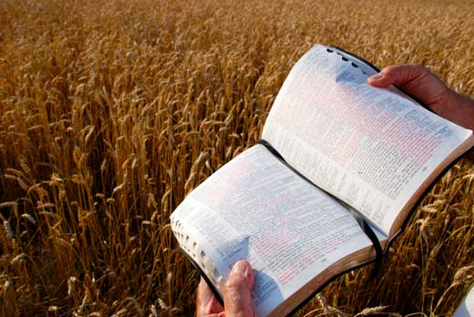
What Are “Trials?”
A difficulty or hardship that tests us
Temptation and Trial of faith are related
Satan is the originator of temptation
Deuteronomy 8:2-3
Richie Thetford www.thetfordcountry.com

Slide 10
Our Attitude Toward Temptations
Not be impatient with vulnerability of others
1 Corinthians 10:12-13
Galatians 6:1
Beware of thinking our own situation is worse than others
Assume personal responsibility for the choices that we make
James 1:12-15
Richie Thetford www.thetfordcountry.com

Slide 11
Our Attitude Toward Temptations
Don’t subject ourselves to temptation
Matthew 6:13
1 Timothy 6:9-11
Titus 2:11-12
Proverbs 1:10
Richie Thetford www.thetfordcountry.com

Slide 12
Our Attitude Toward Trials
Don’t be surprised we have to suffer hardship
1 Peter 4:12-13
Don’t see hardship as undesirable
No shortcut to strong faith
Rejoice in trials
James 1:2-4
1 Peter 1:6-7
Richie Thetford www.thetfordcountry.com

Slide 13
Our Attitude Toward Trials
Meet trials in the strength of the Lord
2 Corinthians 12:7-10
Philippians 4:13
Richie Thetford www.thetfordcountry.com

Slide 14
Conclusion
Meet temptations and trials in the assurance that Jesus knows what we are experiencing
Hebrews 2:14-18
Hebrews 4:15-16
Hebrews 5:7-8
Don’t blame God for our temptations – resist them!
Don’t complain about our trials – endure them!
Richie Thetford www.thetfordcountry.com

