Slide 1
Now It’s Time To Go Fishing!
Talking, Planning, and Studying
Richie Thetford www.thetfordcountry.com

Slide 2
Now It’s Time To Go Fishing!
Talking, Planning, and Studying
A group of men TALKING about going fishing
A group of men PLANNING to go fishing
A group of men STUDYING about fishing
They never caught one fish!
Richie Thetford www.thetfordcountry.com

Slide 3
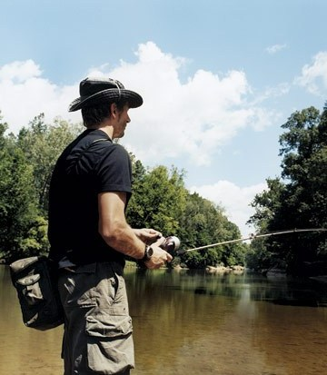
Bible Examples of Fishing
Mending nets
Matthew 4:21
Washing nets
Luke 5:2
Must fish to catch fish
Matthew 4:18
May not catch any fish
Luke 5:4-5
Richie Thetford www.thetfordcountry.com

Slide 4
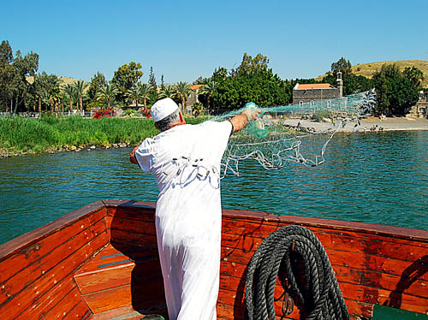
Lessons Learned
“follow Me, and I will make you fishers of men.” Matthew 4:19
In preparing to fish we should think on these things:
Philippians 4:8
Richie Thetford www.thetfordcountry.com

Slide 5
Lessons Learned
KNOW
What to Say
1 Peter 3:15; 1 Timothy 4:16
The story of Jesus
Why He came
What He did for man
What He expects
What we must do
Plan of Salvation
How we must live
Richie Thetford www.thetfordcountry.com

Slide 6
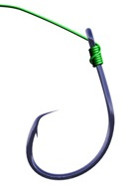
Fishing for the Lord
Matthew 28:18-20 And Jesus came and spoke to them, saying, "All authority has been given to Me in heaven and on earth. Go therefore and make disciples of all the nations, baptizing them in the name of the Father and of the Son and of the Holy Spirit, teaching them to observe all things that I have commanded you; and lo, I am with you always, even to the end of the age." Amen.
“follow Me, and I will make you fishers of men.” Matthew 4:19
Luke 19:10 for the Son of Man has come to seek and to save that which was lost.
Richie Thetford www.thetfordcountry.com

Slide 7
Fishing for the Lord
1 Corinthians 11:1 Imitate me, just as I also imitate Christ.
Romans 1:16 For I am not ashamed of the gospel of Christ, for it is the power of God to salvation for everyone who believes, for the Jew first and also for the Greek.
2 Corinthians 5:9-10 Therefore we make it our aim, whether present or absent, to be well pleasing to Him. For we must all appear before the judgment seat of Christ…..
“follow Me, and I will make you fishers of men.” Matthew 4:19
Richie Thetford www.thetfordcountry.com

Slide 8
Fishing for the Lord
Ephesians 5:8 For you were once darkness, but now you are light in the Lord. Walk as children of light.
Matthew 5:14-16 You are the light of the world. A city that is set on a hill cannot be hidden. Nor do they light a lamp and put it under a basket, but on a lampstand, and it gives light to all who are in the house. Let your light so shine before men, that they may see your good works and glorify your Father in heaven.
“follow Me, and I will make you fishers of men.” Matthew 4:19
Richie Thetford www.thetfordcountry.com

Slide 9
Fishing for the Lord
Philippians 4:9 The things which you learned and received and heard and saw in me, these do, and the God of peace will be with you.
2 Timothy 2:24 And a servant of the Lord must not quarrel but be gentle to all, able to teach, patient.
“follow Me, and I will make you fishers of men.” Matthew 4:19
Richie Thetford www.thetfordcountry.com

Slide 10
Fishing for the Lord
Hebrews 5:12-14 For though by this time you ought to be teachers, you need someone to teach you again the first principles of the oracles of God; and you have come to need milk and not solid food. For everyone who partakes only of milk is unskilled in the word of righteousness, for he is a babe. But solid food belongs to those who are of full age, that is, those who by reason of use have their senses exercised to discern both good and evil.
“follow Me, and I will make you fishers of men.” Matthew 4:19
Richie Thetford www.thetfordcountry.com

Slide 11
Fishing for the Lord
1 Peter 2:9 But you are a chosen generation, a royal priesthood, a holy nation, His own special people, that you may proclaim the praises of Him who called you out of darkness into His marvelous light;
James 4:17 Therefore, to him who knows to do good and does not do it, to him it is sin.
“follow Me, and I will make you fishers of men.” Matthew 4:19
Richie Thetford www.thetfordcountry.com

Slide 12
Conclusion
When fishing for the Lord, we may have some empty nets, but we can say that we have been fishing!
Allow God to give the increase
1 Corinthians 3:6-7 I planted, Apollos watered, but God gave the increase. So then neither he who plants is anything, nor he who waters, but God who gives the increase.
When was the last time that you put the TALKING, PLANNING, and STUDYING to work and actually went fishing for men?
Richie Thetford www.thetfordcountry.com

