Slide 1
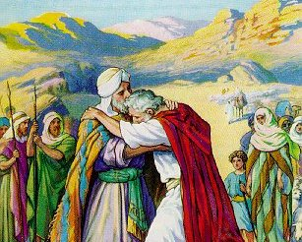
The Struggles of Jacob
“If God will be with me….then the Lord shall be my God.”
Genesis 28:20-21
“Be anxious for nothing, but in everything by prayer and supplication, with thanksgiving, let your requests be made known to God; and the peace of God, which surpasses all understanding, will guard your hearts and minds through Christ Jesus.”
Philippians 4:6-7
Richard Thetford www.thetfordcountry.com

Slide 2
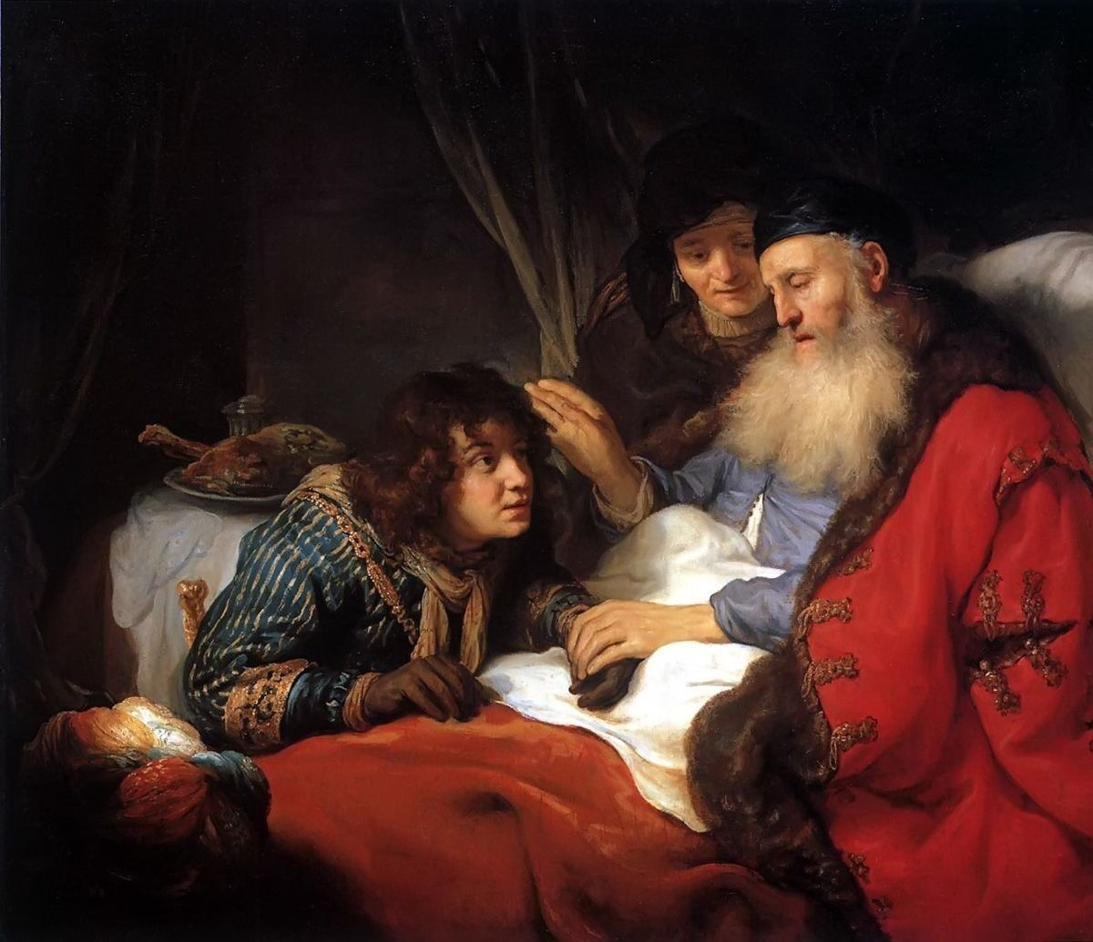
Background
Jacob born to Rebekah
Esau sells his birthright to Jacob
Isaac pronounces his blessing upon Jacob
Genesis 27:27-29
Esau is determined to kill Jacob
Isaac sends Jacob to Padan Aram
Jacob puts a stone under his head and goes to sleep
Genesis 28:12-21
Richard Thetford www.thetfordcountry.com

Slide 3
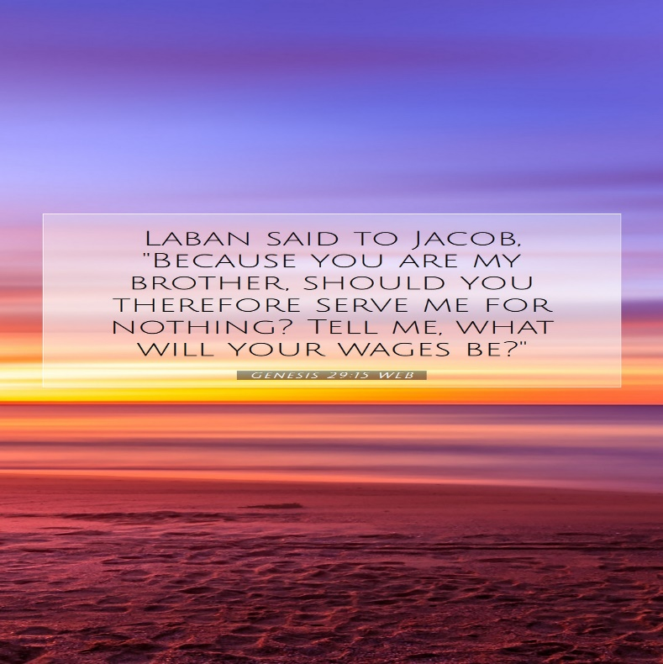
Jacob’s Struggle with Laban
Jacob meets Rachel
Genesis 29:15-30
Jacob works for Laban 20 years
Jacob asks to return to his own country
Jacob served Laban but helped himself
Genesis 31:1-2
Jacob knows he must leave but still wants to have favor in the sight of Laban
Genesis 31:5-13
Richard Thetford www.thetfordcountry.com

Slide 4
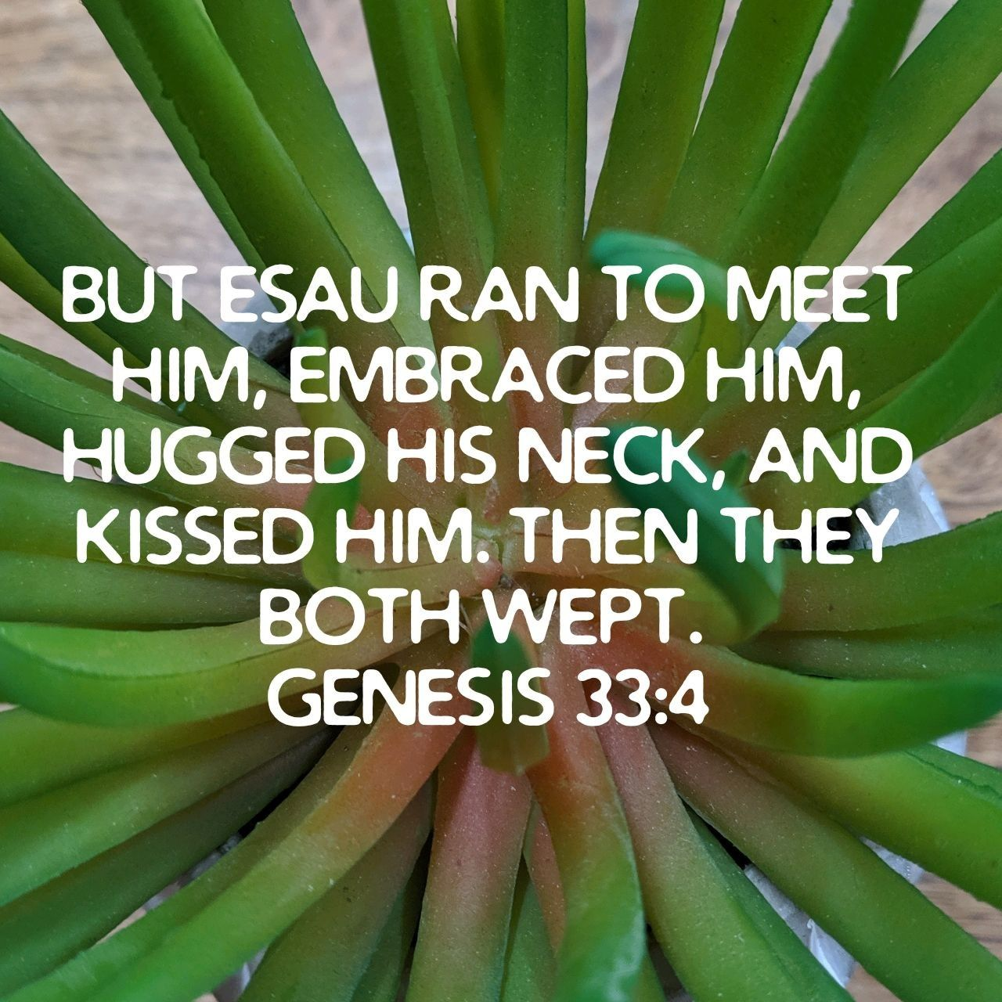
Jacob’s Struggle with Esau
Esau coming with 400 men!
Jacob is distressed
Genesis 32:7-12
Jacob wrestles with God
Genesis 32:24-29
Name changed to Israel
“for you have struggled with God and with men and have prevailed.”
Jacob bowed before his brother
Genesis 33:4
Richard Thetford www.thetfordcountry.com

Slide 5
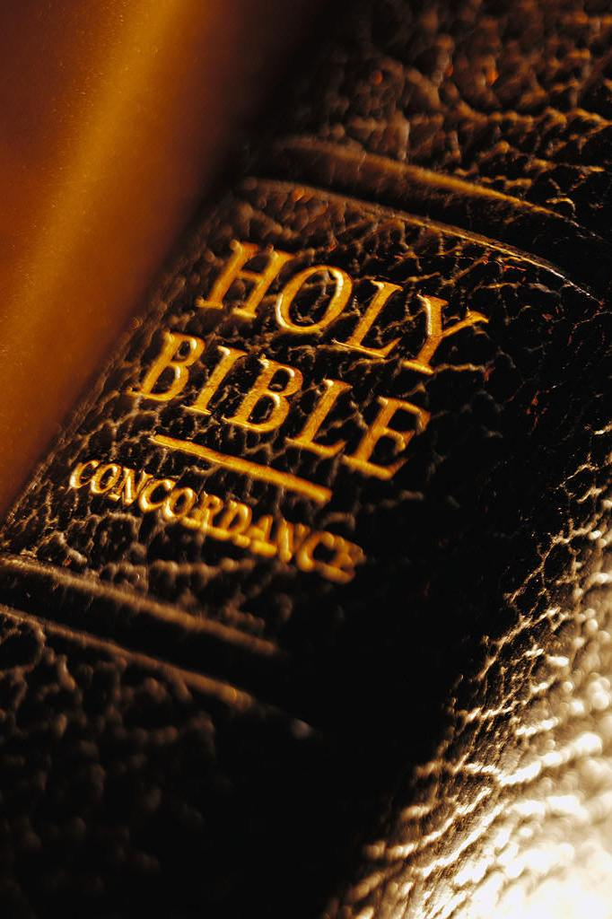
Lessons Learned from Jacob’s Struggles
At Bethel – Jacob made a vow to God that He would be His Lord
Upon our confession and baptism, we have made a vow to be loyal to God (Acts 8:37-39)
Jacob had a two-way relationship with God
We must have a two-way relationship with God
Jeremiah 10:23; 2 Timothy 2:15; Matthew 21:22
Jacob was not discouraged
We must keep pressing on (Matthew 10:22)
Richard Thetford www.thetfordcountry.com

Slide 6
“For we do not wrestle against flesh and blood, but against principalities, against powers, against the rulers of the darkness of this age, against spiritual hosts of wickedness in the heavenly places. Therefore, take up the whole armor of God, that you may be able to withstand in the evil day, and having done all, to stand.”
Ephesians 6:12-13
Richard Thetford www.thetfordcountry.com

