Slide 1
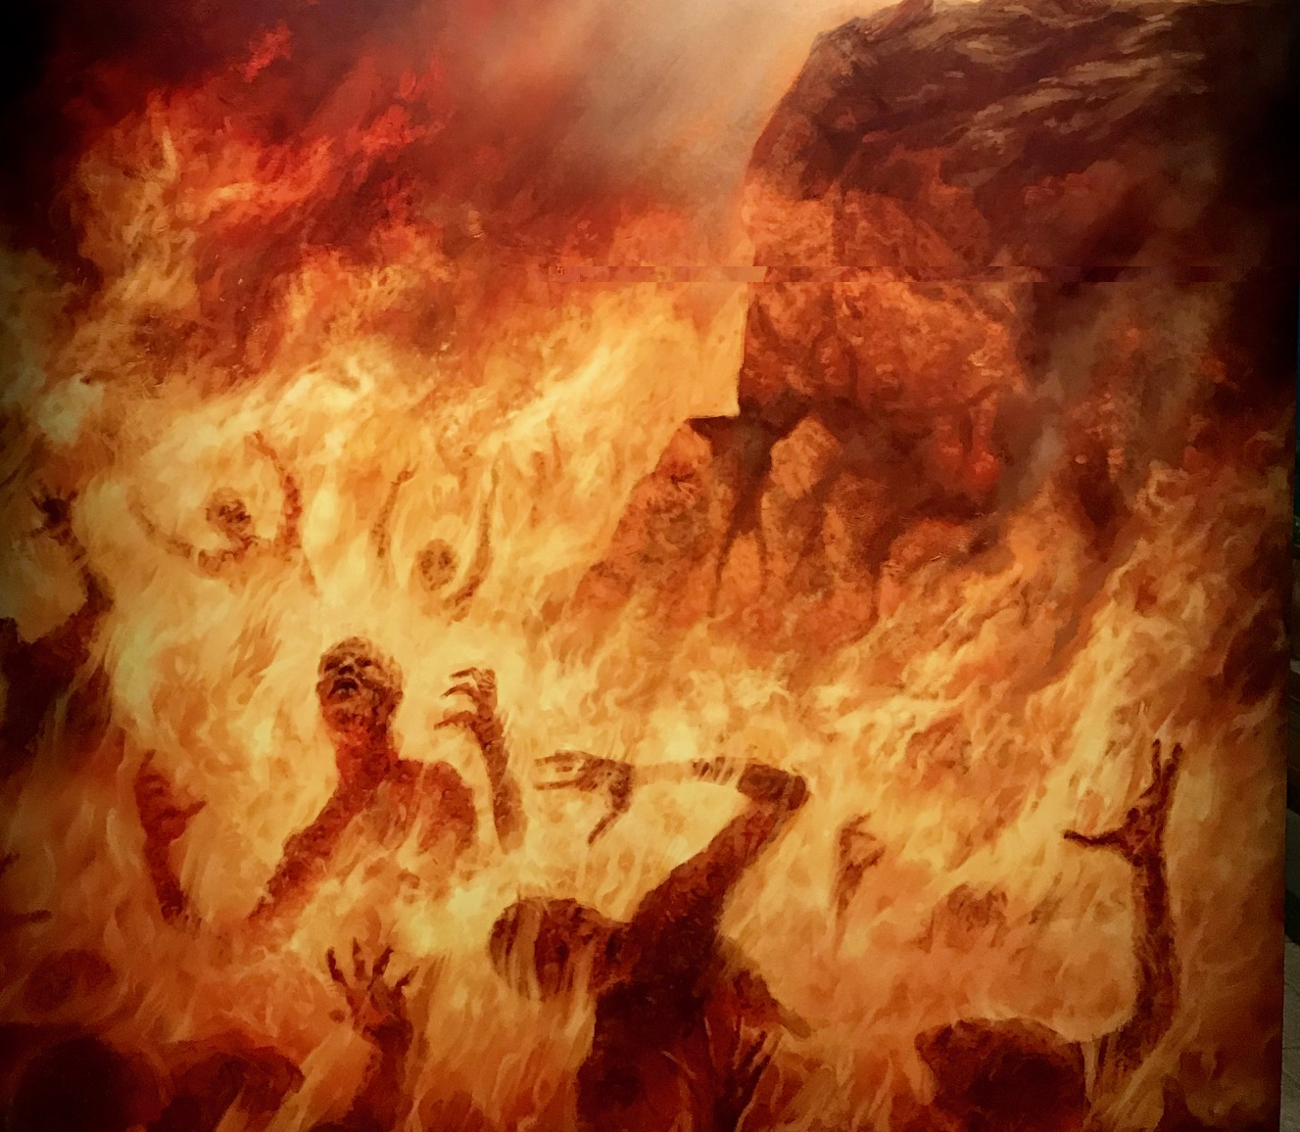
The Souls of Eternity!
Hell's
Matthew 10:28
Hebrews 9:27
Acts 17:30-31
Richard Thetford www.thetfordcountry.com

Slide 2
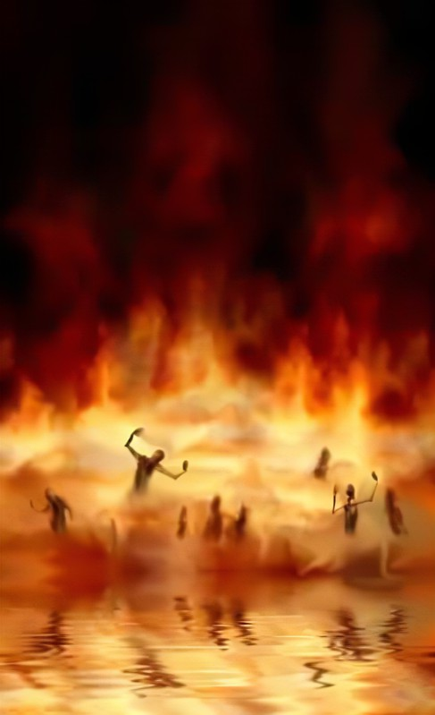
HELL
A real place
Place of everlasting fire
Matthew 25:41
Place of Torment
Luke 16:19-31
Soul will be cast into Hell
Matthew 10:28
Will remain in torment forever!
Revelation 14:9-11
Richard Thetford www.thetfordcountry.com

Slide 3
HELL
A place filled with horrible souls
Those who satisfy the lust of flesh
Revelation 21:8
Galatians 5:19-21
Romans 1:28-32
Unbelievers of God
John 12:42-43
Richard Thetford www.thetfordcountry.com

Slide 4
HELL
A place filled with good moral people
Those like Cornelius
Acts 10:1-2
Acts 11:13-14
Acts 10:48
Richard Thetford www.thetfordcountry.com

Slide 5
HELL
A place filled with devoutly religious people
Sincere, religious people
Matthew 15:8-9
Richard Thetford www.thetfordcountry.com

Slide 6
HELL
A place filled with lukewarm church members
Backsliders
2 Peter 2:20-22
Disobedient
2 Thessalonians 1:7-9
Hypocrites
Matthew 23:15, 23
Richard Thetford www.thetfordcountry.com

Slide 7
The Souls of Eternity!
Hell's
“For we must all appear before the judgment seat of Christ, that each one may receive the things done in the body, according to what he has done, whether good or bad.” 2 Corinthians 5:10
Richard Thetford www.thetfordcountry.com

