Slide 1
Some Things jesus had

Slide 2
Some things Jesus had
Jesus had pre-existence
Genesis 1:26
Colossians 1:16-17
John 8:58

Slide 3
Some things Jesus had
Jesus had an unusual conception
Isaiah 7:14
Matthew 1:18-20

Slide 4
Some things Jesus had
Jesus had dual being
Matthew 1:23
John 1:14
Philippians 2:5-8

Slide 5
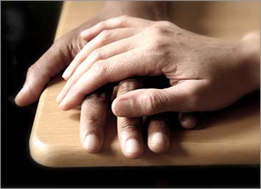
Some things Jesus had
Jesus had compassion
Matthew 9:36
1 Peter 3:8-9
1 John 3:17-19

Slide 6
Some things Jesus had
Jesus had work to do
John 9:4
Luke 2:49
John 5:17
Matthew 11:5
John 17:4
Every Christian needs to be working
1 Corinthians 15:58

Slide 7
Some things Jesus had
Jesus had all authority
Matthew 28:18
John 2:5
Matthew 7:29
Jesus is the head of the body, the church.
Everyone must be in subjection to Him

Slide 8
Some things Jesus had
Pre-existence
Unusual conception
Dual being
Compassion
A work to do
All authority
ONLY Jesus
had these
Jesus left us an example
We must respect this

