Slide 1
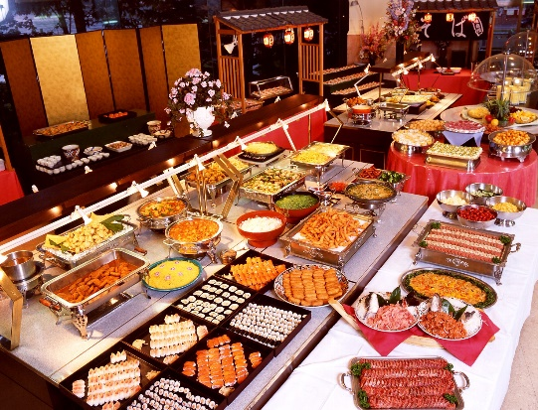

Smorgasbord
Religion
We are not at liberty to “pick and choose” which parts of God’s Word we prefer to obey

Slide 2


The Emphasis of James 2:10
Those trying to serve God and those who aren’t
  Romans 6:16-18
Church at Sardis
  Revelation 3:4-5
We can’t disregard the will of God arbitrarily
  James 2:12
  James 4:11

Slide 3
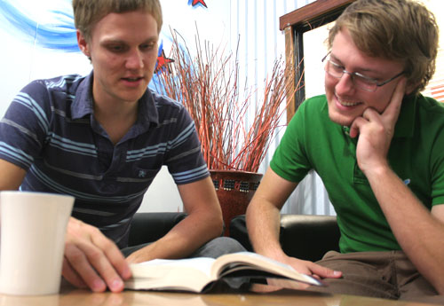
The Emphasis of James 2:10
No amount of “good works” compensates for a lawless attitude
  Matthew 7:21-23
Noah’s obedience
  Genesis 6
To disregard any part of God’s will is to be a “transgressor of the law”
  James 2:11

Slide 4

Principle of Unqualified Obedience to God
Must have an attitude of submission to God’s will
  Mark 12:30
Amaziah
  2 Chronicles 25:2
Joshua and Caleb
  Numbers 32:11-12
Josiah
  2 Kings 23:25

Slide 5
Practical Applications of the Principle
Do we refuse to do things commanded by God?
  Colossians 3:16
Are we selective about which sins we will avoid?
  Romans 1:29-31
  Galatians 5:19-21
Regarding some sins as less offensive than others
is the very point of the context of James 2:10-11

Slide 6
Conclusion
Obedience to God is not a partial endeavor
A love of God and a desire to be with Him
eternally should motivate us to fully do His will
“And whatever you do in word or deed, do all in the name of the Lord Jesus, giving thanks to God the Father through Him.”
Colossians 3:17

