Slide 1
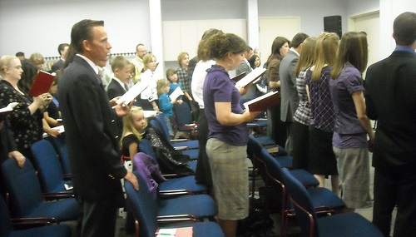
Ephesians 5:19
Colossians 3:16
Singing….to the Lord
“a worship service is only as good as the singing.”
Why?
ALL are participating, giving of themselves for God’s service and for the edification of the saints
We are not here just for the taking
Richie Thetford www.thetfordcountry.com

Slide 2
“Singing.....to the Lord”
“Singing.....to the Lord”
Matthew 26:30 And when they had sung a hymn, they went out to the Mount of Olives.
Acts 16:25 But at midnight Paul and Silas were praying and singing hymns to God, and the prisoners were listening to them.
Romans 15:9 and that the Gentiles might glorify God for His mercy, as it is written: For this reason, I will confess to You among the Gentiles and sing to Your name.
Richie Thetford www.thetfordcountry.com

Slide 3
“Singing.....to the Lord”
1 Corinthians 14:15 What is the conclusion then? I will pray with the spirit, and I will also pray with the understanding. I will sing with the spirit, and I will also sing with the understanding
Ephesians 5:19 speaking to one another in psalms and hymns and spiritual songs, singing and making melody in your heart to the Lord
Colossians 3:16 Let the word of Christ dwell in you richly in all wisdom, teaching and admonishing one another in psalms and hymns and spiritual songs, singing with grace in your hearts to the Lord
Richie Thetford www.thetfordcountry.com

Slide 4
“Singing.....to the Lord”
Hebrews 2:12 saying: I will declare Your name to My brethren; In the midst of the assembly I will sing praise to You.
Hebrews 13:15 Therefore by Him let us continually offer the sacrifice of praise to God, that is, the fruit of our lips, giving thanks to His name
James 5:13 Is anyone among you suffering? Let him pray. Is anyone cheerful? Let him sing psalms
Richie Thetford www.thetfordcountry.com

Slide 5
What Should We Sing?
Psalms
Songs of praise, devotion and exhaltation
Hymns
Song of praise addressed to God
The main point of a hymn is praise
Some Psalms are also hymns, but not all
Spiritual Songs
A song based on spiritual things
Songs of which the burden is the things revealed by the Spirit
Richie Thetford www.thetfordcountry.com

Slide 6
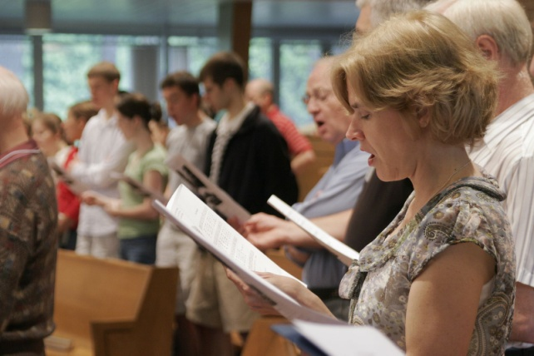
How Should We Sing?
In “spirit and truth”
John 4:24
With grace in our hearts
Colossians 3:16; Ephesians 5:19
This involves our emotions as we sing
With Understanding
1 Corinthians 14:15
Singing is teaching and admonishing one another
Richie Thetford www.thetfordcountry.com

Slide 7
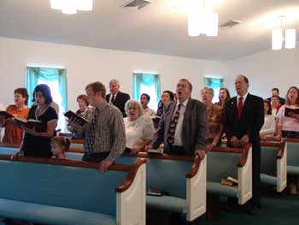
What Is the Purpose of Singing?
To Praise God
Natural for all Christians
Psalms 28:6-7; 100
To Teach and Admonish One Another
Edifying one another (1 Corinthians 14:26)
Congregational singing is congregational teaching
God made us with everything that we need to worship and praise Him
Richie Thetford www.thetfordcountry.com

Slide 8
“Singing.....to the Lord”
Questions to Consider
Which is more important when we sing, how we sound or how we feel?
Are we really teaching and admonishing one another in song if we just whisper or mouth the words?
Which is unscriptural: singing with mechanical instruments of music or singing without engaging the instrument of the heart?
Richie Thetford www.thetfordcountry.com

Slide 9
Hebrews 13:15
Psalms 104:33
“Singing….to the Lord”
Praise the LORD! For it is good to sing praises to our God; for it is pleasant, and praise is beautiful
Psalms 147:1
Richie Thetford www.thetfordcountry.com

