Slide 1
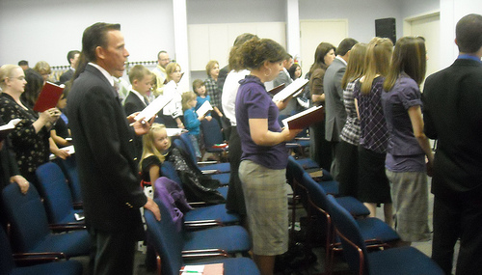
Ephesians 5:19
Colossians 3:16
Singing….to the Lord
“a worship service is only as good as the singing.”
Why?
ALL are participating, giving of themselves for God’s service and for the edification of the saints
We are not here just for the taking

Slide 2
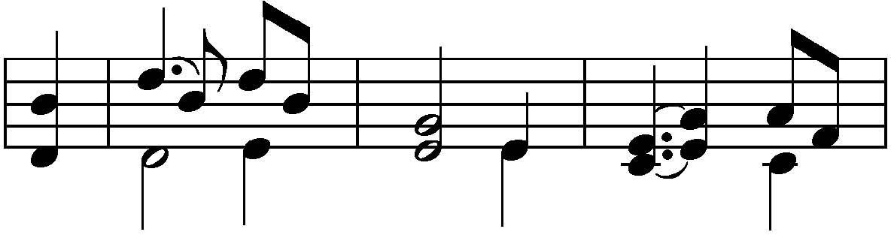
“Singing.....to the Lord”
“Singing.....to the Lord”
Matthew 26:30 And when they had sung a hymn, they went out to the Mount of Olives.
Acts 16:25 But at midnight Paul and Silas were praying and singing hymns to God, and the prisoners were listening to them.
Romans 15:9 and that the Gentiles might glorify God for His mercy, as it is written: "For this reason I will confess to You among the Gentiles, And sing to Your name."

Slide 3
“Singing.....to the Lord”
1 Corinthians 14:15 What is the conclusion then? I will pray with the spirit, and I will also pray with the understanding. I will sing with the spirit, and I will also sing with the understanding
Ephesians 5:19 speaking to one another in psalms and hymns and spiritual songs, singing and making melody in your heart to the Lord
Colossians 3:16 Let the word of Christ dwell in you richly in all wisdom, teaching and admonishing one another in psalms and hymns and spiritual songs, singing with grace in your hearts to the Lord

Slide 4
“Singing.....to the Lord”
Hebrews 2:12 saying: "I will declare Your name to My brethren; In the midst of the assembly I will sing praise to You.
Hebrews 13:15 Therefore by Him let us continually offer the sacrifice of praise to God, that is, the fruit of our lips, giving thanks to His name
James 5:13 Is anyone among you suffering? Let him pray. Is anyone cheerful? Let him sing psalms

Slide 5

What Should We Sing?
Psalms
  Songs of praise, devotion and exhaltation
Hymns
  Song of praise addressed to God
  The main point of a hymn is praise
    Some Psalms are also hymns, but not all
Spiritual Songs
  A song based on spiritual things
    Songs of which the burden is the things revealed by the Spirit

Slide 6
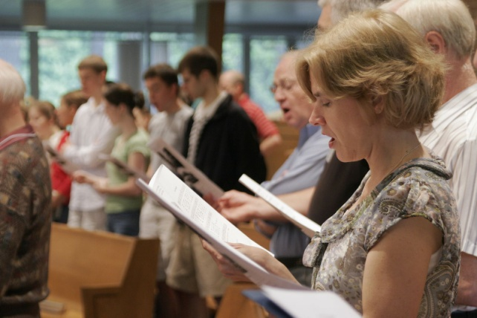
How Should We Sing?
In “spirit and truth”
  John 4:24
With grace in our hearts
  Colossians 3:16; Ephesians 5:19
  This involves our emotions as we sing
With Understanding
  1 Corinthians 14:15
  Singing is teaching and admonishing one another

Slide 7
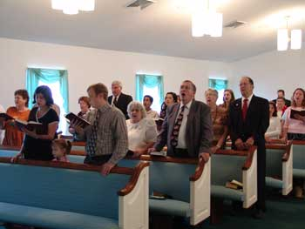
What Is The Purpose In Singing?
To Praise God
  Natural for all Christians
  Psalms 28:6-7; 100
To Teach and Admonish One Another
  Edifying one another (1 Corinthians 14:26)
  Congregational singing is congregational teaching
God made us with everything that we need to worship and praise Him

Slide 8
“Singing.....to the Lord”
Questions to Consider
Which is more important when we sing,
how we sound or how we feel?
Are we really teaching and admonishing
one another in song if we just whisper
or mouth the words?
Which is unscriptural:
singing with mechanical instruments of music or
singing without engaging the instrument of the
heart?

Slide 9
Hebrews 13:15
Psalms 104:33
Singing….to the Lord
Praise the LORD! For it is good to sing praises to our God; for it is pleasant, and praise is beautiful
Psalms 147:1

