Slide 1
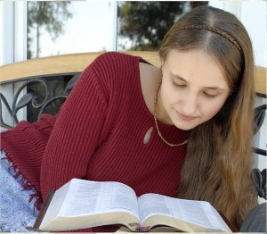
The Sin of
In-sliding

Slide 2
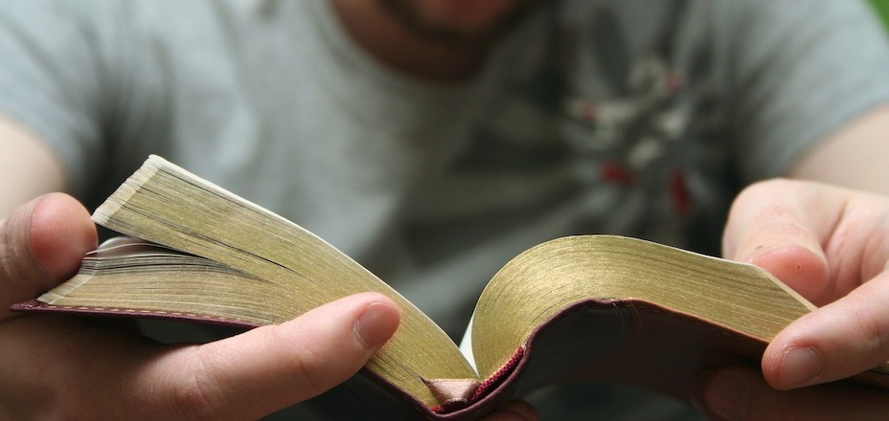
Backsliding
A warning
  1 Corinthians 10:12
Describes unfaithful descent
  Jeremiah 3:6, 8, 11-14
Angers God
  Isaiah 57:17
God’s pleading and forgiveness
  Jeremiah 3:12-13, 22-25
  Isaiah 66:1-2

Slide 3
The Sin of In-sliding
Israel did not return to God by “sliding back” into fellowship
  Psalms 51:3-4, 7-13
“In-sliding” describes how some, who fell away from God, try to return to fellowship with Him.
  Some brethren allow it to happen
  Some may “assume” he has repented

Slide 4
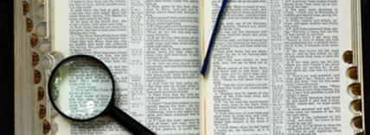
The Sin of In-sliding
In-slider does not confess his sins
  James 5:16
  1 John 1:9
    But is still accepted back into fellowship
“Brethren, if a man is overtaken in any trespass,
you who are spiritual restore such a one in a spirit
of gentleness, considering yourself lest you also be tempted. Bear one another's burdens, and so fulfill the law of Christ.” Galatians 6:1-2

Slide 5

The Sin of In-sliding
In-sliding fails to Scripturally address the presence of sin
  No passage endorses “in-sliding”
    Luke 13:5
    Acts 8:22-24
  Fruit of repentance borne after repentance
    2 Corinthians 7:10-11
In-sliding is not repentance on the part of the sinner

Slide 6
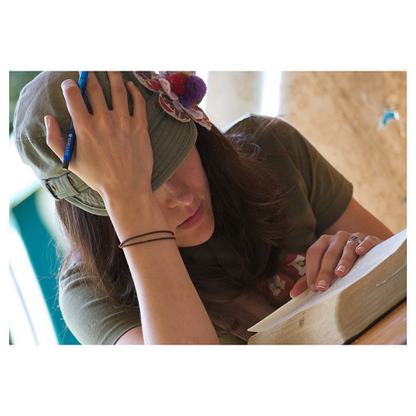
The Sin of In-sliding
In-sliding knowingly accepts a sinner into fellowship
  Warnings against this
    2 John 9-11
  Emphasizes peace –
  when not established
    Ephesians 5:11
  False plea of “peace”
    Jeremiah 6:14-15

Slide 7
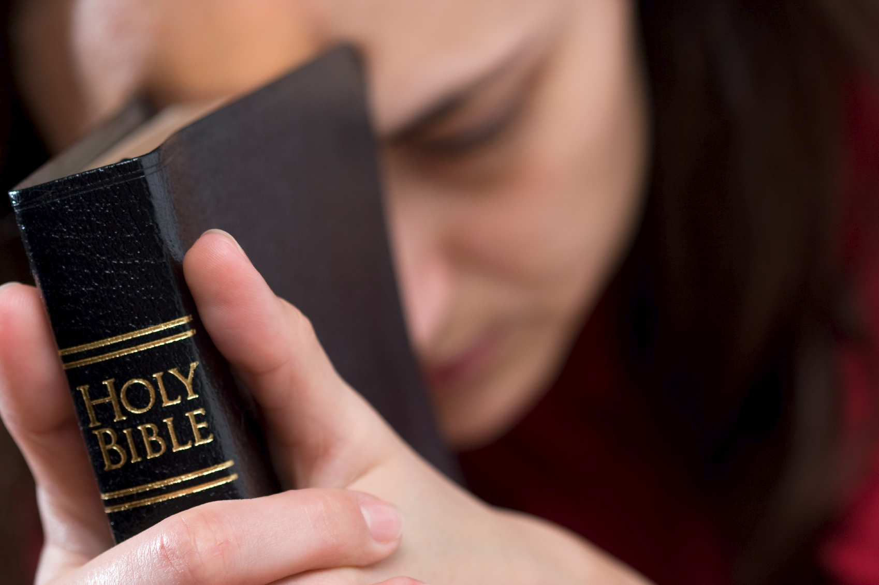
The Sin of In-sliding
Forsaking the assembly
  Often “in-slide” back into the assembly
  Violation of scripture
    Hebrews 10:24-25
  Should exhort them
  to repent
  If they object – more work to do:
    James 5:19-20
Can’t leave the message that they did not really sin

Slide 8
The Sin of In-sliding
Endorsing preachers who teach error
  Passing of time doesn’t equal repentance
  When one does not reject error it equals toleration
  Compromise with error requires full repentance
  Must warn against those with “itching ears”
    2 Timothy 4:2-5

Slide 9
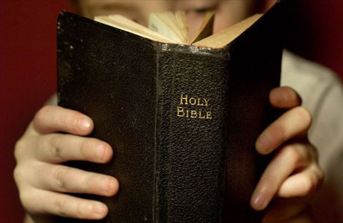
Conclusion
Cannot “in-slide” into fellowship
Sin separates us from God
  1 John 9
  Acts 8:22
Where there has been backsliding there MUST now be repentance
God does not approve of “in-sliding”
All backsliding requires repentance

