Slide 1
The Sin of
Hosea 4:6
1 Timothy 2:3-4
Richard Thetford www.thetfordcountry.com

Slide 2
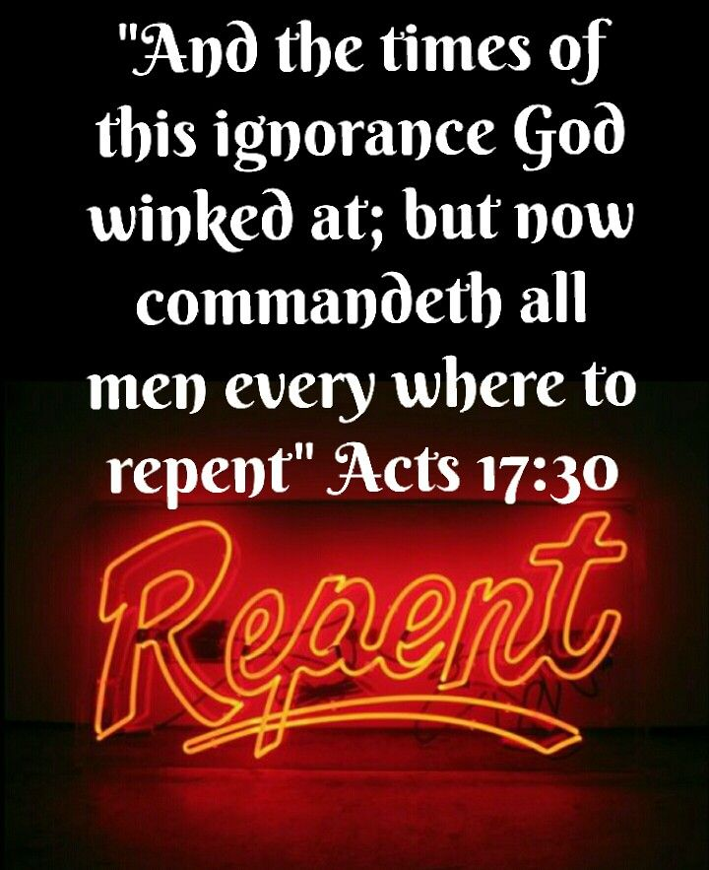
Ignorance of God
Must not be ignorant of God
Acts 17:23, 30-31
No excuse to be ignorant of God
Romans 1:18-20
Leads to an abandonment of morality
Ephesians 4:17-19
Fornication
Homosexuality
Doing evil with “friends”
Richard Thetford www.thetfordcountry.com

Slide 3
Ignorance of the Gospel
Makes us a sinner
1 Timothy 1:12-15
2 Thessalonians 1:7-10
Some are willfully ignorant
2 Peter 3:4-7
Romans 1:28-32
“The fear of the LORD is the beginning of knowledge, But fools despise wisdom and instruction.”
Proverbs 1:7
Richard Thetford www.thetfordcountry.com

Slide 4
Ignorance of Perfect Obedience
Must grow in knowledge
Philippians 1:9-10
Colossians 1:9-10
Put it to proper use
Hebrews 5:12-14
2 Timothy 3:7
Richard Thetford www.thetfordcountry.com

Slide 5
Two Necessary Considerations
Seek and you shall find
Matthew 7:7-8
Understand the difference between absolute and relative commands
2 Peter 1:5-11
Richard Thetford www.thetfordcountry.com

Slide 6
The Sin of
The gospel was preached to all creation in the first century. No society, culture, or race has any excuse before God to be ignorant of Him and His word!
Richard Thetford www.thetfordcountry.com

