Slide 1
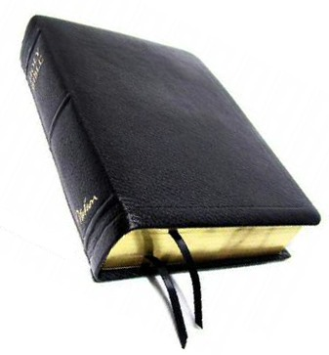
The Silence of God
“Speak where the Bible speaks, remain silent where the Bible is silent.”
Richie Thetford www.thetfordcountry.com

Slide 2
2 Different Attitudes Toward the Silence of God
Permissive:
“If God doesn’t say I can’t, then I can.”
Prohibitive:
“If God doesn’t say I can, then I can’t.”
We need to make sure that we are handling accurately the Word of God – we must know whether God’s silence is permissive or prohibitive.
Richie Thetford www.thetfordcountry.com

Slide 3
What the Bible says about the Silence of God
Must respect God’s Word
Jews under the law of Moses:
“Now, O Israel, listen to the statutes and the judgments which I teach you to observe, that you may live, and go in and possess the land which the LORD God of your fathers is giving you. You shall not add to the word which I command you, nor take from it, that you may keep the commandments of the LORD your God which I command you.” Deuteronomy 4:1-2
Richie Thetford www.thetfordcountry.com

Slide 4
What the Bible says about the Silence of God
Must respect God’s Word
Christians under the gospel of Jesus Christ:
“Whoever transgresses and does not abide in the doctrine of Christ does not have God. He who abides in the doctrine of Christ has both the Father and the Son. If anyone comes to you and does not bring this doctrine, do not receive him into your house nor greet him; for he who greets him shares in his evil deeds.” 2 John 9-11
Richie Thetford www.thetfordcountry.com

Slide 5
What the Bible says about the Silence of God
Respect for God’s Word demands a certain attitude toward God’s silence
If a contractor cannot find something on the blueprint what does he do?
NOTHING!
Richie Thetford www.thetfordcountry.com

Slide 6
What the Bible says about the Silence of God
It is not SILENCE that sanctions, it is scripture that sanctions
Holy Spirit searched out the mind of God and revealed them to the apostles
1 Corinthians 2:6-13
However, the Holy Spirit has not revealed everything to man
Deuteronomy 29:29
Richie Thetford www.thetfordcountry.com

Slide 7
What the Bible says about the Silence of God
That which pleases us – may not please God
“For My thoughts are not your thoughts, Nor are your ways My ways," says the LORD. “For as the heavens are higher than the earth, So are My ways higher than your ways, And My thoughts than your thoughts.” Isaiah 55:8-9
Only the scripture is able to equip a man unto every good work
2 Timothy 3:16-17
Richie Thetford www.thetfordcountry.com

Slide 8
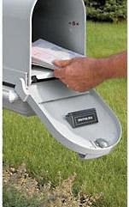
What the Bible says about the Silence of God
Bible does not always spell out all the details concerning a matter
Sometimes God will tell us WHAT to do, but does not tell us HOW, WHEN, or WHERE to do it
EXAMPLE: “Go check the mail” (walk, run, ride, etc.?)
Richie Thetford www.thetfordcountry.com

Slide 9
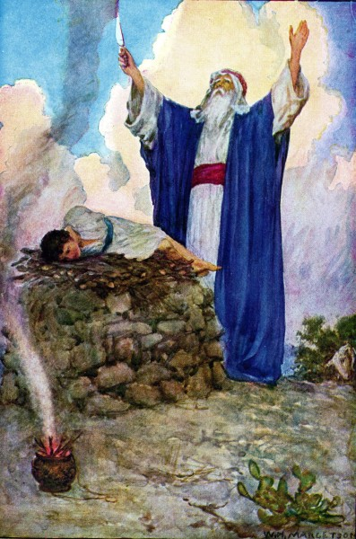
What the Bible says about the Silence of God
EXAMPLE: (Abraham & Isaac) “…go to the land of Moriah, and offer him there as a burnt offering on one of the mountains which I shall tell you” Genesis 22:2, 6 (wood, fire, knife?)
Richie Thetford www.thetfordcountry.com

Slide 10
What the Bible says about the Silence of God
EXAMPLE: (Church Buildings) “not forsaking the assembling of ourselves together…” Hebrews 10:25 (buy, rent, size?)
Richie Thetford www.thetfordcountry.com

Slide 11
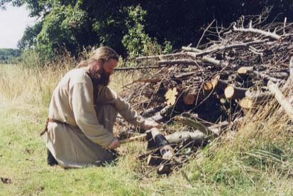
How God’s People Have Reacted Toward the Silence of God
Old Testament
Son of an Israelite woman blasphemed
Leviticus 24:10-12
Man picking up sticks on the Sabbath
Numbers 15:32-36
They did NOT presume to act upon God’s silence
Richie Thetford www.thetfordcountry.com

Slide 12
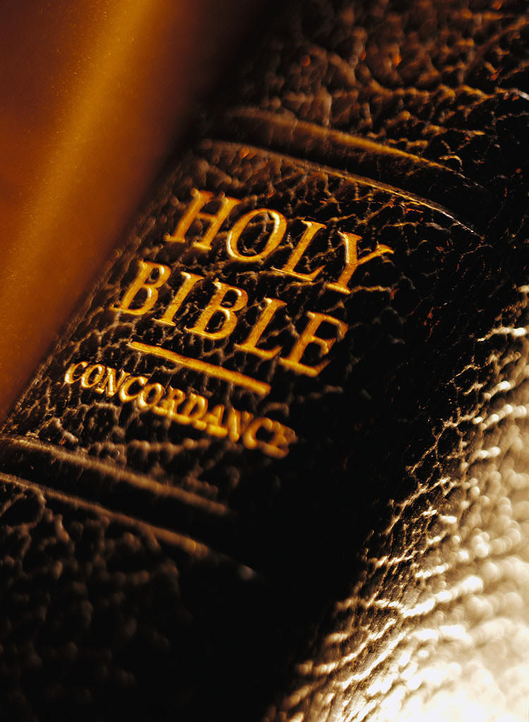
How God’s People Have Reacted Toward the Silence of God
New Testament
Apostles reaction to the Judaizers
Some taught – had to be circumcised
Created controversy
Since NO instruction had been given, the teachers had no right to speak
“Since we have heard that some who went out from us have troubled you with words, unsettling your souls, saying, "You must be circumcised and keep the law" — to whom we gave no such commandment —” Acts 15:24
Richie Thetford www.thetfordcountry.com

Slide 13
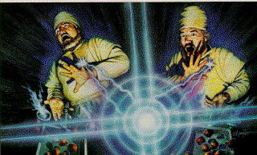
How God Has Reacted Toward Those Who Did Not Listen To His Silence
Nadab and Abihu
Leviticus 10:1-3
Get fire from the altar of burnt offering
God did not specifically condemn fire from another place but he also did NOT command it
Here is another example that God demands that His silence be respected!
Richie Thetford www.thetfordcountry.com

Slide 14
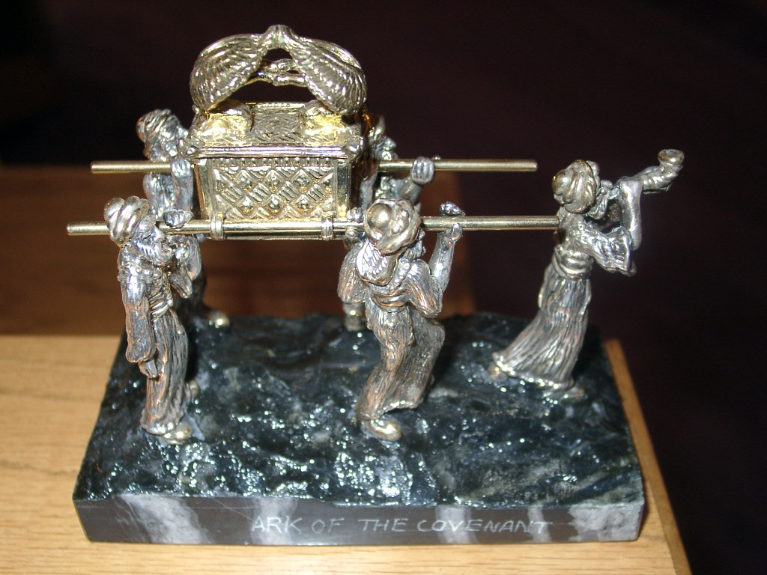
How God Has Reacted Toward Those Who Did Not Listen To His Silence
Ark of the Covenant
Law specified that the Levites were to CARRY the Ark on their shoulders
Numbers 4:15
2 Samuel 6:3-7
God did not command the use of an ox cart! Silence must be respected
Richie Thetford www.thetfordcountry.com

Slide 15
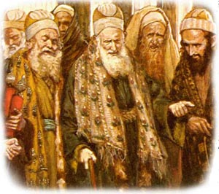
How God Has Reacted Toward Those Who Did Not Listen To His Silence
Jesus’ attitude toward the Pharisees’ traditions
Mark 7:7-9
The Pharisees bound several things as religious observances that God had not bound. God was SILENT concerning those things!
Richie Thetford www.thetfordcountry.com

Slide 16
The SILENCE of God is PROHIBITIVE Rather than Permissive
Richie Thetford www.thetfordcountry.com

Slide 17
CONCLUSION
Silence is prohibitive in other areas of life as well
We demand that our silence be respected
Silence does not sanction (authorize), scripture authorizes
Richie Thetford www.thetfordcountry.com

Slide 18
CONCLUSION
“failure to respect God’s silence may suggest that we have done what He has commanded only because we felt this was a good thing.”
Robert Turner Plain Talk
Richie Thetford www.thetfordcountry.com

Slide 19
CONCLUSION
The Bible is Silent About:
Use of instrumental music in worship to God
Church sponsored recreation & entertainment
Infant baptism
Sponsoring church arrangement
Church sponsored benevolence to non-Christians
Church sponsored institutions to evangelize the world and edify the saints
We dare not presume to act upon the SILENCE of God
Richie Thetford www.thetfordcountry.com

