Slide 1

The
Shield of
Faith
Hebrews 11:1
Hebrews 11:6
Romans 10:17
The Protection
and Reaffirming
of Our Faith

Slide 2

“But you must continue in the things which
you have learned and been assured of,
knowing from whom you have learned them, and that from childhood you have known the Holy Scriptures, which are able to make you wise for salvation through faith which
is in Christ Jesus.” 2 Timothy 3:14-15
“I have been crucified with Christ; it is no longer I who
live, but Christ lives in me; and the life which I now live in
the flesh I live by faith in the Son of God, who loved me
and gave Himself for me.” Galatians 2:20
“Therefore we also, since we are surrounded by so great a
cloud of witnesses, let us lay aside every weight, and the sin which so easily ensnares us, and let us run with endurance the race that is set before us, looking unto Jesus, the author and finisher of our faith….” Hebrews 12:1-2

Slide 3
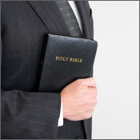
Not all who hear the gospel will respond to its message
  Acts 2:38-40
Not all who do respond to the gospel will continue to remain faithful to the Lord
  Colossians 1:21-23
Can it be said of you that you have your
shield before you, ready to defend and fight
for the cause of Christ?

Slide 4
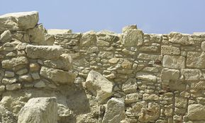
Nehemiah Rallies the People of God
The wall needed rebuilt, yet at the same time, they needed to defend themselves against the army of Samaria
Faith helped them overcome the enemy and to complete their work
  Nehemiah 4:6-9, 15-18
Before being ready to do such a thing for Nehemiah and God – they had to have a true and abiding faith
1 Corinthians 15:58

Slide 5
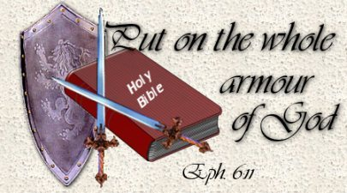
The
Whole Armor of God
Paul’s exhortation to the Ephesians
Life is a warfare – we struggle with the common calamities of life
Religion is warfare – we struggle with the opposition of the powers of darkness
Ephesians 6:10-20

Slide 6
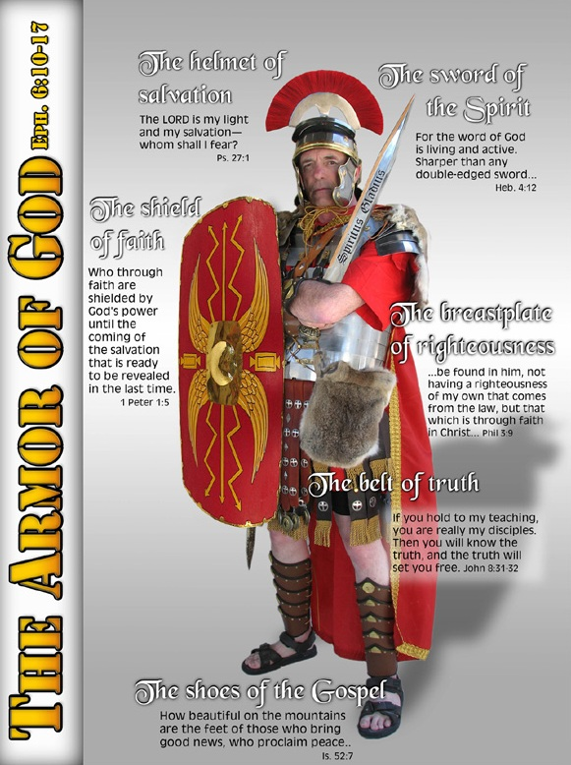
Belt of Truth
  Truth must be taken into our hearts
  Must read, study, understand and believe
  Must be applied in our life
  Character is not developed by hypocrisy, guilt and deceit – but rather by openness and faithfulness

Slide 7
Breastplate of Righteousness
  Moral uprightness should be the mark of a Christian
  Christian’s obligation is to stand and fight
Shoes
  Always ready to go to battle

Slide 8
Helmet of Salvation
  The result of God’s great grace toward us and although we can throw it aside voluntarily – the enemy can never strip it from us against our own free will
Sword
  The Word of God

Slide 9
Shield of Faith
  Describes the unshakable trust in undeniable fact
  True faith comes from hearing the Word of God
    Romans 10:17
  Christianity is a system of faith
  We MUST take up the shield of faith in order to be ready for battle!

Slide 10


The Shield of Faith
We are to resist the Devil
“Be sober, be vigilant; because your adversary the devil walks about like a roaring lion, seeking whom he may devour. Resist him, steadfast in the faith….”
1 Peter 5:8-9
“Therefore submit
to God. Resist the
devil and he will
flee from you.”
James 4:7

Slide 11
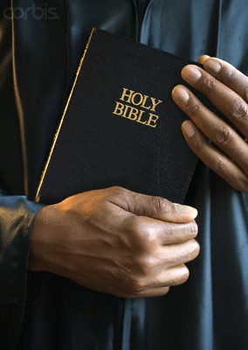
The Shield of Faith
Will protect us by resisting the Devil in several different ways:
By giving us the Will
By giving us a Confident Spirit
By giving us the Scripture
By giving us Prayer
By giving us Wisdom
By giving us Character

Slide 12

Our Need to Reaffirm Our Faith
We need more to be like Joshua
“And if it seems evil to you to serve the LORD, choose for yourselves this day whom you will serve, whether the gods which your fathers served that were on the other side of the River, or the gods of the Amorites, in whose land you dwell. But as for me and my house, we will serve the LORD.” (Joshua 24:15)
Why does the Christian’s faith weaken?
  There is no true desire to let Christ be Lord of their life!
Matthew 10:34-39

Slide 13
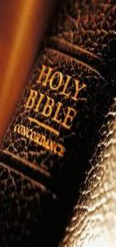
Our Need to Reaffirm Our Faith
It is up to US where We end up
  Faith doesn’t just happen
    It is the result of dutifully serving and doing what the Lord has given us to do!
  To become more than what we are we must be dissatisfied with our present condition and
  WANT to change
Philippians 3:12-14

Slide 14


Our Need to Reaffirm Our Faith
Firm conviction is a must
  Cost of discipleship is high
    Revelation 2:10
  Faithfulness is firm conviction and being fully persuaded about God’s revelation and truth
Be determined to take up the “shield of faith” and be fully persuaded to serve your creator!

