Slide 1

Seven “Blunders” of Man

Slide 2

Rejecting Jesus as God’s Son
We must believe that Jesus is the Son of God
  Matthew 1:18-24
  John 8:24
  John 14:6
  Acts 4:12

Slide 3

Thinking Our Own Goodness Can Save
All are in need of the redemption that is found in Jesus
  Hebrews 9:22
  Romans 3:24-26
  Matthew 26:28

Slide 4

Looking Only at Things Seen
….Here and Now Only
The physical and spiritual are contrasted
  2 Corinthians 4:18
  Luke 12:15-21
  2 Peter 3:10-13

Slide 5

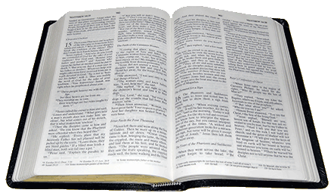
Thinking That Faith Only
Will Save Us!
Several things are mentioned in the Bible which saves us
  James 1:18-25; 2:14-26
Thinking the Church is Unnecessary to Our Salvation
The church is the saved
  Ephesians 5:23

Slide 6
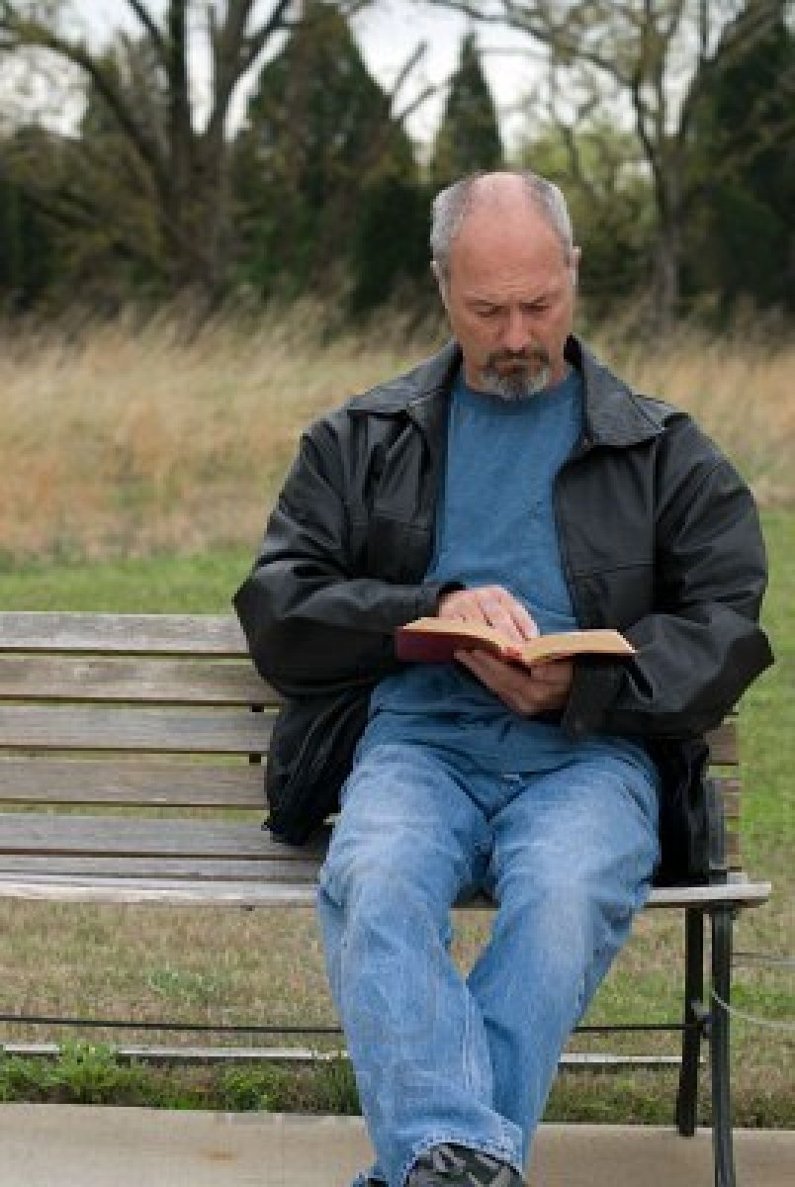
Thinking We Are Too Bad for Christ to Save Our Soul
How bad is too bad?
  Acts 2:23
  Acts 7:52
  1 Timothy 1:15

Slide 7

Thinking We’ll Submit to Christ One Day … but We Have Time
How much time do we really have?
  Ecclesiastes 12:1
  James 4:13-15
  Hebrews 3:13
  2 Corinthians 6:2
  Acts 24:25

Slide 8
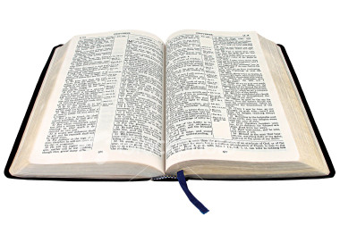
Conclusion
If we reject Christ – we have committed an enormous blunder!
  2 Corinthians 5:10
  John 12:48
Are you ready to serve and live for Christ today?
IF NOT…….
You’ll live forever with your blunder in hell

