Slide 1
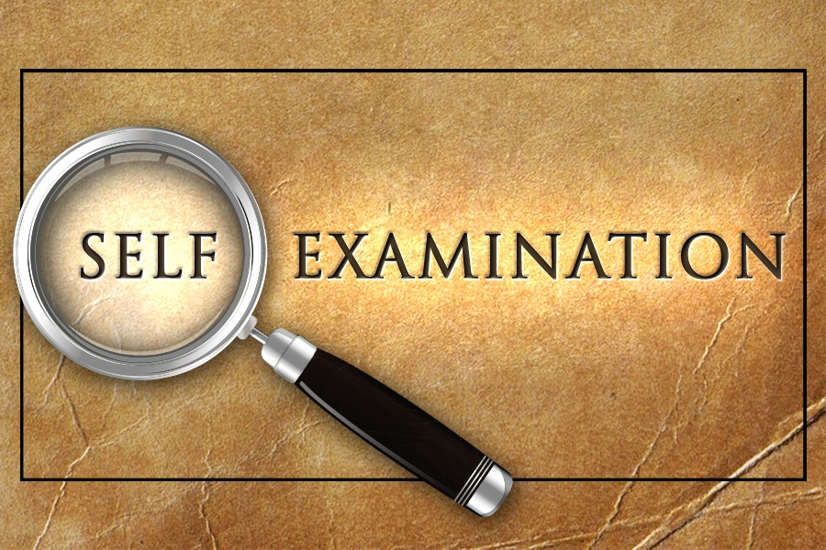
2 Corinthians 13:5-6
Richard Thetford www.thetfordcountry.com

Slide 2


Why Should We Examine Ourselves?
To ensure that we are “in the faith”
  2 Timothy 1:13
  1 Timothy 4:16
  Hebrews 2:1
  Romans 10:17
  2 Timothy 1:12
Richard Thetford www.thetfordcountry.com

Slide 3
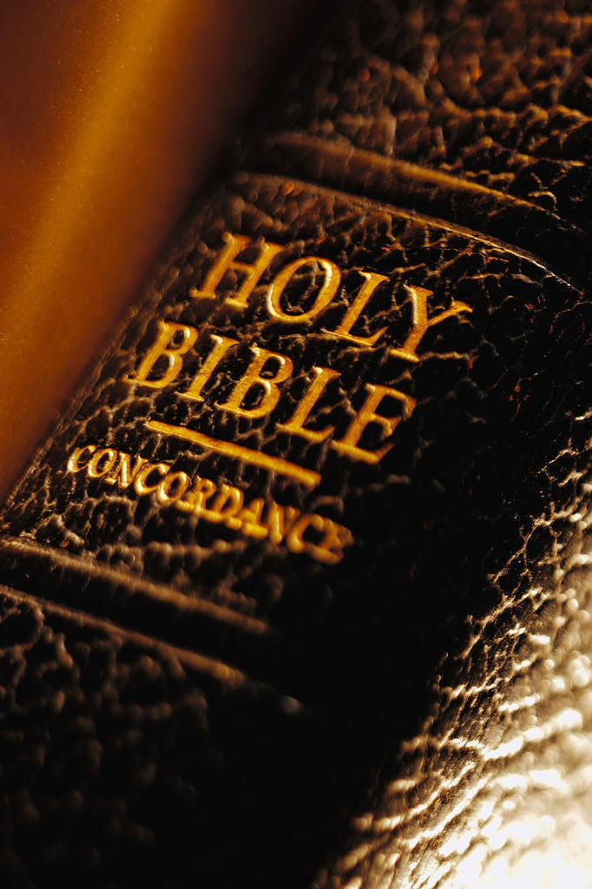
Why Should We Examine Ourselves?
To determine if Jesus is in us
  Romans 8:10
  Galatians 2:20
To determine if we are a reprobate
  Romans 1:28
To determine if we know ourselves
  1 Corinthians 10:12; 2 Corinthians 10:18
  1 Corinthians 3:13; Galatians 6:4
Richard Thetford www.thetfordcountry.com

Slide 4
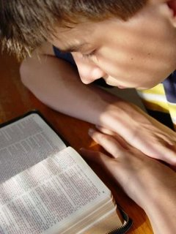
What Standard Should We Use?
Not by our own estimates
  Galatians 6:3
  1 Corinthians 8:2
  Romans 12:3
Not by the estimate of others
By the word of God
  2 Timothy 2:15
  Romans 8:14
Richard Thetford www.thetfordcountry.com

Slide 5

We Should Ask:
Am I in the faith?
Is Christ in me?
Am I pure in heart and life?
Do I have a loving heart?
Am I humble?
Do I hate sin?
Richard Thetford www.thetfordcountry.com

Slide 6

We Should Ask:
Do we bless or curse?
Am I eager to hear good news?
Do I love the body, the church?
Do I believe I will be judged?
“So then each of us shall give account of himself to God.”
Romans 14:12
Richard Thetford www.thetfordcountry.com

Slide 7
Before we can do what is right, we must first know our real condition before God
Richard Thetford www.thetfordcountry.com

