Slide 1

Self-centeredness
Philippians 2:1-4
Genesis 3:1-6
Richard Thetford www.thetfordcountry.com

Slide 2

Religion Toward God Turns Into Idolatry
Consists of anything that “dethrones” God
  Colossians 3:5
Substitution of
self-will for God’s will
  Genesis 3:1-6
  Romans 1:18-25
Humanism
Richard Thetford www.thetfordcountry.com

Slide 3
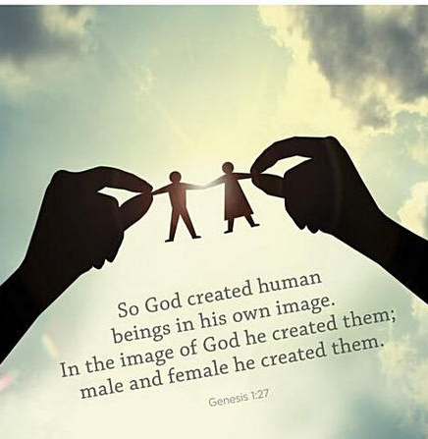
Relationships with Other Human Beings Degenerate
Caring for nothing but ourselves
  Genesis 1:27
  Acts 20:35
  1 John 4:7-11
Marriage relationship
Must submit ourselves to the needs of others
  Philippians 2:3-4
Richard Thetford www.thetfordcountry.com

Slide 4

We Detest the Very Self We Have Come to Worship
Doing our duty
Must serve
  Matthew 20:25-28
Richard Thetford www.thetfordcountry.com

Slide 5

Selflessness
John 13:14-15
Philippians 2:5-9
Richard Thetford www.thetfordcountry.com

