Slide 1

The “Seed”
Is Good
Matthew 13:27
Richie Thetford www.thetfordcountry.com

Slide 2

Did You Not Sow Good Seed?
Parable of the tares
  Matthew 13:3-9, 18-23
Is God’s Word good enough?
  To the religious world – “no”
    Seek ways to “market” their religion
Richie Thetford www.thetfordcountry.com

Slide 3
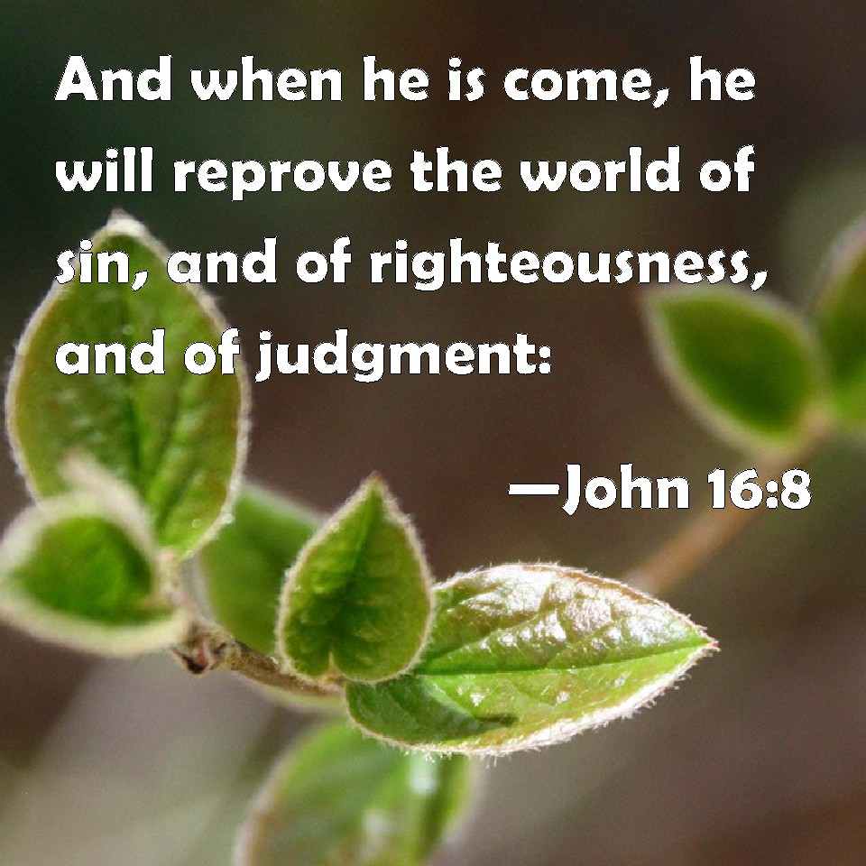
How Christians Are Made
How did this work?
  Matthew 28:18-20
People given a message from God
  John 16:8
Examples
  Jews on Pentecost – Acts 2:14-40
  Felix – Acts 24:24-26
  Samaritans – Acts 8:4-5, 12
  Eunuch – Acts 8:25-40
Richie Thetford www.thetfordcountry.com

Slide 4
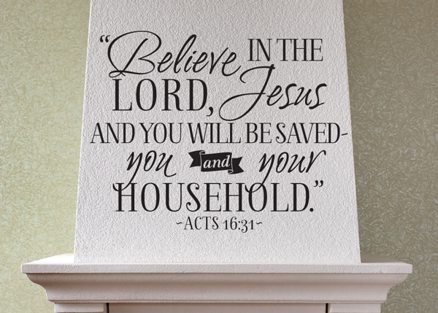
How Christians Are Made
People moved by the teaching
of God’s Word
  Lydia – Acts 16:11-15
  Philippian Jailor – Acts 16:29-33
  The Corinthians – Acts 18:5-8
In every case:
  Moved by godly sorrow
  Obeyed the gospel
  Repented and were baptized
Richie Thetford www.thetfordcountry.com

Slide 5

The Gospel Being Preached
How men should be drawn to God
  John 6:44-45
  Romans 10:17
Gospel preaching is powerful
  Salvation – Romans 1:16
  Reconciliation and hope – Colossians 1:21-23
  Spiritual maturity – Acts 20:32
  Sufficiency – 2 Timothy 3:16-17
Richie Thetford www.thetfordcountry.com

Slide 6

The Gospel Being Preached
Must preach the gospel of Christ
  1 Corinthians 9:16
  2 Timothy 4:2-5
Richie Thetford www.thetfordcountry.com

Slide 7

What Business Are We In?
Soul-saving!
  1 Timothy 3:15
Some – misplaced zeal
  Romans 10:1-3
Richie Thetford www.thetfordcountry.com

Slide 8
The “seed” is good!
To an honest heart it will take root, blossom, and mature into a faithful child of God.
HEAVEN – Don’t Miss It For The World!
Richie Thetford www.thetfordcountry.com

