Slide 1
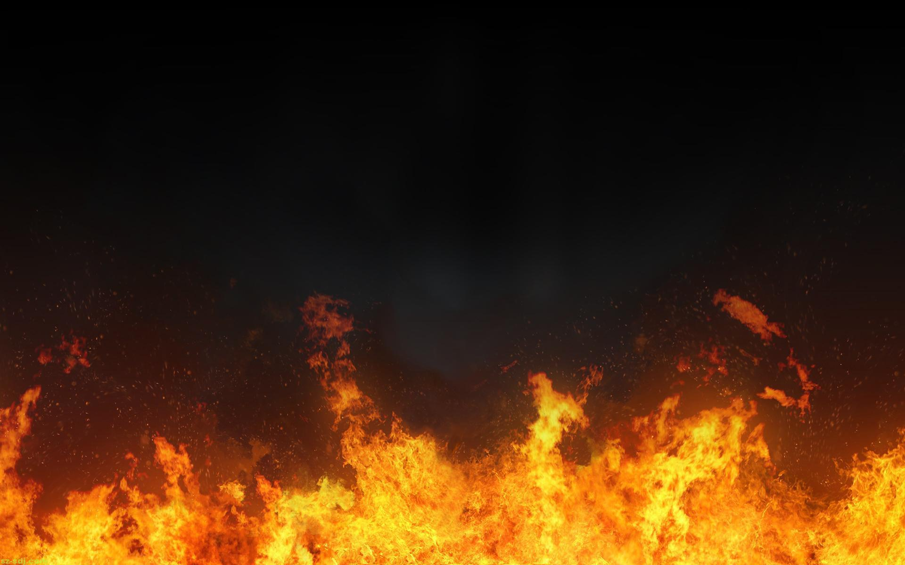
The Scary Reality of HELL
Richie Thetford www.thetfordcountry.com

Slide 2
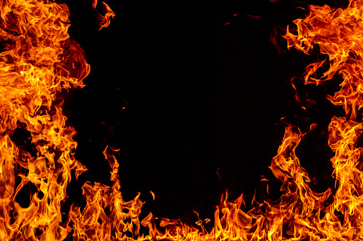
HELL is Real
Not a fictitious story or myth
Luke 16 – foretaste of greater things
Luke 16:23, 28
He was in a REAL place!
Richie Thetford www.thetfordcountry.com

Slide 3
HELL is Real
Hell is as real as Heaven!
Equality – as far as their nature
Matthew 25:46
Hell should be feared
Hell is beyond the grave
Hell should motivate us to live right
Richie Thetford www.thetfordcountry.com

Slide 4
HELL is Terrible
Gehenna
Points back to the Valley of Hinnom
Seat of worship to the idol Molech
2 Chronicles 28:3
2 Chronicles 33:6
2 Kings 23:10
Jeremiah 7:30-32
Jeremiah 19:5-6
Jeremiah 31:40
Richie Thetford www.thetfordcountry.com

Slide 5
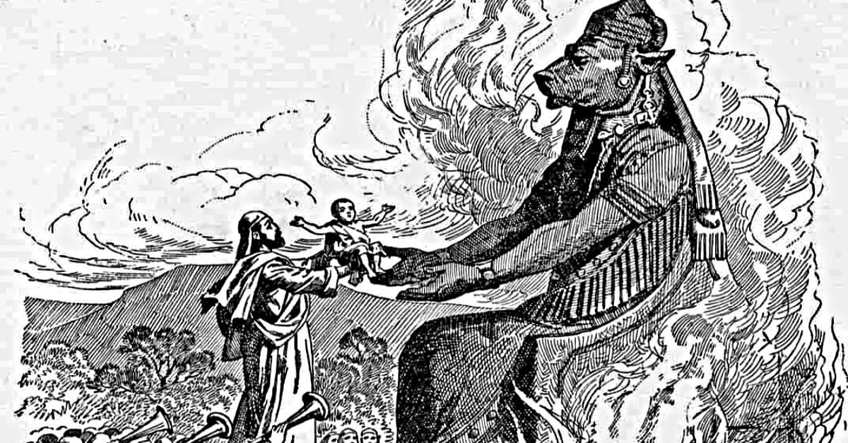
Richie Thetford www.thetfordcountry.com

Slide 6
HELL is Terrible
Gehenna
Points back to the Valley of Hinnom
Seat of worship to the idol Molech
2 Chronicles 28:3
2 Chronicles 33:6
2 Kings 23:10
Jeremiah 7:30-32
Jeremiah 19:5-6
Jeremiah 31:40
Richie Thetford www.thetfordcountry.com

Slide 7
HELL is Terrible
Lake of fire
Fire and brimstone
Revelation 20:10, 14-15; 21:8
Furnace of fire
Matthew 13:42
Flaming fire
2 Thessalonians 1:7-9
Unquenchable fire
Mark 9:43
Richie Thetford www.thetfordcountry.com

Slide 8
HELL is Terrible
Weeping, wailing, gnashing of teeth
Howling and crying
Matthew 13:50
Matthew 25:30
Hell is eternal!
Matthew 18:8-9
Matthew 25:46
Richie Thetford www.thetfordcountry.com

Slide 9
The Scary Reality of HELL
The smoke of torment ascends FOREVER!
Revelation 14:10-11
Richie Thetford www.thetfordcountry.com

