Slide 1
Satan Is Having a Field Day!
The Sins of Summer
Proverbs 22:6
Richard Thetford www.thetfordcountry.com

Slide 2
Immodest Apparel Everywhere!
Immodesty has a direct relationship between the individual, worldliness, or godliness
Newspaper ads entice people to buy immodest apparel
Lascivious: “expressing lust or lewdness; wanton. Tending to excite lust” (Webster)
Richard Thetford www.thetfordcountry.com

Slide 3
Immodest Apparel Everywhere!
Lascivious attitudes have crept into the church
Warnings concerning the sin of lasciviousness:
“Lest, when I come again, my God will humble me among you, and I shall mourn for many who have sinned before and have not repented of the uncleanness, fornication, and lewdness which they have practiced.”
Jude 4
1 Peter 4:3
Ephesians 4:19
2 Corinthians 12:21
Richard Thetford www.thetfordcountry.com

Slide 4
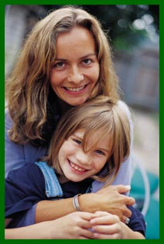
Immodest Apparel Everywhere!
Some parents are not setting a good example for their children
Children wear what they do because of a lack of proper teaching
Near nudity has become commonplace in many homes today
Richard Thetford www.thetfordcountry.com

Slide 5
Immodest Apparel Everywhere!
“in like manner also, that the women adorn themselves in modest apparel, with propriety and moderation, not with braided hair or gold or pearls or costly clothing, but, which is proper for women professing godliness, with good works.”
1 Timothy 2:9-10
Modest
Orderly, well-arranged, decent, of good behavior
Propriety (Shamefacedness):
Decency, that modesty which is rooted in the character
Moderation (Sobriety):
Habitual inner self-government, with its constant rein on the passion and desires
Richard Thetford www.thetfordcountry.com

Slide 6
Christians should only be governed by the standard of God!
Romans 12:1-2
1 Peter 1:15-16
1 Peter 2:9
2 Corinthians 6:17
“Come out from among them and be separate, says the Lord….”
Richard Thetford www.thetfordcountry.com

Slide 7
Parents – Don’t Make Excuses
Parents are to control their children
God rules first – Husbands second
Parents:
Recognize the excuses our children might give
“But mom, everybody else does.”
John 15:18-25
Richard Thetford www.thetfordcountry.com

Slide 8
Swimming Pools and Christians
Needed – A “swimsuit”
Heard of a “modest” swimsuit sale?
Can you find:
A non-revealing, modest, loose fitting, godly swimsuit?
We are Christians first!
“Test all things; hold fast what is good. Abstain from every form (appearance –KJV) of evil.”
1 Thessalonians 5:21-22
Richard Thetford www.thetfordcountry.com

Slide 9
Conclusion
Put Christ FIRST in our life!
Desire to keep ourselves pure in every way
1 Corinthians 15:33
2 Corinthians 7:1
1 Timothy 5:22
1 John 3:3
Romans 13:14
Richard Thetford www.thetfordcountry.com

Slide 10
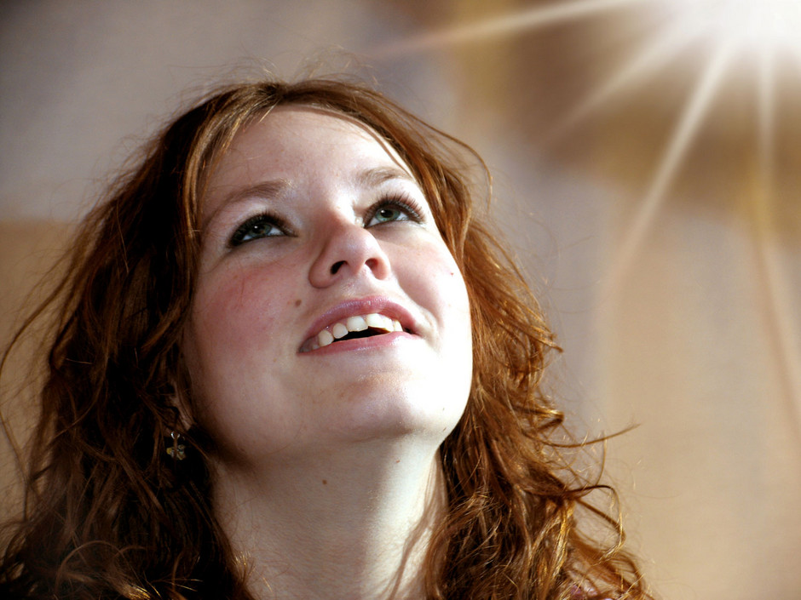
Conclusion
Do what is right in God’s sight
Stand up and be counted a Christian!
“And whatever you do in word or deed, do all in the name of the Lord Jesus, giving thanks to God the Father through Him.”
Colossians 3:17
Richard Thetford www.thetfordcountry.com

