Slide 1
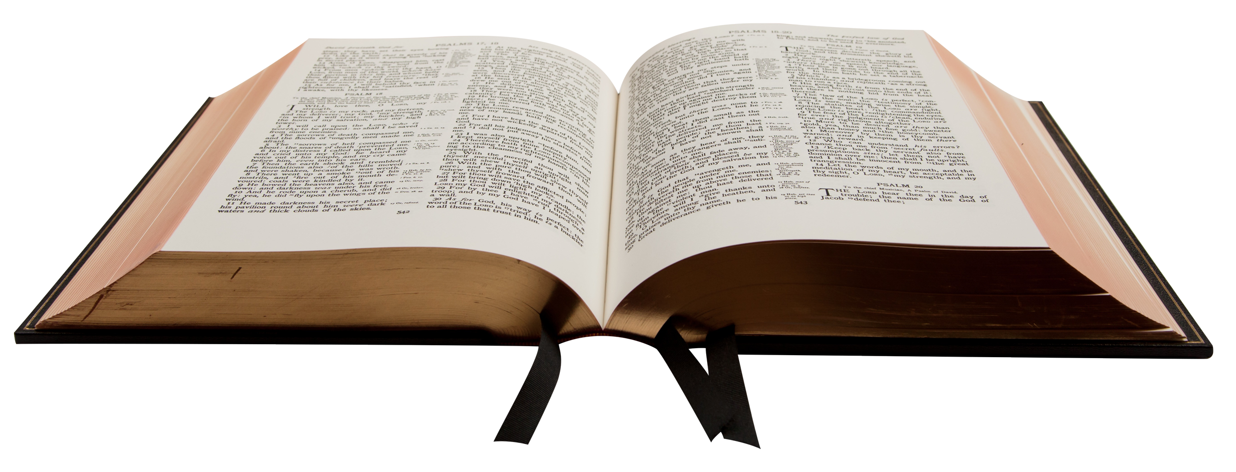
Samuel’s Important Words
1 Samuel 3:1-10
John 8:47
Richie Thetford www.thetfordcountry.com

Slide 2
Reverence Toward God Himself
Having a receptive attitude toward what God says
Ecclesiastes 12:13
Luke 6:46
Be eager to hear God
2 Corinthians 8:5
“…well done, good and faithful servant…” (Matthew 25:21)
Richie Thetford www.thetfordcountry.com

Slide 3
Responsiveness to Divine Truth
“willing to yield”
James 3:17
Exodus 5:2
Exodus 10:3
2 Kings 22:19
Acts 10:33
Richie Thetford www.thetfordcountry.com

Slide 4
Responsiveness to Divine Truth
A “sympathetic vibration” within our hearts?
Our “readiness to hear”
Hebrews 13:17
Jesus warned:
Luke 8:18
Richie Thetford www.thetfordcountry.com

Slide 5
Readiness to Obey God
Eager and ready to obey God?
Exodus 4:13-14
Isaiah 6:8
Have a purpose for listening to God
John 7:17
2 Thessalonians 2:10-12
“I made haste, and did not delay to keep Your commandments” (Psalms 119:60)
Richie Thetford www.thetfordcountry.com

Slide 6
Conclusion
“I will hasten to Him, hasten so glad and free”
“Lord, what do you want me to do?” (Acts 9:6)
Romans 1:15
“…having heard the word with a noble and good heart, keep it and bear fruit with patience” (Luke 8:15)
Richie Thetford www.thetfordcountry.com

