Slide 1
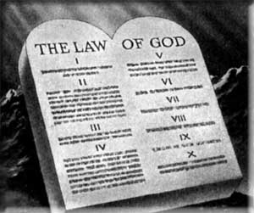
The Sabbath or first day of the week?
Which day are Christians taught to keep?

Slide 2
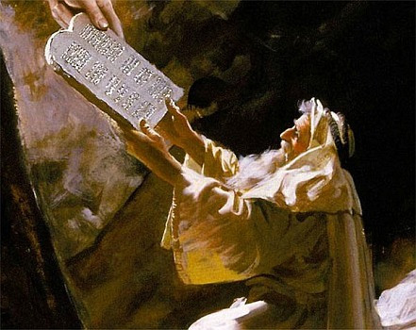
Sabbath Law Revealed at Sinai
Not given at creation
Given by Moses at Sinai
Nehemiah 9:13-14
If commanded at the creation, then the patriarchs would have had to observe it

Slide 3
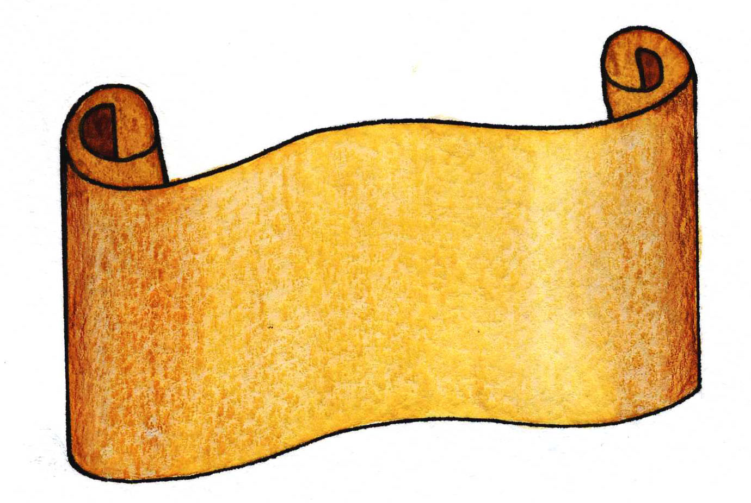
Sabbath Keeping
Belonged to the Jewish age
Moses told them what they must do
Exodus 16:22-26

Slide 4
Sabbath Keeping
1500 years of Jewish Law
Can read of the Sabbath command and the penalty for violating it!
The Bible shows us when the Sabbath day observance was given and to whom

Slide 5
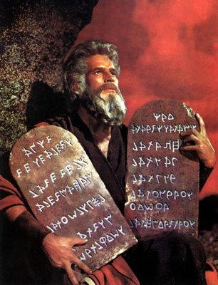
Sabbath Day Observance
Given when the children of Israel came out of Egyptian bondage
Exodus 20:1-2,8

Slide 6
Sabbath Day Observance
Purpose of the Sabbath
Given to the Jews as a memorial of their deliverance from Egyptian bondage
Deuteronomy 5:15

Slide 7
Sabbath Day Observance
A sign between God and Israel
“The Sabbath is a sign between me and the children of Israel forever….throughout their generations”
Exodus 31:12-17; Ezekiel 20:10-12

Slide 8
Sabbath Day Observance
A special law for the fleshly descendants of Jacob
“The Lord our God made a covenant with us in Horeb. The Lord did not make this covenant with our fathers, but with us, those who are here today, all of us who are alive ……. Observe the Sabbath day, to keep it holy, as the Lord your God commanded you.”
Deuteronomy 5:2-3,12

Slide 9
Sabbath Keeping
NO distinction in the Law of God and the Law of Moses
One and the same Law
2 Chronicles 34:14; Ezra 7:6; Mark 7:10; 2 Chronicles 31:3
Moses was the Law giver – it was God’s Law
Nehemiah 8:1,8,14

Slide 10
Old Covenant Abolished
Made at the time the Israelites came out of the land of Egypt
1 Kings 8:9,21
“So He declared to you His covenant which He commanded you to perform, the Ten Commandments; and He wrote them on two tablets of stone.”
Deuteronomy 4:13

Slide 11
Old Covenant Abolished
What does the New Testament say about these commandments which were written on “two tablets of stone?”
2 Corinthians 3:6-14
“engraved on stones”
“passing away”
“taken away in Christ”

Slide 12
“having abolished in His flesh the enmity, that is, the law of commandments contained in ordinances, so as to create in Himself one new man from the two, thus making peace, and that He might reconcile them both to God in one body through the cross, thereby putting to death the enmity.”
Ephesians 2:15-16

Slide 13
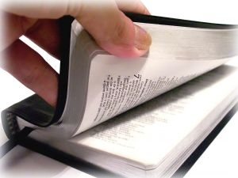
Old Covenant Abolished
Hebrew writer says it plainly:
Hebrews 8:7-13
We are reconciled to God in the New Testament church
Colossians 2:11-14

Slide 14
Sabbath Keepers
Do not keep the Sabbath properly
Sabbath was a day of rest
Exodus 35:1-3
Do Sabbath keepers observe this rest-rule today?

Slide 15
Sabbath Keepers
Do not keep the Sabbath properly
Penalty for violating the Sabbath
Numbers 15:32-36
What passage teaches that the Sabbath day is binding, but the penalty for violating it has been removed?

Slide 16
Sabbath Keepers
Do not keep the Sabbath properly
A burnt offering
Numbers 28:9-10
What passage teaches that the Sabbath day is binding, but not the burnt offering?

Slide 17
Sabbath Keepers
Do not keep the Sabbath properly
Travel restricted
Exodus 16:29
Why don’t Sabbatarians respect this regulation? Where is the consistency in practice?

Slide 18
First Day of the Week
The “Lord’s Day”
Things that took place on the “first day of the week”
Christ arose from the dead
Jesus met with His disciples
First gospel sermon was preached
Lord’s church had its beginning

Slide 19
First Day of the Week
The “Lord’s Day”
Things that took place on the “first day of the week”
The church assembled
To observe the Lord’s Supper
Acts 20:7
To give of their means
1 Corinthians 16:1-2

Slide 20
First Day of the Week
Notes of interest:
A Sabbath day passed while Paul waited for the first day of the week, and he was silent about keeping the Sabbath day
Paul went into the Synagogues on the Sabbath day in order to teach the gospel of Christ
Acts 17:2-3
Acts 18:4-7

Slide 21
First Day of the Week
If the Sabbath day was binding on these early Christians, why were they never told to do anything on that day?

Slide 22
Conclusion
The Sabbath day served its purpose and then was taken away
“Tell me, you who desire to be under the law, do you not hear the law?”
Galatians 4:21

Slide 23
“So let no one judge you in food or in drink, or regarding a festival or a new moon or sabbaths, which are a shadow of things to come, but the substance is of Christ.”
Colossians 2:16-17
Those of us who are “in Christ” do not need to, nor should we desire to, return to the inferior shadows of the old law

