Slide 1


Slide 2

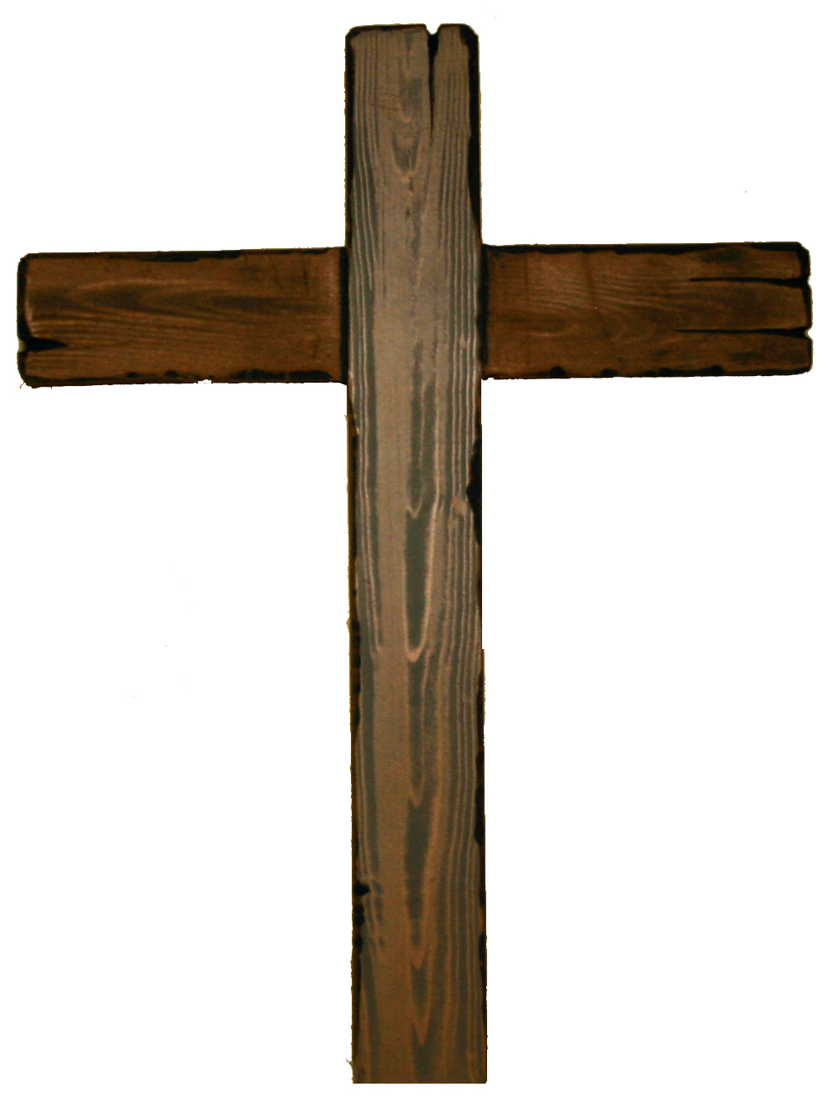
Rooted in Love
Love begins with God
Love of God
  John 3:14-16
God is love
  1 John 4:8-10
God’s children
  1 John 3:1-2
Jesus gave His life
  Ephesians 3:1-2
  1 John 3:16
We were sinners
Romans 5:6-8
Richie Thetford www.thetfordcountry.com

Slide 3

Rooted in Love
The Nature of God’s Love
Surpasses knowledge
  Ephesians 3:17-19
Mercy and grace
  Ephesians 2:4-9
Suffers long
  1 Corinthians 13:4-8
Does no harm
  Romans 13:8-10
Richie Thetford www.thetfordcountry.com

Slide 4

Rooted in Love
Our Response to God’s Love
To love Him
  Matthew 22:36-40
Obey His commands
  John 14:15
  John 14:21
  1 John 5:2-3
Richie Thetford www.thetfordcountry.com

Slide 5

Rooted in Love
Our Response to God’s Love
We will reflect His Son
  2 Corinthians 5:14-15
Love one another
  1 John 4:7-11
Richie Thetford www.thetfordcountry.com

Slide 6

Love Him and Obey Him
Richie Thetford www.thetfordcountry.com

