Slide 1
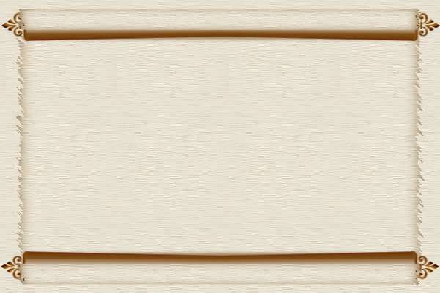
For the GOD of the Covenant
“Remember the Sabbath day, to keep it holy. Six days you shall labor and do all your work, but the seventh day is the Sabbath of the LORD your God. In it you shall do no work: you, nor your son, nor your daughter, nor your male servant, nor your female servant, nor your cattle, nor your stranger who is within your gates. For in six days the LORD made the heavens and the earth, the sea, and all that is in them, and rested the seventh day. Therefore the LORD blessed the Sabbath day and hallowed it.”
Reverence
Exodus 20:8-11

Slide 2
Additional Revelation Given
Commanded to provide a rest for man and animal
  Exodus 23:12
Must always be observed – No excuses!
  Exodus 34:21
Even the building of the Tabernacle was put on hold while the Sabbath was observed
  Exodus 31:12-17; 35:1-3

Slide 3
Punishment of the Sabbath Breaker
The man who violated the Sabbath was to be punished by death!
  Exodus 31:15
He was stoned by the whole congregation!
  Numbers 15:36
Why such severe punishment?
  Sabbath breaker showed a willful disregard for the Sabbath day and for God

Slide 4
New Testament Parallels
Lord’s Supper instituted
  Matthew 26:28
Jesus’ death on our behalf
  1 Corinthians 11:24
Lord’s Supper observed every week
  Acts 20:7
Collection completed weekly
  1 Corinthians 16:1-2
Assembling to worship God
  Hebrews 10:25-29; Matthew 26:24
Forsaking is a WILLFUL Sin

Slide 5
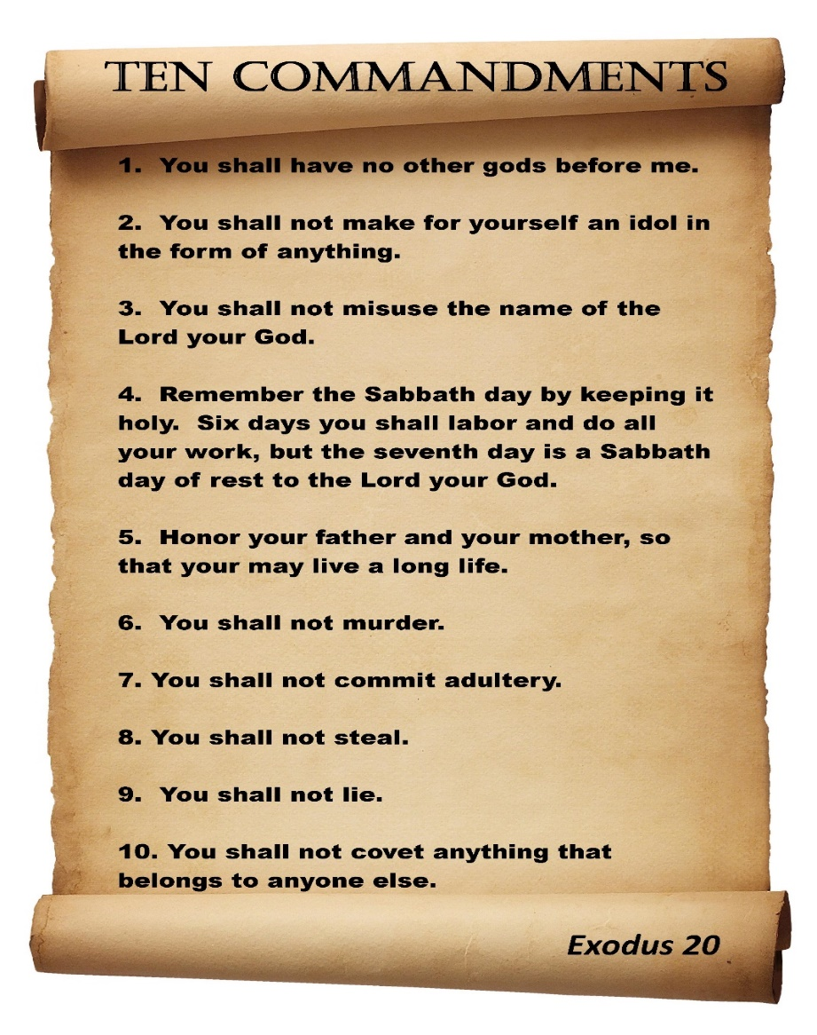
We are not bound by the law of Moses
…but Paul tells us:
“For whatever things were written before were written for our learning, that we through the patience and comfort of the Scriptures might have hope.” (Romans 15:4)

Slide 6
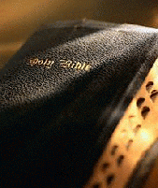
WE CAN LEARN:
“that we must show a REVERENCE for the Covenant we are now under AND the God who made it!”

