Slide 1
Restoring the Church
Richie Thetford www.thetfordcountry.com

Slide 2
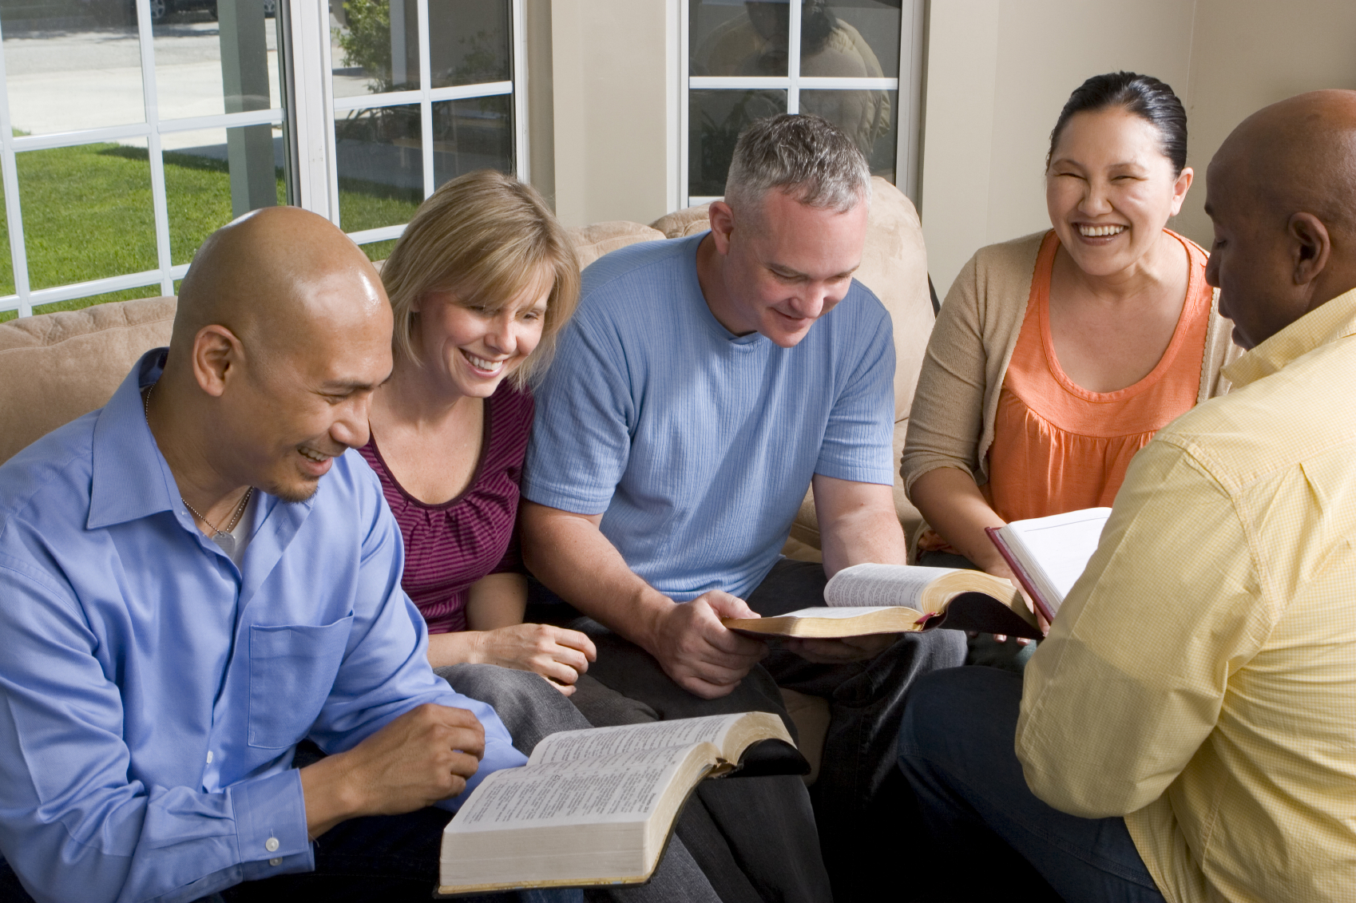
Proper Restoration of the Church
Things we must know
Ephesians 1:22-23
Acts 2:37
Romans 10:9-10
2 Corinthians 4:5
Richie Thetford www.thetfordcountry.com

Slide 3
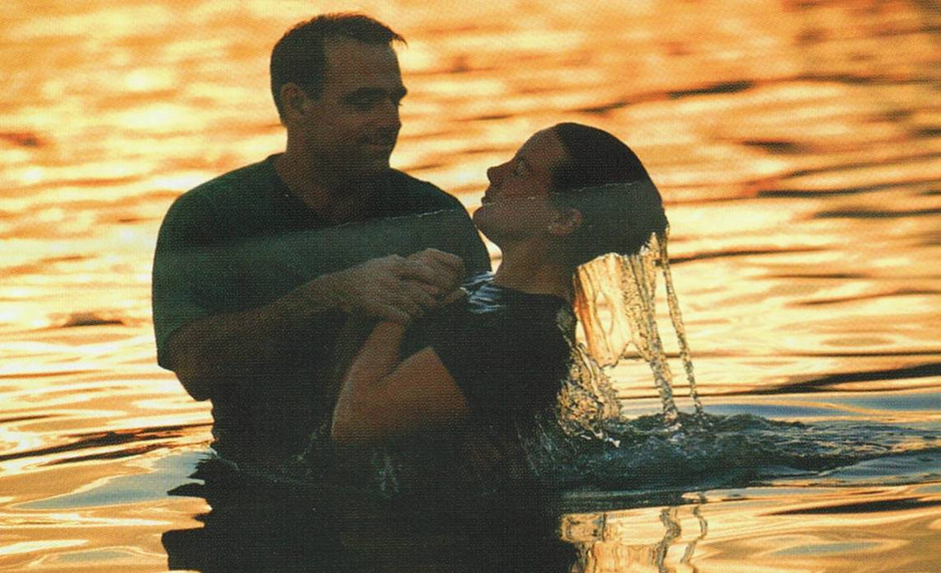
Added to the Church
Added by obedience
Acts 2:41
Acts 2:47
Acts 10:34-35
Romans 2:11
Richie Thetford www.thetfordcountry.com

Slide 4
Added to the Church
Names written in heaven
Luke 10:20
Philippians 4:3
Revelation 3:5
Revelation 20:11-15
Hebrews 12:23
Hebrews 12:1-29
Jesus is “Savior of the Body”
Ephesians 5:23
Acts 20:28
Richie Thetford www.thetfordcountry.com

Slide 5
Restoring the Church
In Him we have redemption through His blood, the forgiveness of sins, according to the riches of His grace
Ephesians 1:7
Richie Thetford www.thetfordcountry.com

