Slide 1
Responsible
For Our Actions
“Therefore, whatever you want men to do to you, do also to them, for this is the Law and the Prophets.”
Matthew 7:12
Richie Thetford www.thetfordcountry.com

Slide 2
Christians Are Accountable
Sin affects the person and often the entire congregation
All are responsible for their actions
  Can’t place the blame on someone else
Can’t read minds
  1 Corinthians 2:11
    Must take what one says or does at face value and not begin making excuses for their actions
All are accountable for their actions
Richie Thetford www.thetfordcountry.com

Slide 3
A Christian Should Be
Of the same mind
  Christians strive to be of the same mind as Christ
    Romans 12:16
    1 Corinthians 1:10
    Philippians 3:16
    1 Peter 4:1
  Christians are sensitive to the needs of others
    Philippians 2:1-5
Richie Thetford www.thetfordcountry.com

Slide 4
A Christian Should Be
Loving and Kind
  Jesus commands us to have love for one another
  Paul shows us how important love is
    Romans 13:10; 1 Corinthians 13:1-8; Ephesians 5:1-2; 4:32
“A new commandment I give to you, that you love one another; as I have loved you, that you also love one another. By this all will know that you are My disciples, if you have love for one another.“
John 13:34-35
Richie Thetford www.thetfordcountry.com

Slide 5

Conclusion
A good name is precious
  Proverbs 22:1; Ecclesiastes 7:1
Don’t be “situational” Christians
Act according to God’s Word
Judged based on our actions
  2 Corinthians 5:10; John 12:48
What we say and do DOES affect the lives of others
Richie Thetford www.thetfordcountry.com

Slide 6
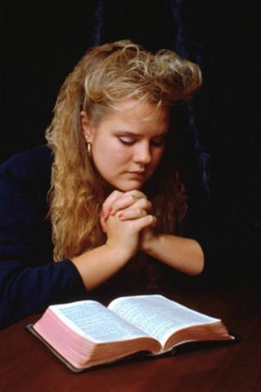
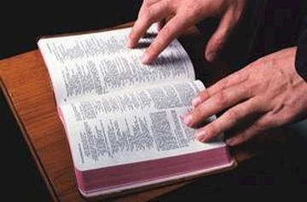
Psalms 26:2
Examine me, O LORD, and prove me; Try my mind and my heart.
May God continue to be with us as we diligently strive to do only that which is right and approved of in His sight!
Richie Thetford www.thetfordcountry.com

