Slide 1

The Renewing of
Our Mind
Romans 12:1-2
Richard Thetford www.thetfordcountry.com

Slide 2

Conformed Versus Transformed
Must study
  Requires constant effort
Conformity to the world is the course
of least resistance
  1 Corinthians 15:33
Richard Thetford www.thetfordcountry.com

Slide 3
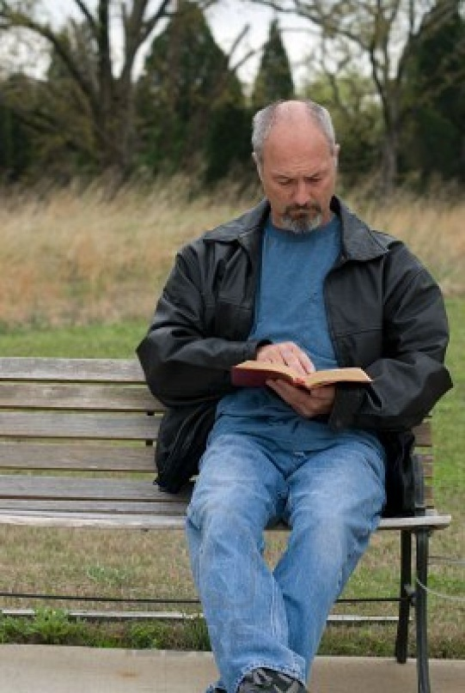
Transformation – A “Renewed” Mind
Must be an inward change of heart
  “Mind” = intellect + emotions + will
Spirituality must be our goal
  Romans 8:5-11; Ephesians 4:17-24;
  1 John 2:15-17
Richard Thetford www.thetfordcountry.com

Slide 4

The Result:
“Proving” what is that good and acceptable and perfect will of God
“Prove” – to scrutinize or test for genuineness
Carnal-minded – poor judge of right and wrong
  Ephesians 5:8-10,17
Richard Thetford www.thetfordcountry.com

Slide 5
John 7:17 If anyone wills to do His will, he shall know concerning the doctrine, whether it is from God or whether I speak on My own authority.
1 Corinthians 3:1-3 And I, brethren, could not speak to you as to spiritual people but as to carnal, as to babes in Christ. I fed you with milk and not with solid food; for until now you were not able to receive it, and even now you are still not able; for you are still carnal. For where there are envy, strife, and divisions among you, are you not carnal and behaving like mere men?
Richard Thetford www.thetfordcountry.com

Slide 6
Hebrews 5:11-14 of whom we have much to say, and hard to explain, since you have become dull of hearing. For though by this time you ought to be teachers, you need someone to teach you again the first principles of the oracles of God; and you have come to need milk and not solid food. For everyone who partakes only of milk is unskilled in the word of righteousness, for he is a babe. But solid food belongs to those who are of full age, that is, those who by reason of use have their senses exercised to discern both good and evil.
Richard Thetford www.thetfordcountry.com

Slide 7

2 Peter 3:16 as also in all his epistles, speaking in them of these things, in which are some things hard to understand, which untaught and unstable people twist to their own destruction, as they do also the rest of the Scriptures.
Richard Thetford www.thetfordcountry.com

Slide 8

The Result:
“Proving” what is that good and acceptable and perfect will of God
A “transformed” person can discern God’s will
  Romans 2:18-20
  Philippians 1:10
  1 Peter 2:2-3
The Christian’s Life is a demonstration of the truth
Richard Thetford www.thetfordcountry.com

Slide 9
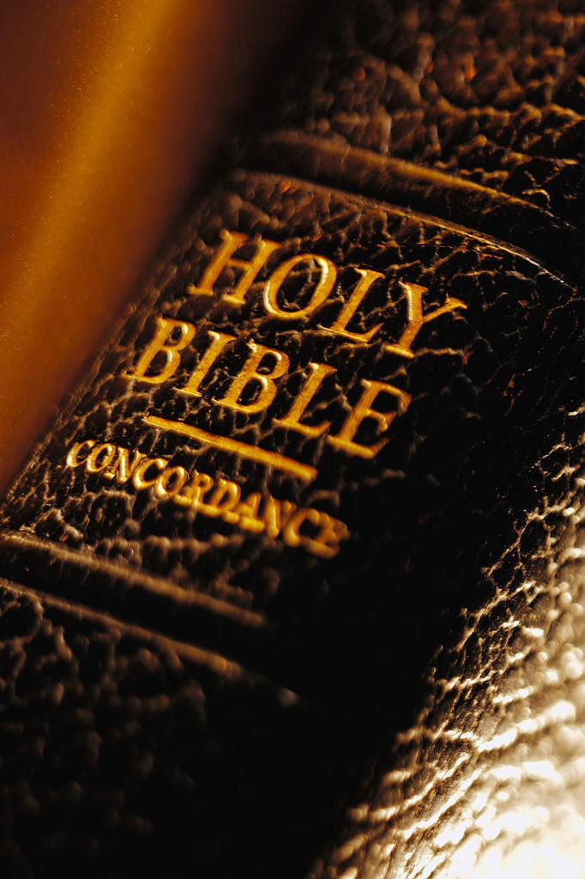
Conclusion
“Renewal” is a continual, daily process
We are seeking the “mind of Christ”
  Philippians 2:3-5
Strive to have our treasures in heaven!
  Matthew 6:21; Colossians 3:2
Richard Thetford www.thetfordcountry.com

