Slide 1
Religious But Not Righteous 2 Timothy 3:1-9
“Pure and undefiled religion before God and the Father is this: to visit orphans and widows in their trouble, and to keep oneself unspotted from the world” James 1:27
Richie Thetford www.thetfordcountry.com

Slide 2
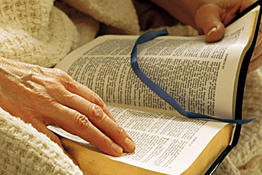
Inconsistency in Righteousness
Zeal without knowledge
Romans 10:1-3
Acts 18:24-26
Knowledge without zeal
Titus 1:16
Titus 2:14
Romans 12:11
Richie Thetford www.thetfordcountry.com

Slide 3
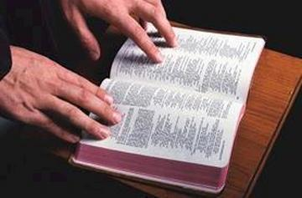
Inconsistency in Righteousness
Opposing divorce – but no happy home
Matthew 19:9
Colossians 3:18-19
Philippians 2:3-5
Richie Thetford www.thetfordcountry.com

Slide 4
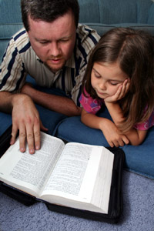
Inconsistency in Righteousness
Church membership, but a lack of dedication
Acts 2:47
Acts 9:26
Matthew 5:16
Philippians 2:15
Matthew 6:33
Richie Thetford www.thetfordcountry.com

Slide 5
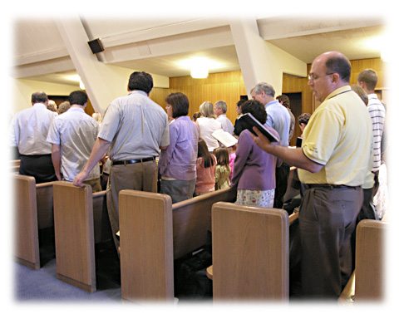
Inconsistency in Righteousness
Opposing the instrument of music, but refusing to sing
Ephesians 5:19
Colossians 3:16
1 Corinthians 14:15
Richie Thetford www.thetfordcountry.com

Slide 6
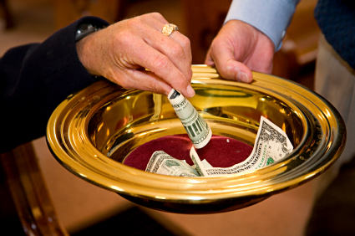
Inconsistency in Righteousness
Opposing fund raisers, but failing to give of our means
1 Corinthians 16:1-2
2 Corinthians 9:7
Richie Thetford www.thetfordcountry.com

Slide 7
Inconsistency in Righteousness
Conviction of what is right, yet making no effort to teach it
Acts 8:4
2 Timothy 2:2
Attending – but without pleasure
Hebrews 10:25
John 4:24
1 Corinthians 14:15
Richie Thetford www.thetfordcountry.com

Slide 8
Conclusion
We must ensure that we are both:
Religious and Righteous
“Finally, there is laid up for me the crown of righteousness, which the Lord, the righteous Judge, will give to me on that Day, and not to me only but also to all who have loved His appearing.”
2 Timothy 4:8
Richie Thetford www.thetfordcountry.com

