Slide 1
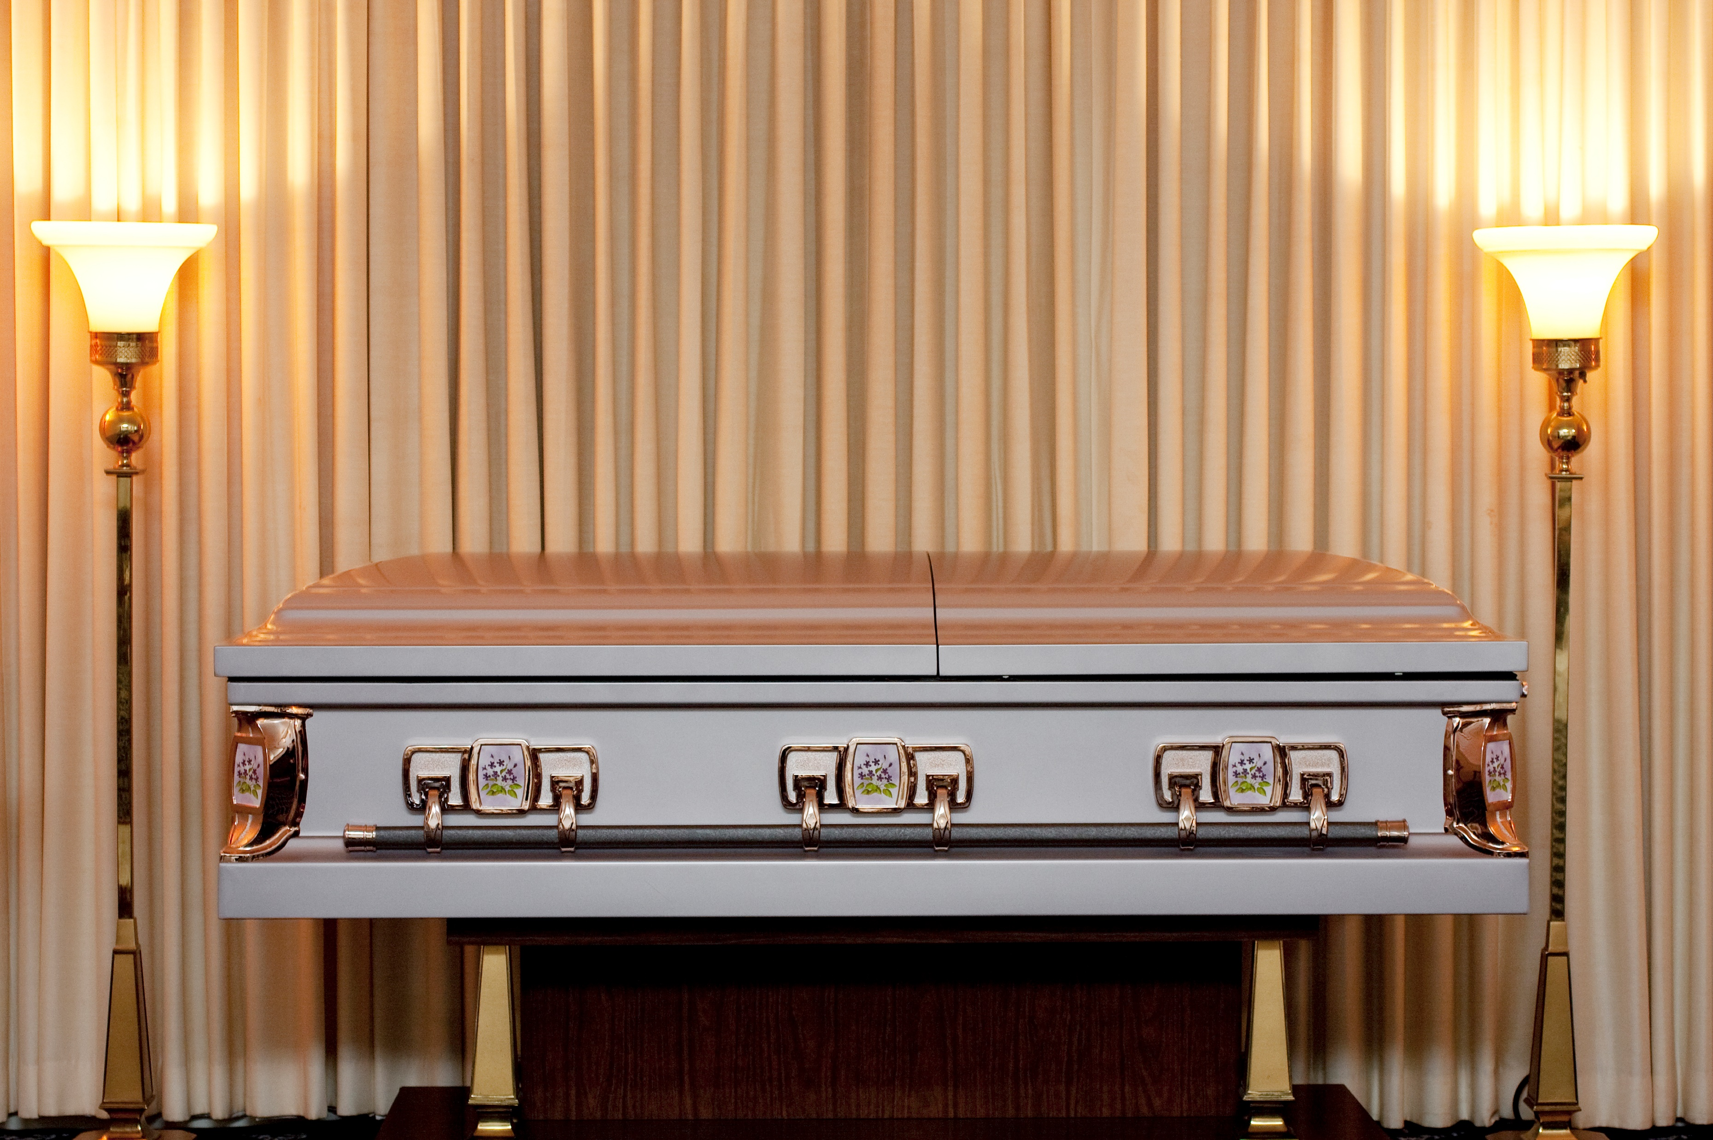
Reflecting on a Life Lived
Richie Thetford www.thetfordcountry.com

Slide 2

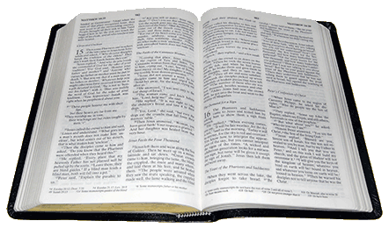
End of Life’s Journey
Psalms 90:9-10
James 4:13-14
Richie Thetford www.thetfordcountry.com

Slide 3
Scripture Fulfilled
Hebrews 9:27
1 Thessalonians 4:15
Richie Thetford www.thetfordcountry.com

Slide 4
End of Decision-Making
2 Corinthians 6:2
Hebrews 3:7-8, 15
Richie Thetford www.thetfordcountry.com

Slide 5
End of Our Earthly Work
Hebrews 11:4
Revelation 14:13
James 2:26
Richie Thetford www.thetfordcountry.com

Slide 6
End of A Family Relationship
Matthew 22:23-30
Romans 7:1-3
Richie Thetford www.thetfordcountry.com

Slide 7
Can’t Change Eternal Destiny
Luke 16:19-31
2 Corinthians 5:10
Romans 14:12
Mark 16:16
Revelation 2:10
Richie Thetford www.thetfordcountry.com

Slide 8
Ourselves in a Short Time
Ecclesiastes 7:2
Ecclesiastes 9:5
James 4:14
Richie Thetford www.thetfordcountry.com

Slide 9
Conclusion
Proverbs 27:1
Psalms 90:12
Matthew 6:33
1 Thessalonians 4:13-14
Richie Thetford www.thetfordcountry.com

Slide 10
Reflecting on a Life Lived
Death is not extinguishing the light from the Christian; it is putting out the lamp because the dawn has come.
(unknown source)
Richie Thetford www.thetfordcountry.com

