Slide 1
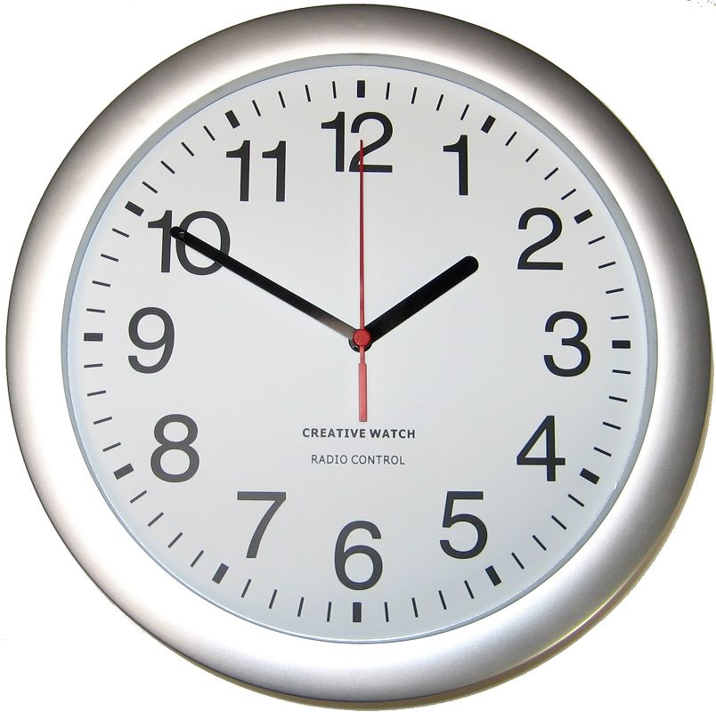
Redeeming the Time
Ephesians 5:15-17; Colossians 4:5
Richie Thetford www.thetfordcountry.com

Slide 2

The Proper Use of Our Possessions
We are stewards of property
  All we have comes from God
    James 1:17
  Christians look at everything
  in life from the viewpoint of
  God’s ownership and man’s
  responsibility
Richie Thetford www.thetfordcountry.com

Slide 3
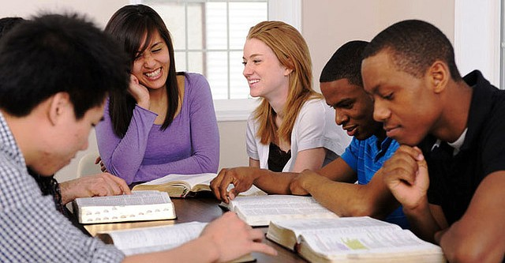
The Proper Use of Our Possessions
We are stewards of property
  Opportunities for “redeeming the time” with our property is temporary
    Luke 12:16-21
  All that we really have
  is that which we have
  given away
    Matthew 6:19-21
Richie Thetford www.thetfordcountry.com

Slide 4

The Proper Use of Life
Life is a trust – It can’t be purchased
Life is not ours to do as we please
  All possessions, powers and responsibilities
  are ours in trust
Life is ours for management
  1 Corinthians 6:20
We must give account of our life
  Romans 14:12
Richie Thetford www.thetfordcountry.com

Slide 5

The Proper Use of Opportunity
We are responsible for opportunities
  Opportunity knocks
  Opportunity must be anticipated
Take advantage of small
and great opportunities
  Often times big opportunities
  are reached by way of small
  opportunities
Richie Thetford www.thetfordcountry.com

Slide 6

The Proper Use of Our Knowledge
2 Corinthians 4:7
1 Thessalonians 2:4
Desire and pray for opportunities
and wisdom to make the
knowledge of God known
  Colossians 4:3-6
Responsibility is upon all of us
  Matthew 28:19-20
Richie Thetford www.thetfordcountry.com

Slide 7
Conclusion
Recognize our responsibility
Which would you rather be at
the judgment?
  The church at Jerusalem
    Acts 4:32
  The church at Laodicea
    Revelation 3:15-17
Redeem the Time!
Richie Thetford www.thetfordcountry.com

