Slide 1
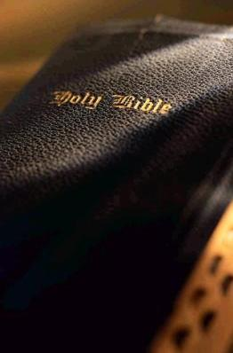
Receiving the “Implanted” Word
James 1:21-25
“Implanted” or “Engrafted” = a shoot or bud of one plant or tree inserted into the stem or trunk of another, where it grows permanently (Webster’s New World Dictionary)

Slide 2
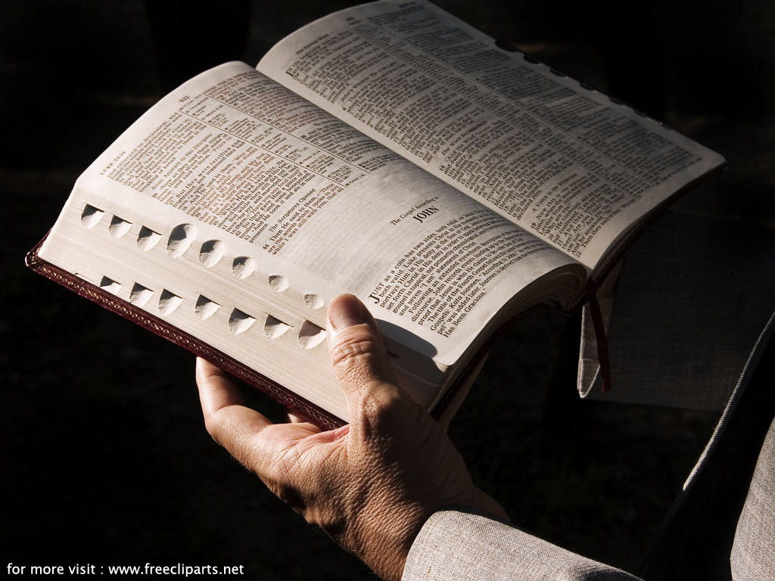
Receiving the Implanted Word
The Power of the Word of God
Able to save souls (1:21)

Slide 3
Receiving the Implanted Word
Power to save is found in its ability to:
Create Anew
1 Peter 1:22-25
James 1:18
Sanctify
Psalm 19:7-11
John 17:15-17
Preserve
Psalm 119:9,11
Acts 20:28-32

Slide 4
Receiving the Implanted Word
Benefiting from the Powerful Word
Things we must lay aside
Colossians 3:5-9
Have a proper attitude
Psalm 119:18
“Implanted” in our hearts
Matthew 15:8-9
Hebrews 8:6-13
Applied in our lives

Slide 5
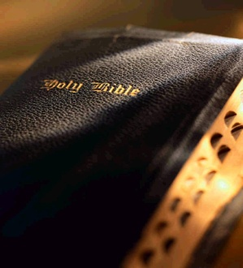
Receiving the Implanted Word
“perfect law of liberty”
Create Anew
Sanctify
Preserve
“And having been perfected, He became the author of eternal salvation to all who obey Him”
Hebrews 5:9

