Slide 1

The Rapture
What Does the Bible Say?
Richie Thetford www.thetfordcountry.com

Slide 2

What Does the Bible Say?
“The Rapture” nor that doctrine is
found in the Bible
Return of Christ will not be done in secret
  1 Thessalonians 4:16
  2 Peter 3:10
  Revelation 1:7
Richie Thetford www.thetfordcountry.com

Slide 3
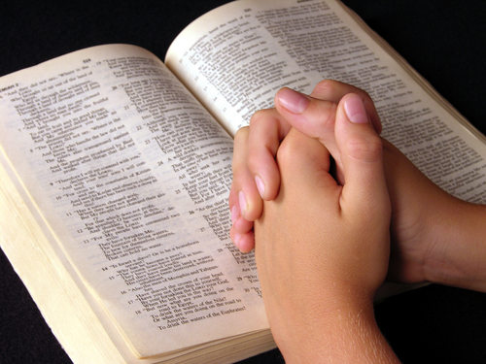
What Does the Bible Say?
Rapture theory based on a misinterpretation
  Matthew 24:1-3
  Matthew 24:34
Only one literal resurrection
  John 5:28-29
  Acts 24:15
Richie Thetford www.thetfordcountry.com

Slide 4
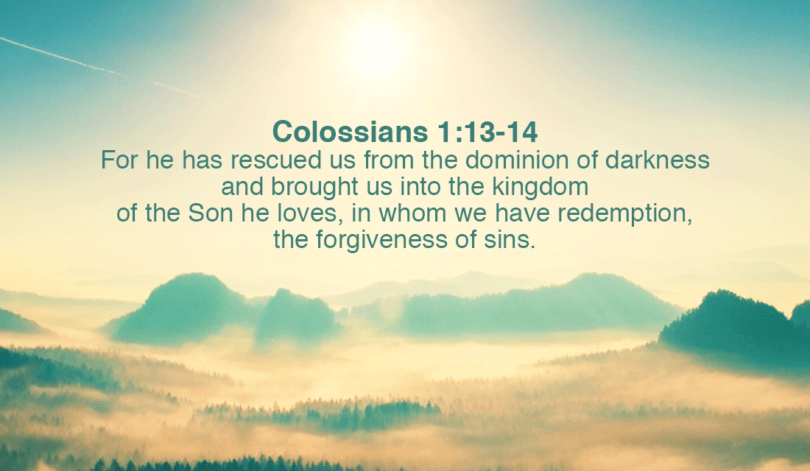
What Does the Bible Say?
Kingdom not established in the future
  John 18:36
  Matthew 16:18-19
  Revelation 1:9
  Colossians 1:13
  Hebrews 12:28
  Mark 9:1
Richie Thetford www.thetfordcountry.com

Slide 5

What Does the Bible Say?
Revelation is a symbolic book
  Revelation 20:1-7
Jesus Christ is reigning today. All people are either in His kingdom or they are not.
Only those in His kingdom and are faithful until death, will be able to live with Him in the eternal kingdom.
Richie Thetford www.thetfordcountry.com

