Slide 1
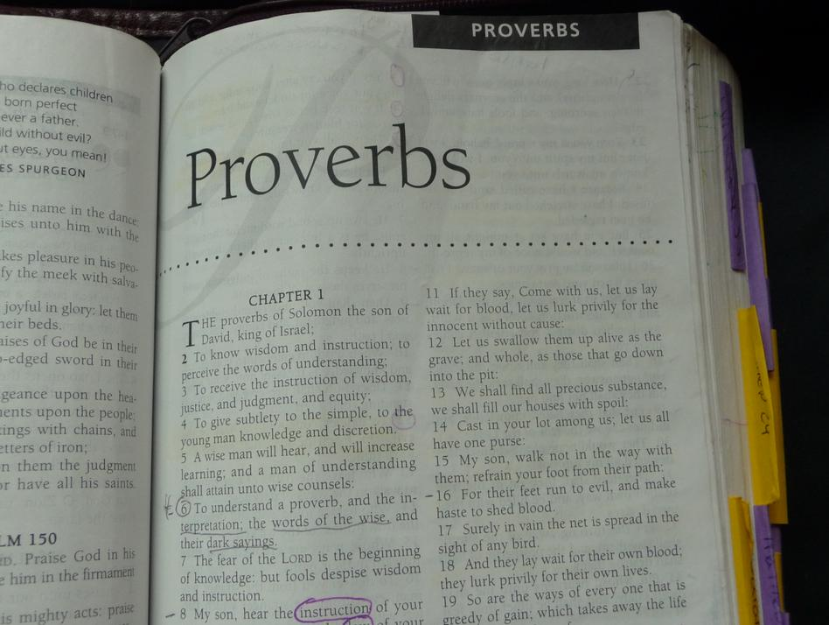
Putting the Proverbs to Use
Richard Thetford www.thetfordcountry.com

Slide 2

Facts on Proverbs
Proverb means “parallel” or “similar”
Proverb is “a description by way of comparisons”
A wise son heeds his father’s instruction, but a scoffer does
not listen to rebuke.”
Proverbs 13:1
Richard Thetford www.thetfordcountry.com

Slide 3
Facts on Proverbs
Proverbs is classified as “wisdom literature”
  A proverb is defined as “a short, self-evident statement”
“The fear of the LORD is the beginning of knowledge, but fools despise wisdom and instruction”
Proverbs 1:7
A catchy way of expressing a truth for remembrance
Richard Thetford www.thetfordcountry.com

Slide 4
Facts on Proverbs
Proverbs is a distinct philosophy of life
  Proverbs 1:10
Capsules of wisdom from those who knew the law of God
  Generally true, but not absolute in every case
“Train up a child in the way he
should go, and when he is old he
will not depart from it”
Proverbs 22:6
Richard Thetford www.thetfordcountry.com

Slide 5
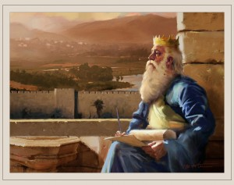
Facts on Proverbs
Book is made of many Proverbs
  Solomon’s
    Spoke 3,000 proverbs
      1 Kings 4:32
    Wisdom to speak was
    a direct gift from God
      1 Kings 4:29-31
Richard Thetford www.thetfordcountry.com

Slide 6
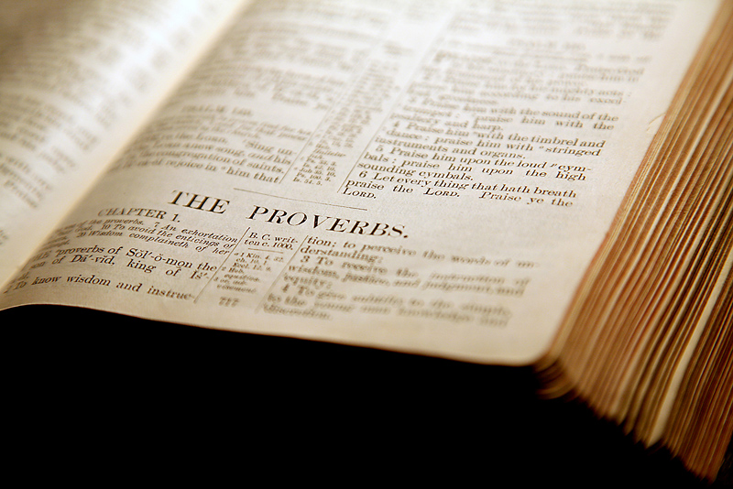
Facts on Proverbs
Book is made of many Proverbs
  Solomon’s
    His proverbs fall into two categories
      Those he personally arranged
        Chapters 1-24
      Those arranged by scribes
      of Hezekiah’s time
        Chapters 25-29
        Agur (c. 30)
        Lemuel (c. 31)
Richard Thetford www.thetfordcountry.com

Slide 7

Facts on Proverbs
Purpose of the Book
  To impart wisdom
    Proverbs 1:1-6
  “the best guide book of success a young man can follow”
  Key thought
    “the fear of the Lord” (14 times)
Richard Thetford www.thetfordcountry.com

Slide 8
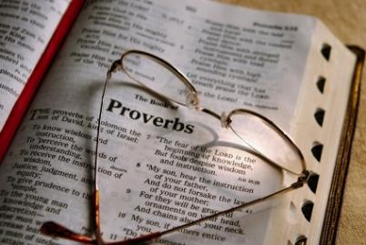
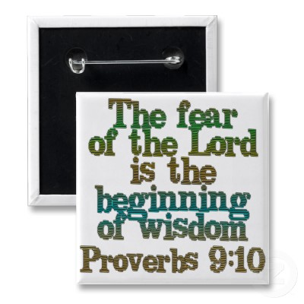
Facts on Proverbs
Theme of the book is “wisdom”
(104 times)
  Wisdom comes from God
    James 1:5
    Proverbs 9:10
Richard Thetford www.thetfordcountry.com

Slide 9

Facts on Proverbs
Theme of the book is “wisdom” (104 times)
  Three things needed to attain true wisdom:
    Available revelation from God
      Proverbs 2:6
    A seeking heart
      Proverbs 2:1-5
    A submissive life
      Psalms 119:100
Richard Thetford www.thetfordcountry.com

Slide 10
Facts on Proverbs
The Bible defines wisdom
in terms of one’s relationship
with God rather than one’s
formal education
The book of Proverbs shows the tremendous value of wisdom!
Richard Thetford www.thetfordcountry.com

