Slide 1
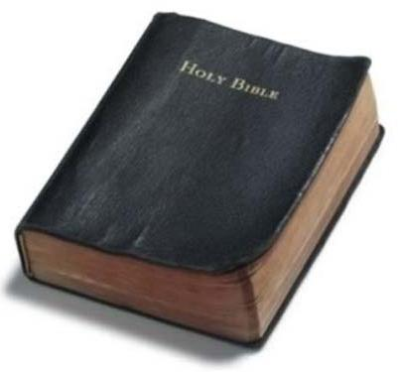
Prove All Things
“Test all things; hold fast what is good”
1 Thessalonians 5:21
Prove – Dokimazo “to try, to test, to prove, approve, after tested and tried, to show to be acceptable”
Other uses of the word:
1 John 4:1
1 Thessalonians 2:4
Philippians 1:9-10
Richard Thetford www.thetfordcountry.com

Slide 2
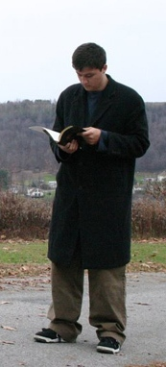
Prove Ourselves
Examine ourselves
2 Corinthians 13:5
1 Corinthians 14:37
Compare our life
1 Corinthians 11:28-29
Don’t serve our own purpose
1 Corinthians 11:19
Luke 17:1
2 Corinthians 10:18
Richard Thetford www.thetfordcountry.com

Slide 3
Prove the Sincerity of Our Love
Prove our love
2 Corinthians 8:8, 24
1 Corinthians 13:4-8
1 John 3:18
John 14:23
2 Timothy 2:15
James 1:12
Richard Thetford www.thetfordcountry.com

Slide 4
Prove the Good and Perfect Will of God
Prove God’s will by living it
Romans 12:2
Ephesians 5:8-10
Richard Thetford www.thetfordcountry.com

Slide 5
Prove Our Own Work
Cause for rejoicing
Galatians 6:4
Measure by Christ’s words and examples
2 Corinthians 10:12
Richard Thetford www.thetfordcountry.com

Slide 6
Must Be Proved to Be Acceptable
To God and men
Romans 14:16-18
Hebrews 3:9
1 Corinthians 10:11
Paul wrote to “prove” the Corinthians
2 Corinthians 2:9
Richard Thetford www.thetfordcountry.com

Slide 7
Conclusion
How will WE stand the test when we are tried?
“Blessed is the man who endures temptation; for when he has been approved, he will receive the crown of life which the Lord has promised to those who love Him.” James 1:12
Are we really showing ourselves to be proving our Christianity by our every action?
Richard Thetford www.thetfordcountry.com

