Slide 1
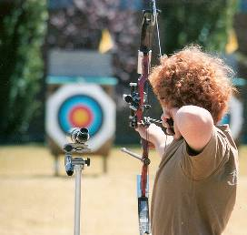
Pressing Toward the Goal
A marksman keeps his target in his sights; is not easily distracted
“Not that I have already attained, or am already perfected; but I press on, that I may lay hold of that for which Christ Jesus has also laid hold of me. Brethren, I do not count myself to have apprehended; but one thing I do, forgetting those things which are behind and reaching forward to those things which are ahead, I press toward the goal for the prize of the upward call of God in Christ Jesus.” Philippians 3:12-14

Slide 2
Have Faith in the Unseen
Unbelief is often why we fall short of our goals
Hebrews 3:18-19
Christian life and service is a walk of “faith”
2 Corinthians 5:7
Promises are “real” to us already
Romans 4:16-22
Our ultimate goal
Hebrews 11:8-10, 16

Slide 3
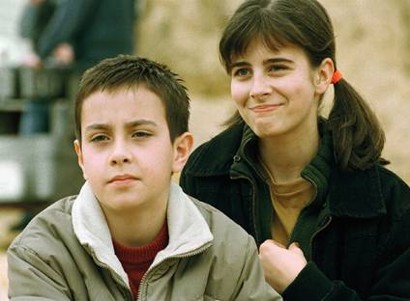
Exhibit Courage
Lack of courage can cost us our souls
Revelation 21:8
Cowardliness is the fruit of failure
Numbers 13:30-33
Reaching the end of our journey requires having courage to forge ahead – regardless of the dangers that have to be faced

Slide 4
Gain Will Power
Keep going when it would be easy to quit
Will is the whole man active. I cannot give up my will; I must exercise it. I must will to obey. When God gives a command or a vision of truth, it is never a question of what He will do, but what we will do. To be successful in God’s work is to fall in line with His will and to do it His way. All that is pleasing to Him is a success. ---- Henrietta Mears
We need determination and strength
Acts 20:22-24; 21:12-14

Slide 5
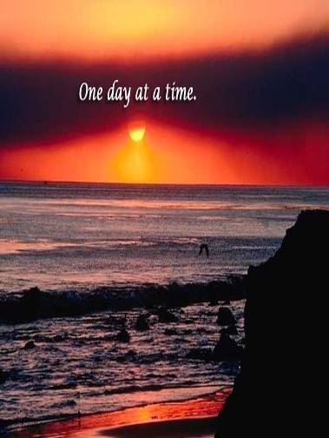
Shoulder One Day’s Burden
Don’t worry about tomorrow’s problems
Matthew 6:34
God took care of the Israelites “one day at a time”
Deuteronomy 8:3
We don’t know what will happen tomorrow

Slide 6
Learn to Have Self-Respect
Upon our confession we made a promise to be faithful to Him
Should be a sincere commitment
We should feel hurt when we are faithless
Faithfulness meant much to the apostle Paul
2 Timothy 4:7
There is great joy in knowing that we have kept our commitments!

Slide 7
Conclusion
We are exhorted to learn from the Israelites
Hebrews 4:11
“Therefore we also, since we are surrounded by so great a cloud of witnesses, let us lay aside every weight, and the sin which so easily ensnares us, and let us run with endurance the race that is set before us, looking unto Jesus, the author and finisher of our faith, who for the joy that was set before Him endured the cross, despising the shame, and has sat down at the right hand of the throne of God.” Hebrews 12:1-2

