Slide 1
Preparing to Enter the “Promised Land”
Joshua 1:6-15
Richie Thetford www.thetfordcountry.com

Slide 2
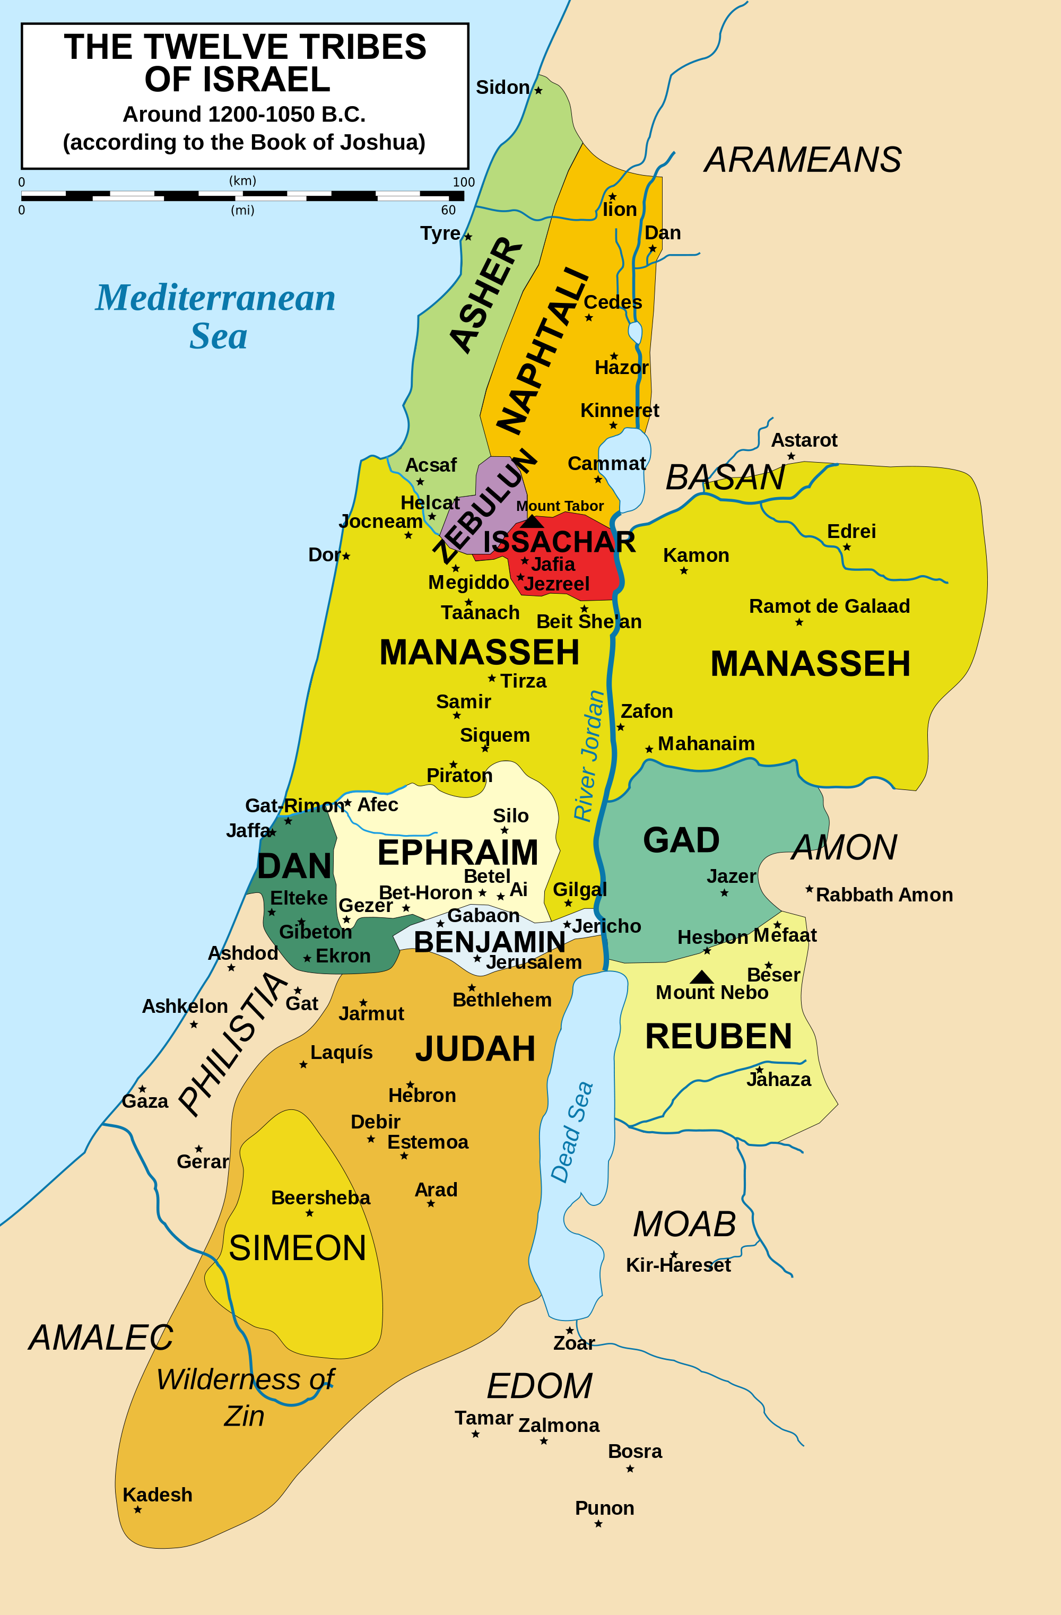
Close Enough
Nearing the border of Canaan
Numbers 32:1-25
Moses upset at their request
Joshua reminds them of their request
Why did they not go into Canaan?
Joshua 22:1-4
Richie Thetford www.thetfordcountry.com

Slide 3
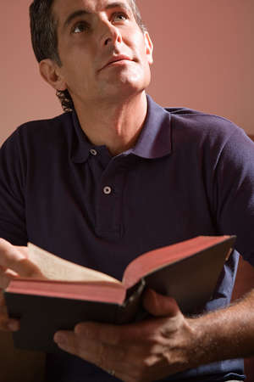
Christians on a Journey to Heaven
Not on an earth-bound journey
Life is compared to a race
1 Corinthians 9:24-27
Hebrews 12:2
2 Timothy 4:6-8
Richie Thetford www.thetfordcountry.com

Slide 4
Christians on a Journey to Heaven
Don’t quit at “close enough”
2 Corinthians 4:16-18
Hebrews 10:35-39
Galatians 6:9
What could keep us from quitting?
Matthew 16:26
1 Timothy 6:10
2 Timothy 4:10
“Close enough” will not get us there
Richie Thetford www.thetfordcountry.com

Slide 5
Conclusion
Stay on course
Matthew 7:13-14
Endure to the end of life
Matthew 10:22; Hebrews 3:6
James 1:12
We are “strangers and pilgrims”
1 Peter 2:11
Remain faithful
Revelation 2:10; Romans 2:7-11
Richie Thetford www.thetfordcountry.com

