Slide 1
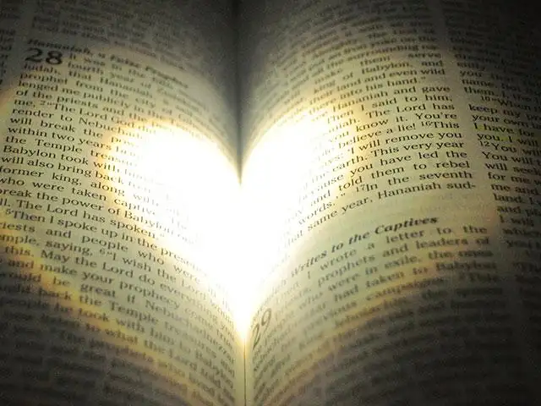
Preparing Our
HEART
Ezra 7:10
“to seek the law of the Lord”
Richie Thetford www.thetfordcountry.com

Slide 2
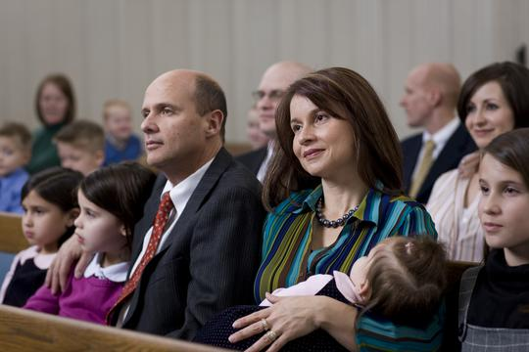
Preparing Our Heart
Preparing Our Heart
We have to prepare our heart!
to Seek the Law of the Lord
Children are instructed
Ecclesiastes 12:1
Parents are instructed
Ephesians 6:4
Richie Thetford www.thetfordcountry.com

Slide 3
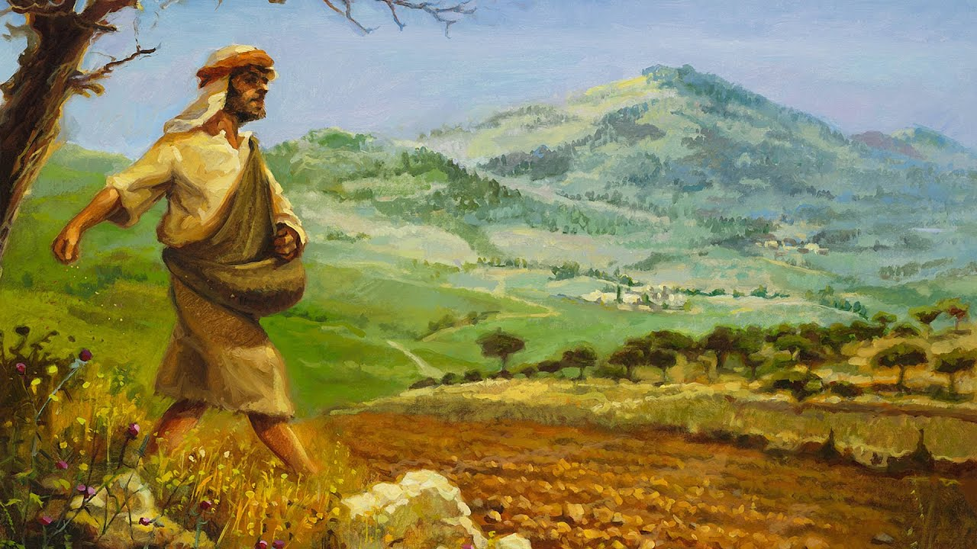
Preparing Our Heart
Preparing Our Heart
How Does One Prepare His Heart?
to Seek the Law of the Lord
Recognize that the heart is as “soil” that needs to be prepared for the planting of the seed
Matthew 13:3-9, 18-23
Richie Thetford www.thetfordcountry.com

Slide 4
Preparing Our Heart
Preparing Our Heart
How Does One Prepare His Heart?
to Seek the Law of the Lord
By not involving ourselves in materialism and immorality
2 Timothy 3:13;
2 Thessalonians 2:10-12
No Love of Truth
Richie Thetford www.thetfordcountry.com

Slide 5
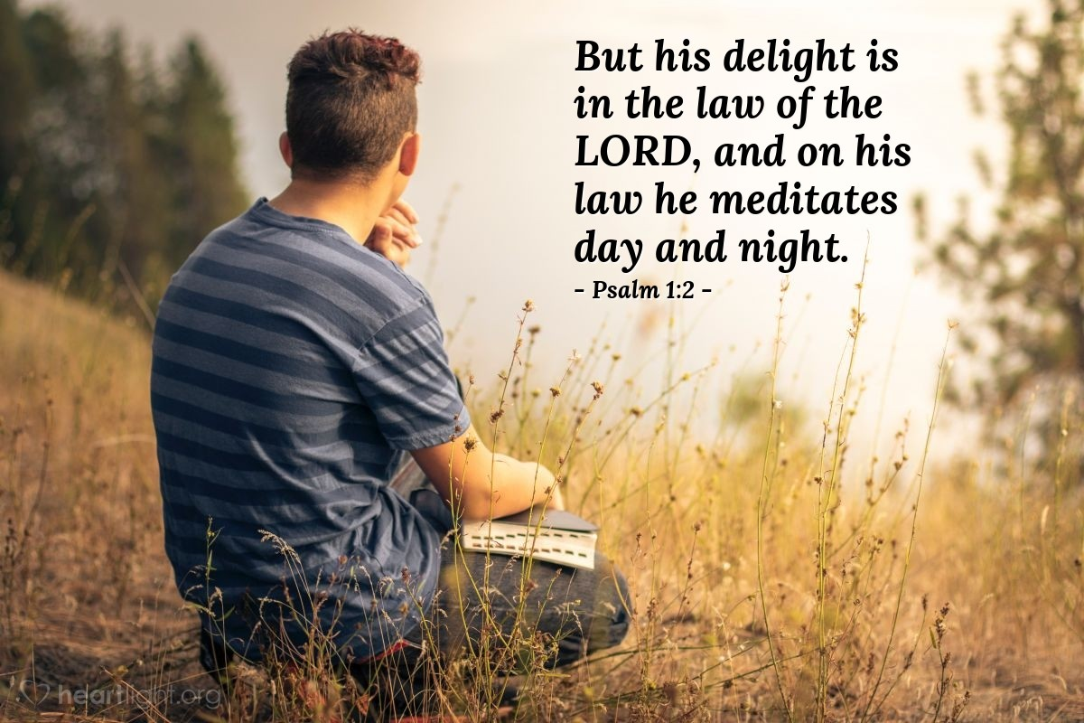
Preparing Our Heart
Preparing Our Heart
How Does One Prepare His Heart?
to Seek the Law of the Lord
Develop a delight in the law of the Lord by meditating on it day and night
Psalms 1:2; Philippians 4:8;
Proverbs 4:23
Richie Thetford www.thetfordcountry.com

Slide 6
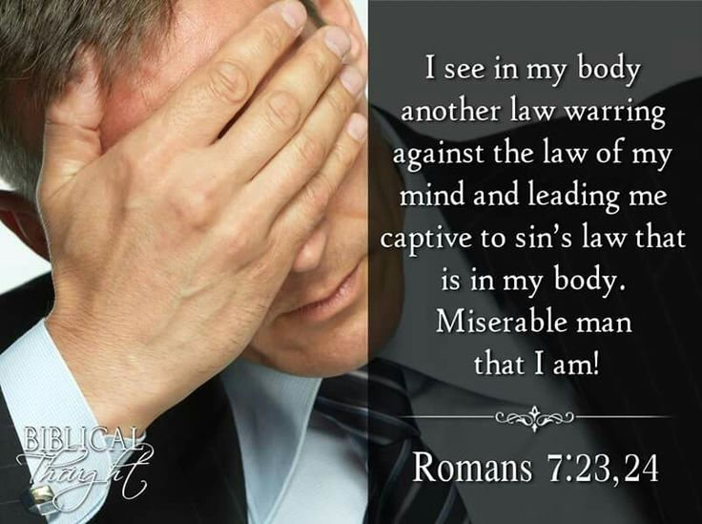
Preparing Our Heart
Preparing Our Heart
How Does One Prepare His Heart?
to Seek the Law of the Lord
Recognizing there is a “warring” going on between the spiritual man and the physical man within
Romans 7:22-23; 8:5-9;
Galatians 5:22-23
Richie Thetford www.thetfordcountry.com

Slide 7
Preparing Our Heart
To Seek the Law of the Lord
To Seek the Law of the Lord
Means to Study!
to Seek the Law of the Lord
The idea of being “diligent” in the seeking process
2 Timothy 2:15; Matthew 7:7; Hebrews 11:6
If we seek -- we will find!
Richie Thetford www.thetfordcountry.com

Slide 8
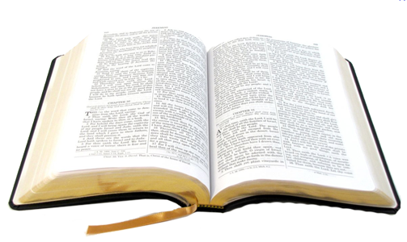
Preparing Our Heart
To Do It
Must Be Willing “to do” the Will of God
to Seek the Law of the Lord
Needed corrections must be made in our life
Matthew 7:21-27; James 1:22-25
“If you know these things, blessed are you if you do them.”
John 13:17
Richie Thetford www.thetfordcountry.com

Slide 9
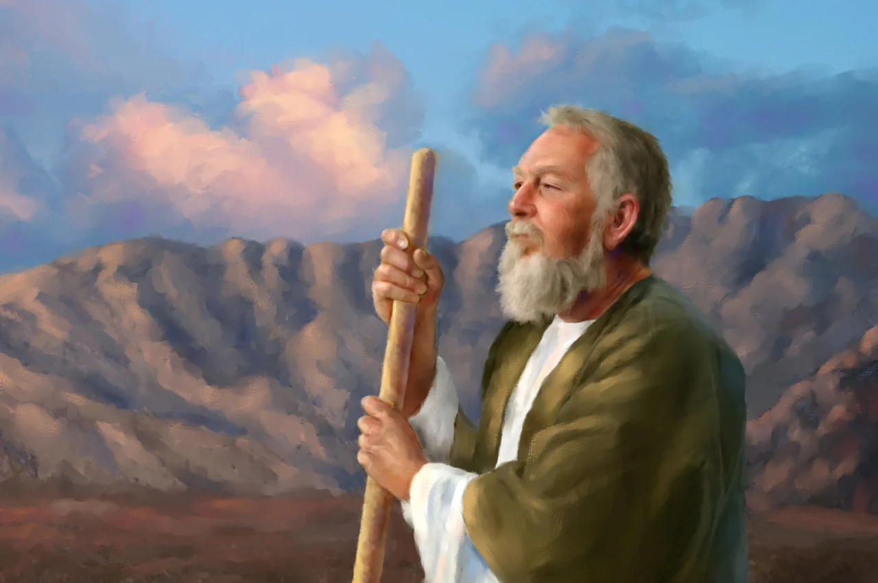
Preparing Our Heart
To Teach It
Like Ezra, We Must Be Involved in “Teaching It”
to Seek the Law of the Lord
Ezra 7:11, 25
Nehemiah 8:1-8
We must prepare to teach it and ensure that we are living it
Hebrews 5:12-14;
2 Timothy 2:2;
Ephesians 3:3-5
Richie Thetford www.thetfordcountry.com

Slide 10
“For Ezra had prepared his heart to seek the Law of the LORD, and to do it, and to teach statutes and ordinances in Israel.”
Ezra 7:10
If Your Heart Is Ready
Your reward will be worth all the effort you put into preparing your heart to “seek the Law of the Lord”
Richie Thetford www.thetfordcountry.com

