Slide 1


Precious Mothers
Proverbs 31:30
Richie Thetford www.thetfordcountry.com

Slide 2


Mama is the LAW!
Proverbs 1:8
Proverbs 6:20-21
Proverbs 29:15
Mother’s Work
Mother’s Value
Mother’s Reward
Richie Thetford www.thetfordcountry.com

Slide 3

Mother’s Work
Wisdom
Stature
  1 Samuel 2:19
Favor with God
  Knowledge of God and His law
Favor with men
Richie Thetford www.thetfordcountry.com

Slide 4

Mother’s Value
God-designed
  Genesis 3:20
Devotion and sacrifice
  John 19:25
Always remembered
  Acts 9:39
An example and persistent
Richie Thetford www.thetfordcountry.com

Slide 5

Mother’s Reward
Great worth
  Luke 2:41-51
Children are of God
  Proverbs 19:26; 23:22-25
Appreciated
  Proverbs 15:20; 31:28
“Well done”
Richie Thetford www.thetfordcountry.com

Slide 6



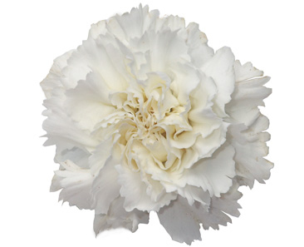
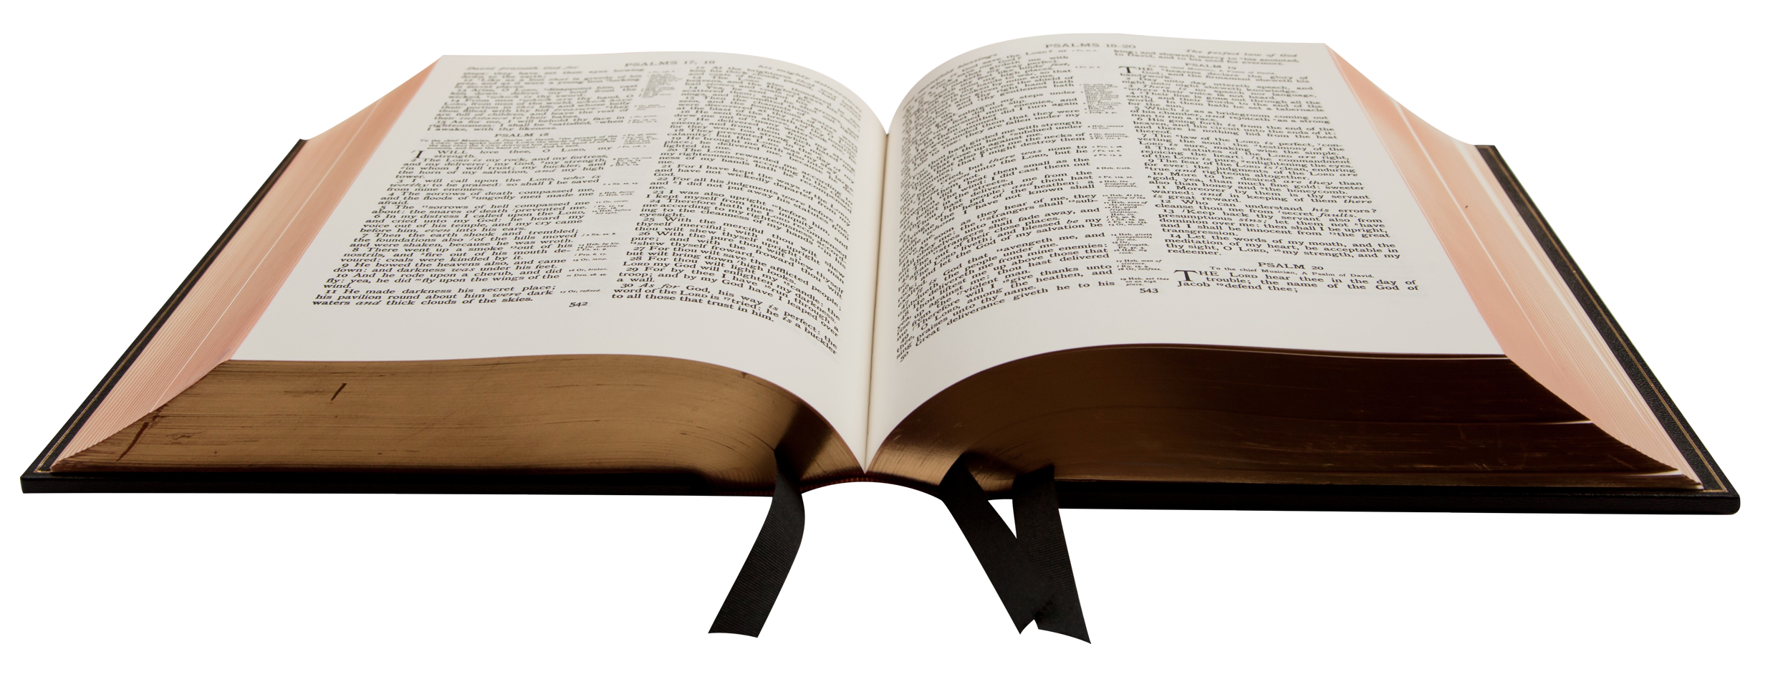
Christians are to be thankful
To God for providing for us
To Christ for dying for us
To moms for living for us
Richie Thetford www.thetfordcountry.com

