Slide 1
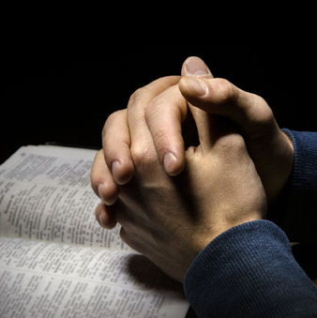
Prayer
Matthew 6:9-13
Luke 11:1
Richie Thetford www.thetfordcountry.com

Slide 2
Introduction
What is prayer?
A spiritual communion with God
Richie Thetford www.thetfordcountry.com

Slide 3
Prayer
Prayer Includes:
Praise
Matthew 6:9
Thanks
Ephesians 5:20
1 Thessalonians 5:17-18
Confession of sins
1 John 1:9
Acts 8:22
Richie Thetford www.thetfordcountry.com

Slide 4
Prayer
Prayer Includes:
Supplication
Luke 22:40-44
Intercession
Romans 15:30-31
Luke 23:34
Richie Thetford www.thetfordcountry.com

Slide 5
Prayer
God’s will concerning prayer:
Pray continuously
Luke 18:1-7
1 Timothy 2:1-2, 8
Richie Thetford www.thetfordcountry.com

Slide 6
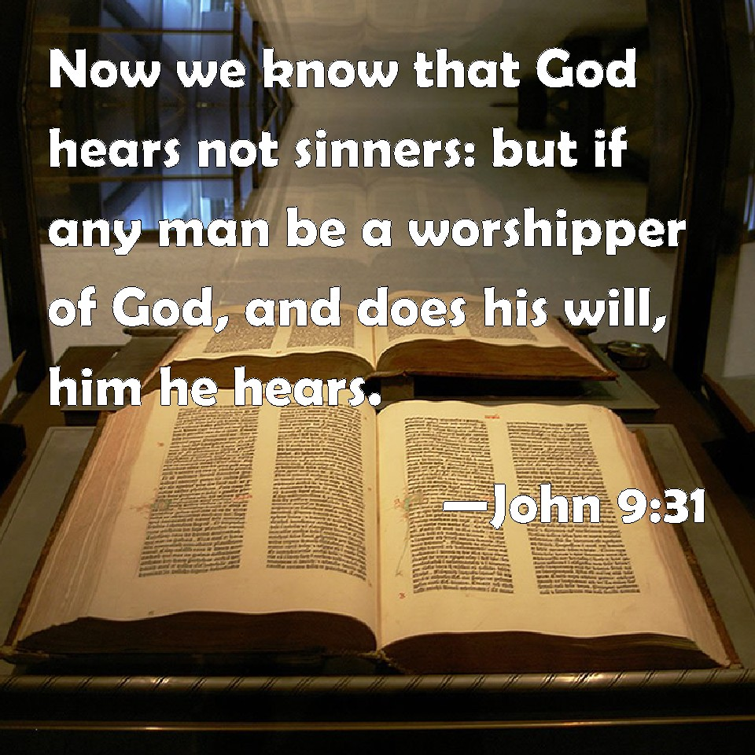
Whose Prayer Will God Not Hear?
Those who turn away
Proverbs 28:9
Wickedness in heart
Psalms 66:18
Those who are proud
Job 35:12
Sinners
John 9:31
Richie Thetford www.thetfordcountry.com

Slide 7
Whose Prayer Will God Not Hear?
Willful, impenitent sinners do NOT have God’s ear
Proverbs 28:9
Psalms 66:18-19; 109:7
Job 27:8-9; 35:13
Isaiah 1:11-15
John 16:23-27
1 John 3:21-22
Richie Thetford www.thetfordcountry.com

Slide 8
Whose Prayer Will God Hear?
Those who worship Him
John 9:31
The humble
Psalms 9:12
The righteous
1 Peter 3:12
Those who keep His commandments
1 John 3:22
Richie Thetford www.thetfordcountry.com

Slide 9
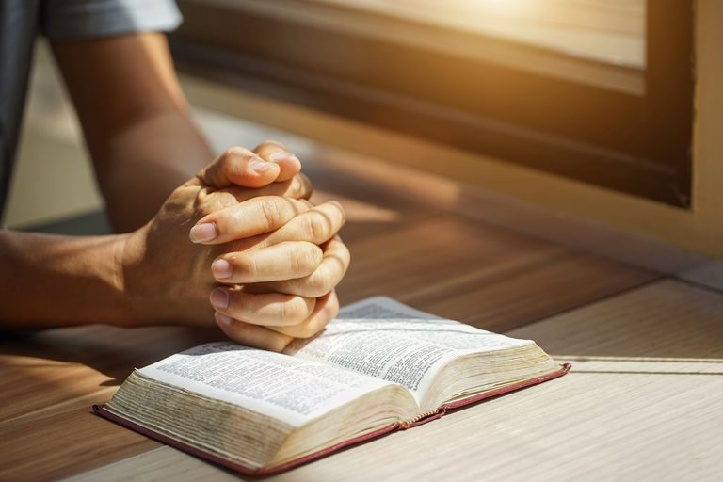
How Then Shall We Pray?
In faith
James 1:6
In harmony with God’s will
1 John 5:14
In the name of Christ
Colossians 3:17
In the spirit of sincerity
Matthew 6:5
Richie Thetford www.thetfordcountry.com

Slide 10
“Unanswered” Prayers?
Pray for health
Must obey laws of health
Pray for the sick
Must help them get well
Pray for the bereaved
Must comfort them
Pray for wisdom
Must seek knowledge through study
Richie Thetford www.thetfordcountry.com

Slide 11
“Unanswered” Prayers?
Pray for spiritual growth
Must take spiritual food
Pray for salvation of sinners
Must seek and study with them
Pray for unity of the church
Must work for unity
Pray for church growth
Must be a faithful member
Richie Thetford www.thetfordcountry.com

Slide 12
PRAYER
Remember to pray for all things
Only those abiding in God’s will are heard by God
Jesus died for us!
All prayers go through Jesus to our Father
Richie Thetford www.thetfordcountry.com

